Slide 1
The Palestine Mandate
and the Birth of the State of Israel
Part II

Slide 2
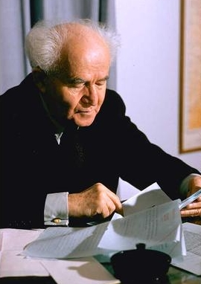
“We shall fight with Great Britain in this war [WWII] as if there was no White Paper, and shall fight the White Paper as if there was no war.” David Ben-Gurion (1889-1973)

Slide 3
Yishuv responded to WWII with conflicting stances, committing itself to British efforts against Germany while planning to subvert the British White Paper of 1939

Slide 4
Biltmore Program:
Set of resolutions adopted at a meeting of
U.S. Zionists in 1942
calling for open immigration to Palestine and
the establishment there of a Jewish commonwealth

Slide 5
In the wake of WWII, many American Jews became ardent supporters of a Jewish state in Palestine

Slide 6
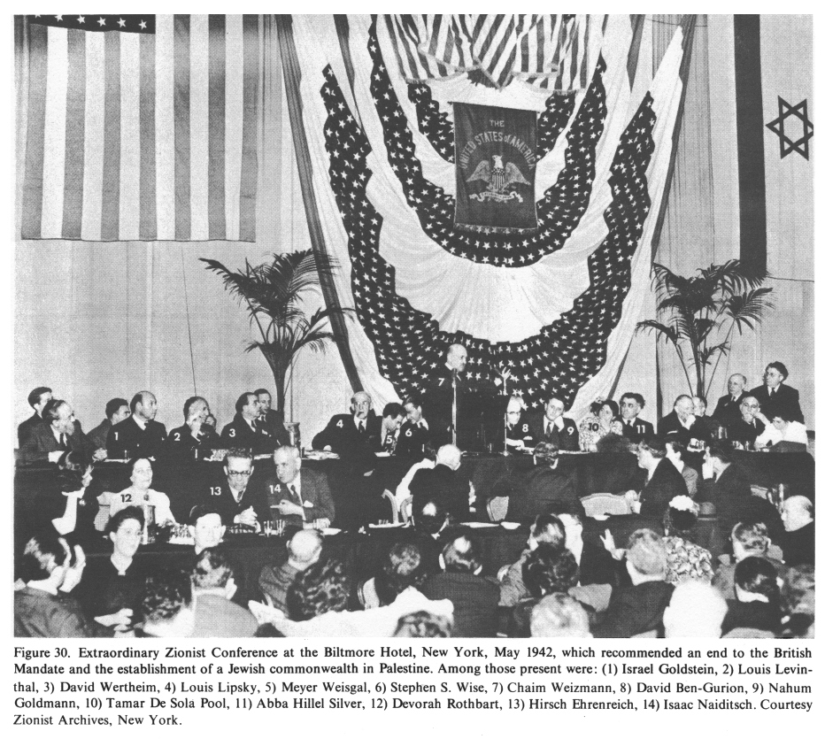
Biltmore Program: Set of resolutions adopted at a meeting of US Zionists in 1942 calling for open immigration to Palestine and the establishment there of a Jewish commonwealth
In the wake of the Holocaust, many American Jews became ardent supporters of a Jewish state in Palestine

Slide 7
Terror and Inter-communal War
Three (3) phases of the conflict
that brought the state of Israel into being
and confirmed its existence:
  1. The Yishuv’s campaign of sabotage against the British administration in Palestine from 1945-1947

Slide 8
Terror and Inter-communal War
  2. The brief intercommunal war between the Arab and Jewish communities of Palestine in 1947-48
    February 1947: Britain lost control of the region, referred to the UN
    UNSCOP (UN Special Committee on Palestine) report:
    Jews are 30% of the population & hold 6% of the land
    Termination of the mandate & independence (partition option)

Slide 9
Terror and Inter-communal War
    Jews accepted it – Arabs rejected it
    (Arab League, in the absence of a “Palestinian authority” rejected all attempts at compromise)
    29 Nov. 1947 UN vote: Partition of Palestine / international status of Jerusalem

Slide 10
Terror and Inter-communal War
  Britain announced the termination of the mandate on May 15, 1948

Slide 11
Terror and Inter-communal War
  3. The 1948 war between Israel
  and the invading forces of the Arab states

Slide 12
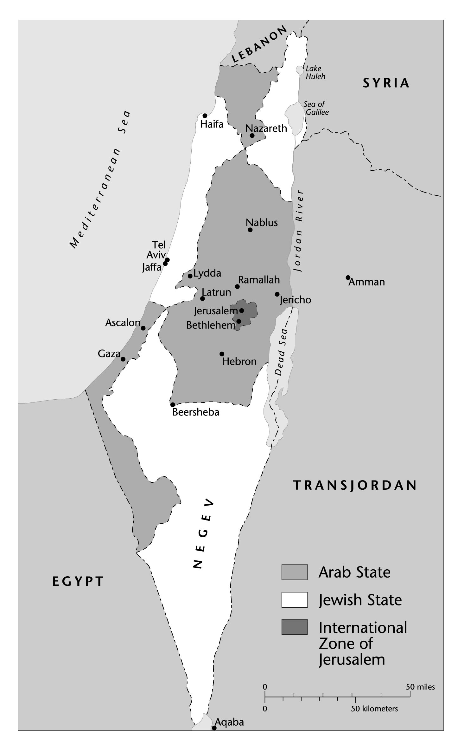
The UN Proposal for the Partition of Palestine, 1947

Slide 13
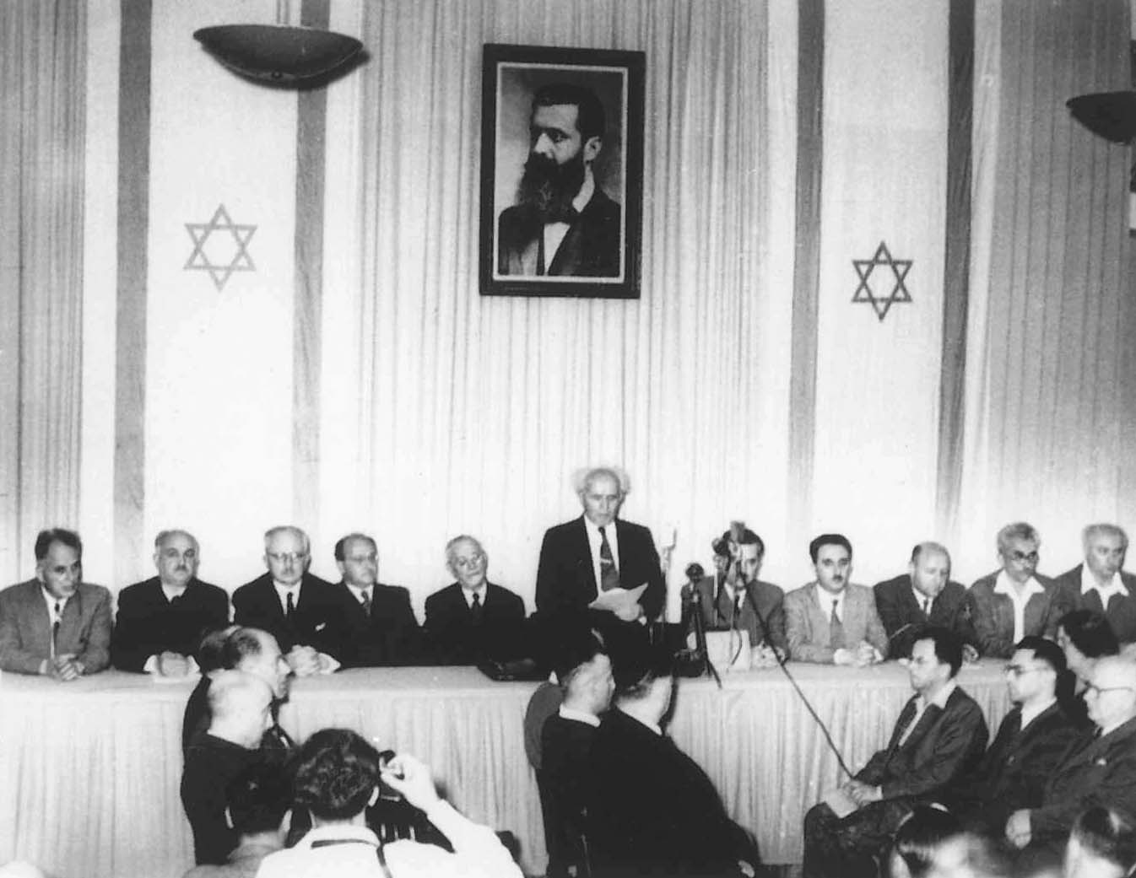
David Ben-Gurion announcing Israeli independence, May 14, 1948
Ben-Gurion announces the independence of the state of Israel. The portrait looming over the proceedings is of Theodor Herzl, the founder of the political Zionist movement and author of The Jewish State. (AP/World Wide Photos)

Slide 14
The First Arab-Israeli War
May 15, 1948
  Army units from Egypt, Syria, Lebanon, Transjordan, and Iraq invaded
  Inter-Arab political rivalries led to a lack of coordination on the battlefield
  Arab forces were overall poorly equipped and outnumbered.

Slide 15
The First Arab-Israeli War
  Ben Gurion led the Haganah, motivated by the belief that they were engaged in a life-and-death struggle for the very existence of a Jewish state.

Slide 16
The First Arab-Israeli War
  The vast majority of the Arab population in the territory that became Israel— over 700,000 people— had become refugees.

Slide 17
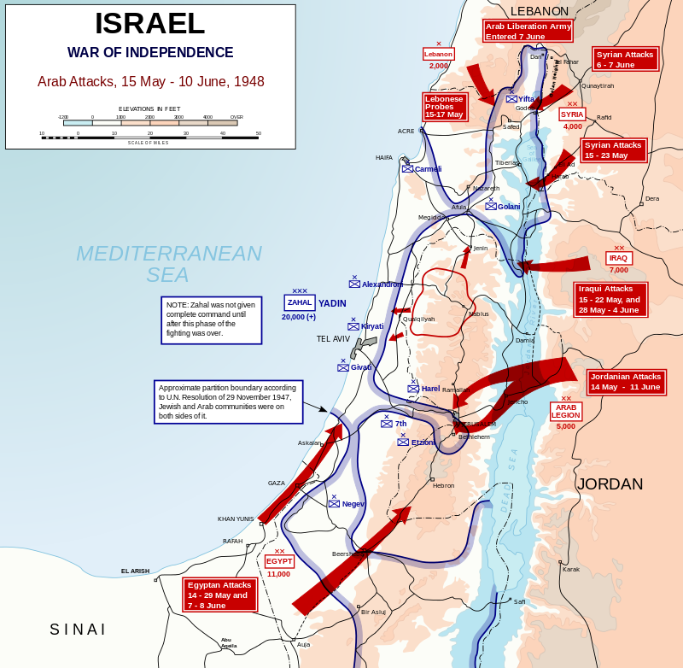

Slide 18
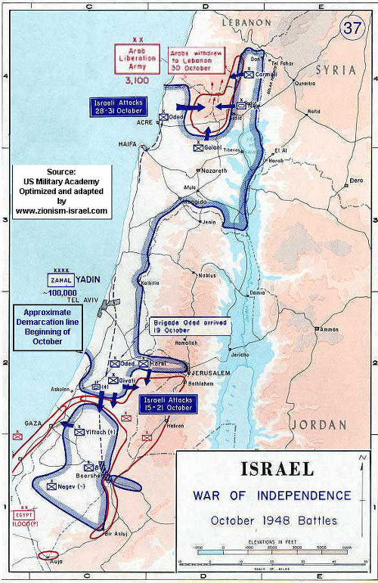

Slide 19
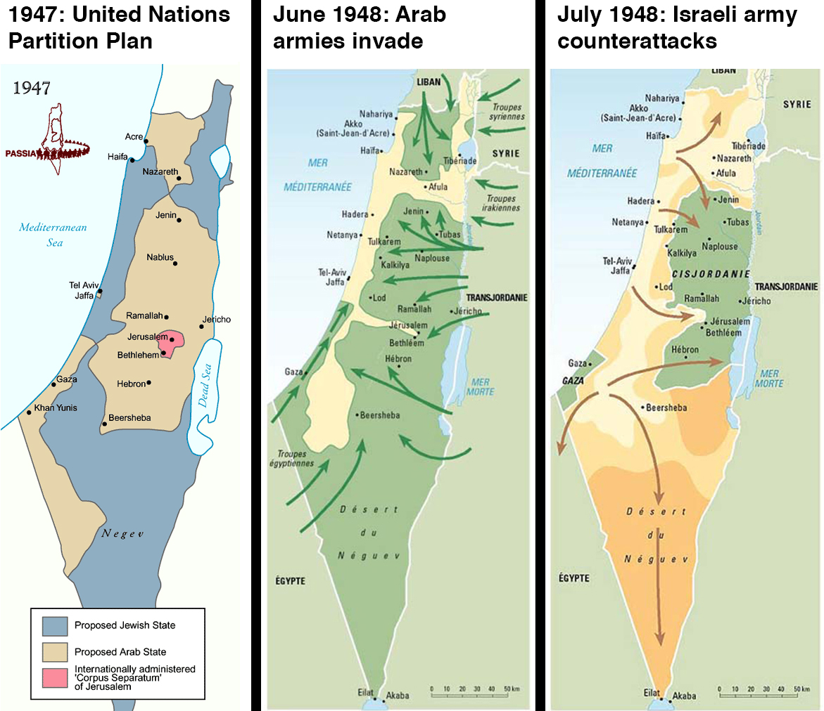

Slide 20
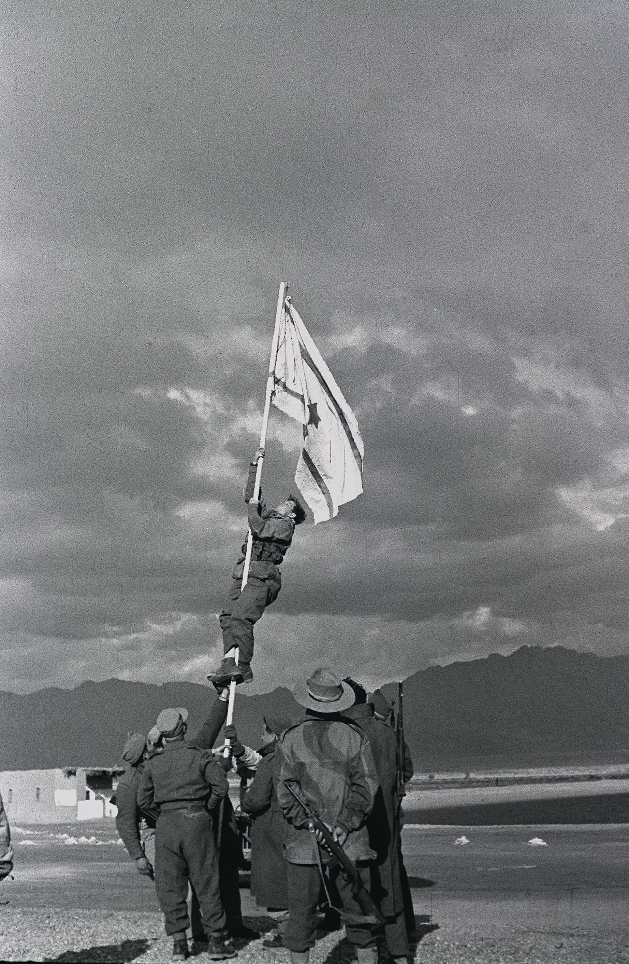
Captain Avraham "Bren" Adan raising the flag at Umm Rashrash (a site now in Eilat),
marking the end of the war

Slide 21
The First Arab-Israeli War
April 1948
  The Haganah authorized Plan D, to undertake the systematic expulsion of the Palestinian Arabs
  Israeli officers took the opportunity to ensure a contiguous and homogenous Jewish state with a solid Jewish majority

Slide 22
The First Arab-Israeli War
The 1948 war → the defeat of Arab forces; the enlargement of Israeli territory; and collapse of the UN proposal for a Palestinian Arab state
By 1949, there remained only 160,000 Arabs within the borders of Israel.

Slide 23
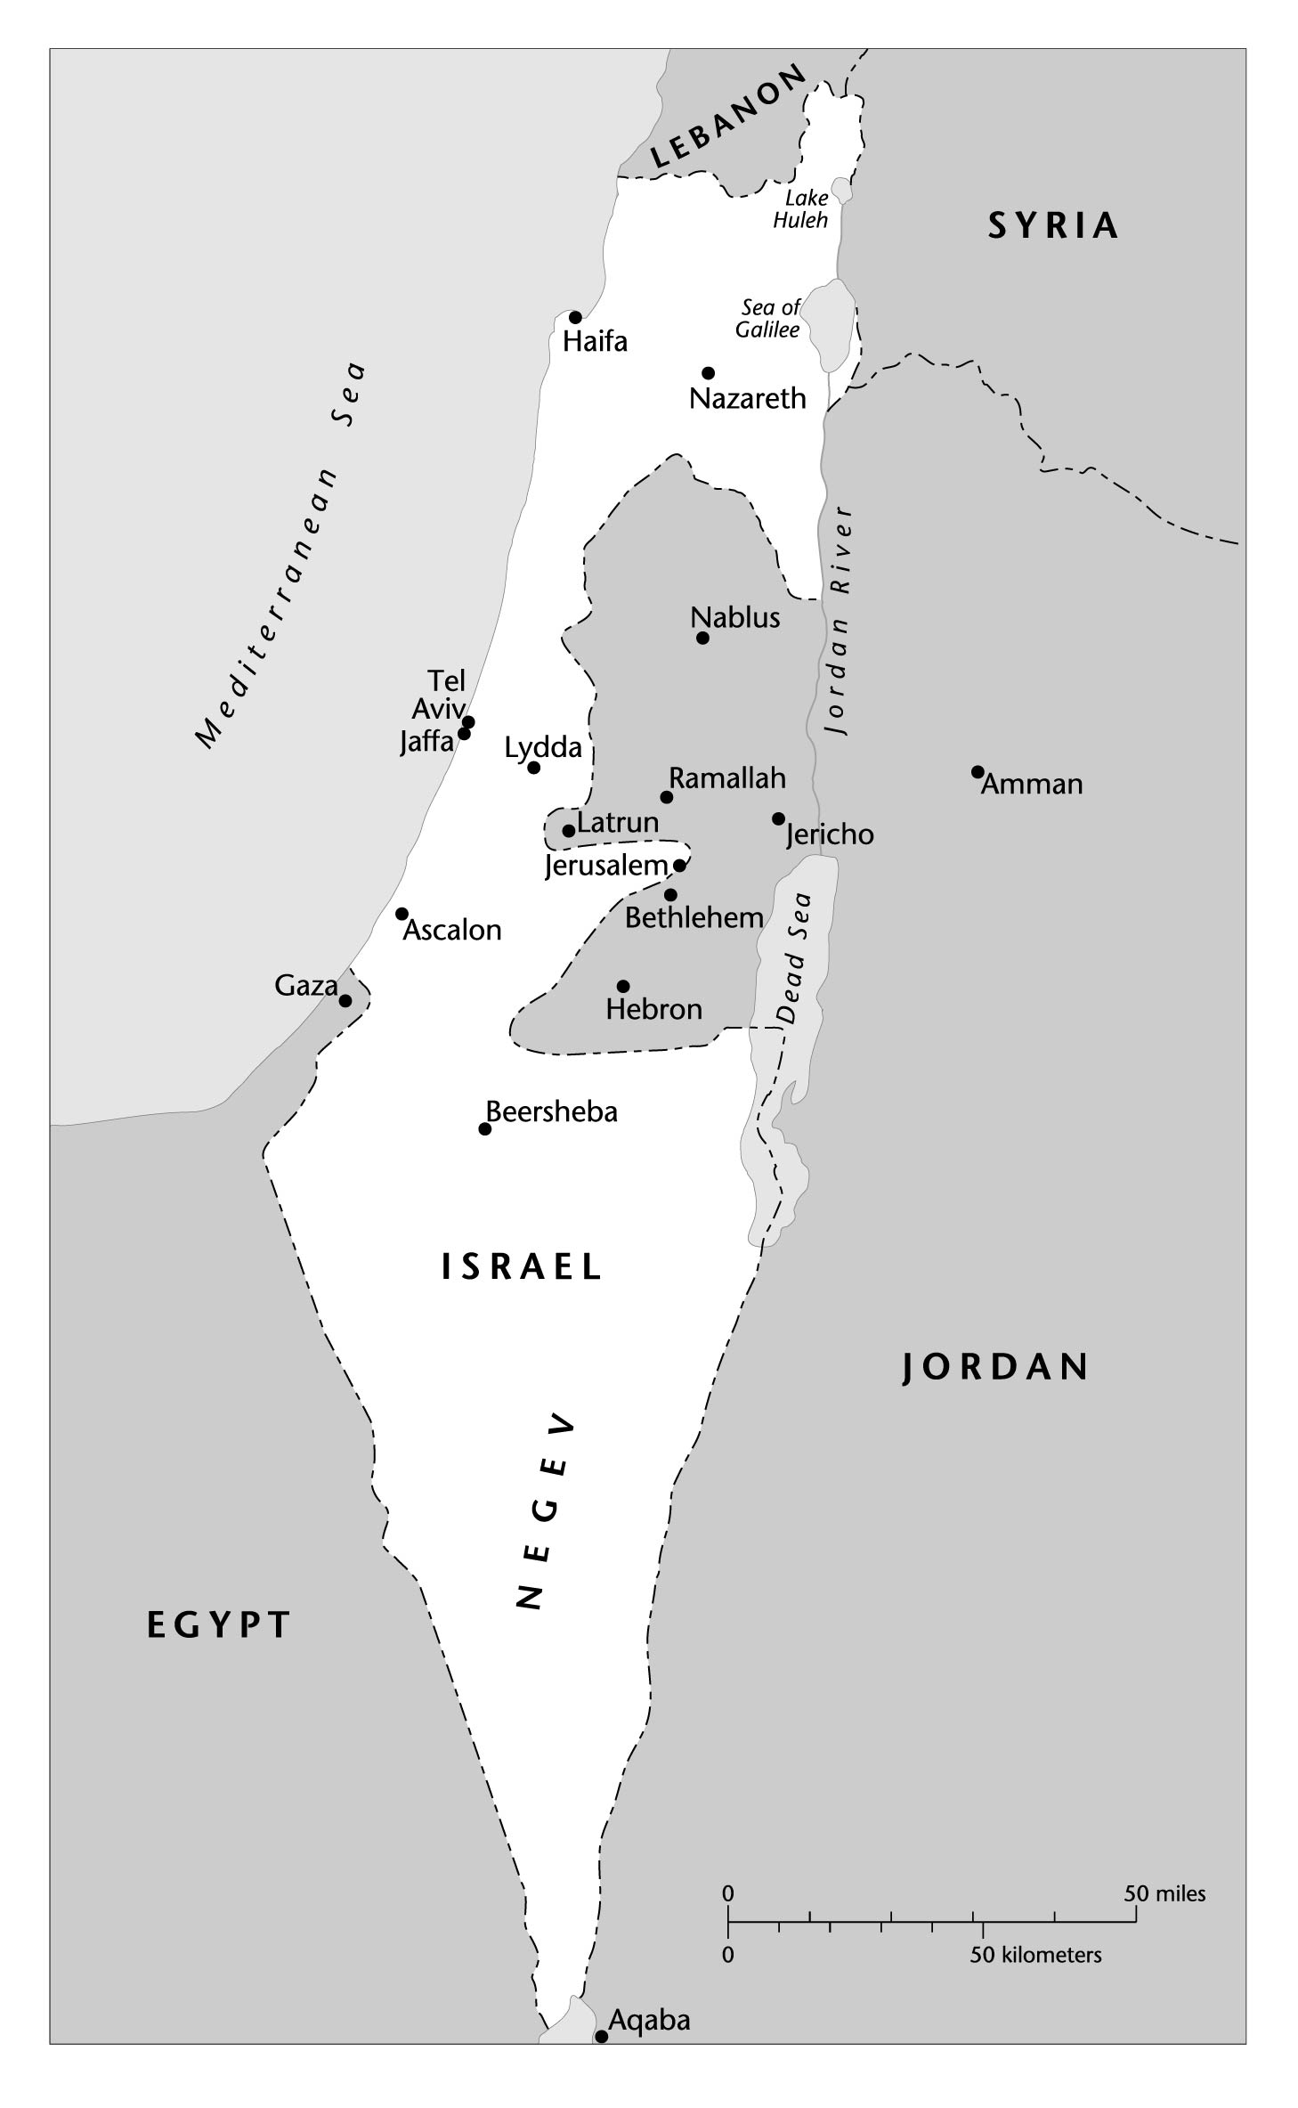
The Arab-Israeli Armistice Lines, 1949

