Slide 1
Challenges to the Existing Order: The Middle East in the 1990s and 2000s

Slide 2
US Policy in the Middle East
3 pillars of U.S. cold war policy in the Middle East:
Containing Soviet ambitions
Ensuring the security and prosperity of Israel
Securing access to petroleum resources
After Gulf War (1991), America unrivaled as superpower in the region
President George W. Bush: Post 9/11 environment
Military engagement
Invasion and regime change in Iraq
“War on terrorism”
President Obama: Arab Uprisings environment
Preference for diplomacy
Resolved tensions with Iran
Dealing with the consequences of the Iraq invasion
President Trump: Fighting ISIS environment
Theory of “Off-shore Balancing”
Combating Islamic Extremism
Finding a new regional security architecture

Slide 3
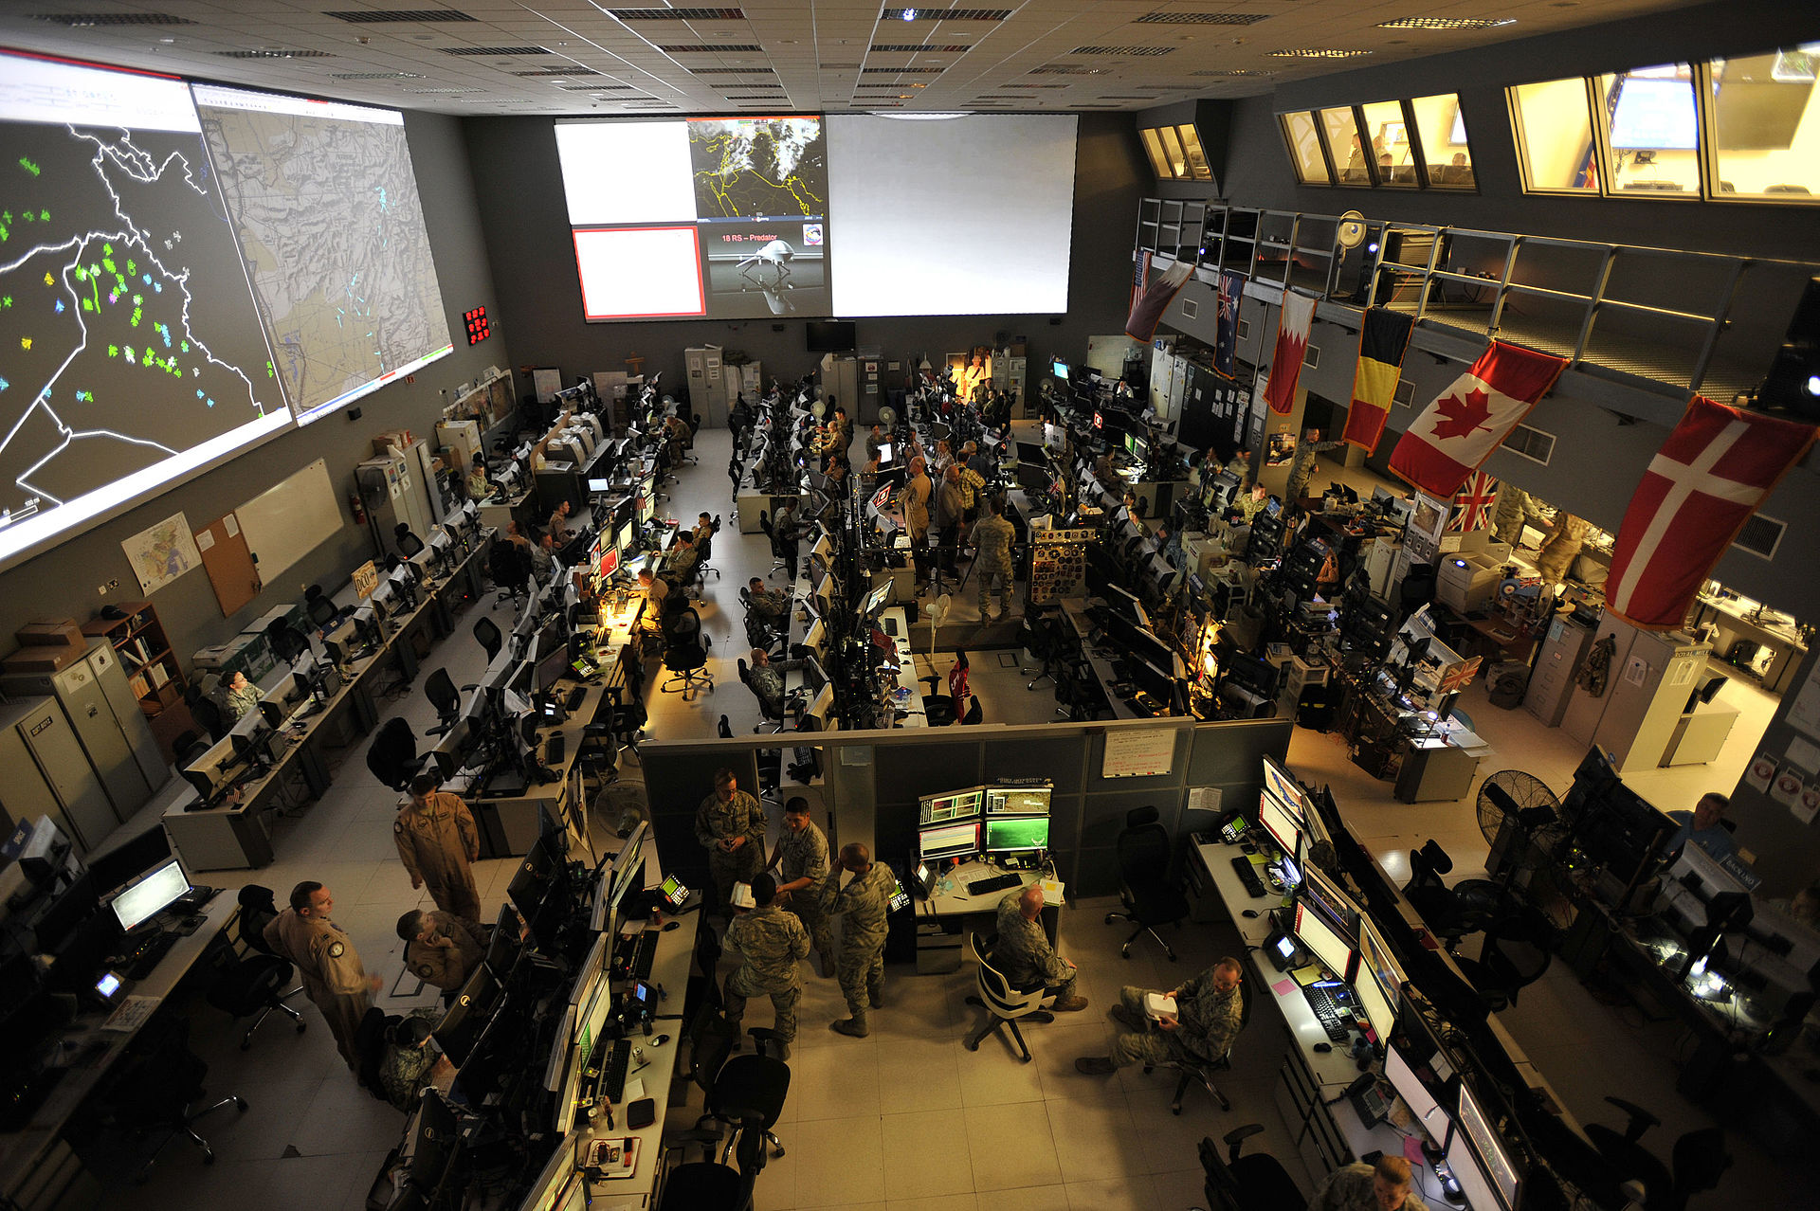
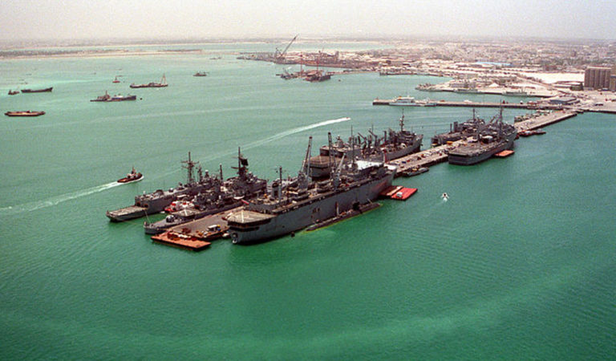
Policy of Dual Containment
One of the primary objectives of the Gulf War of 1991 was to maintain access to Middle Eastern oil
Succeeded through direct military engagement in the region
Dual containment policy
Represented US efforts to isolate both Iraq and Iran
Iran: Economic isolation through sanctions / barred American companies to do business with Tehran / Keep Iran’s revenues down
Iraq: More aggressive policies
Crippling economic sanctions (1990, full compliance with UNSC Resolution 687)
1998, crisis over UN Special Commission Department’s (UNSCOM) right to access Iraq and investigate its disarming efforts escalated into armed conflict, ending up to 2003 invasion
Top: Combined Air and Space Operations Center (CAOC) Qatar, provides command and control of air power throughout Iraq, Syria, Afghanistan, and 17 other nations.
Down: US 5th Fleet base, Bahrain

Slide 5
Al-Qa‘ida and the 9/11 attacks
September 11, 2001: 19 men hijacked 4 commercial airliners and crashed them into the Pentagon and the World Trade Center towers in NYC
The death toll that day was more than 3,200
15 of the hijackers were of Saudi origin, and all were connected to the transnational Islamic terrorist organization al-Qa‘ida, led by the Saudi-born Osama bin Laden
Al-Qa‘ida’s base was in Afghanistan where the ruling Taliban regime sheltered bin Laden
October 2001: President Bush authorizes US-led invasion of Afghanistan. US force had dispersed the Taliban and disrupted al-Qa‘ida networks, but it had not destroyed them

Slide 6
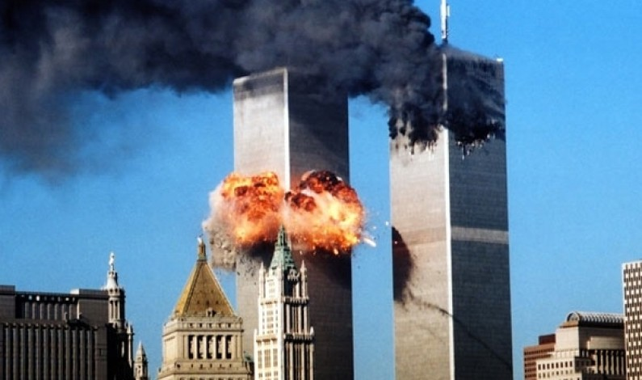
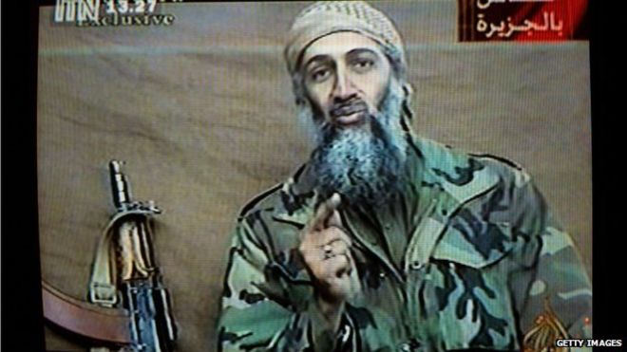

Slide 7
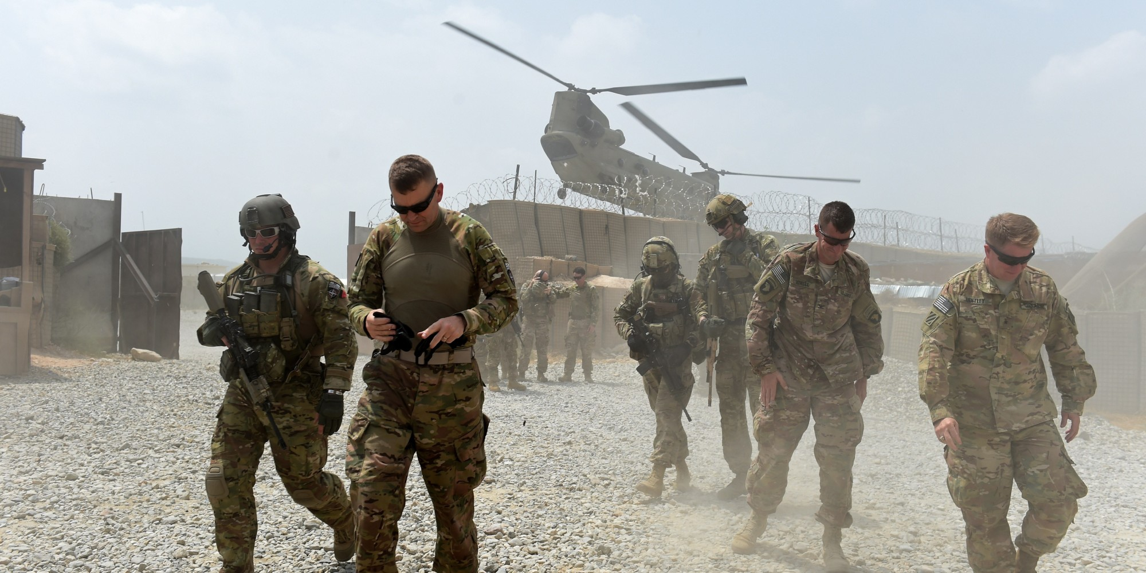

Slide 9
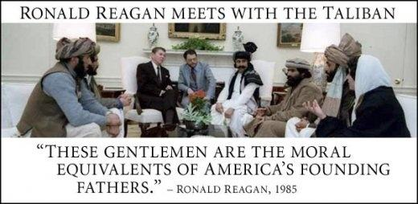
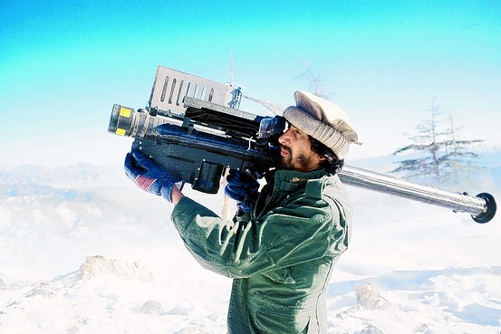

Slide 10
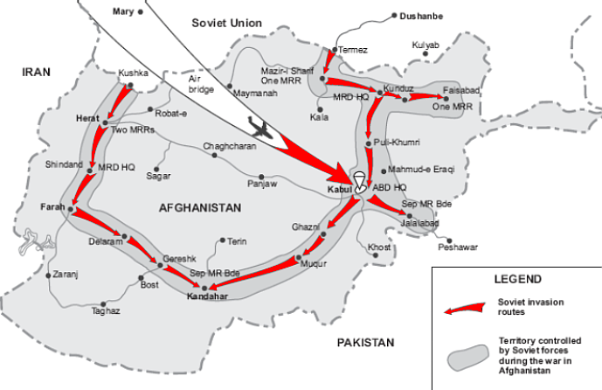
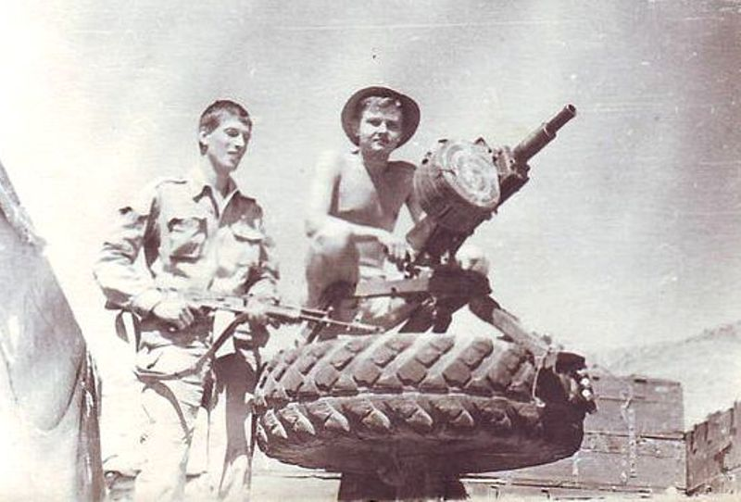
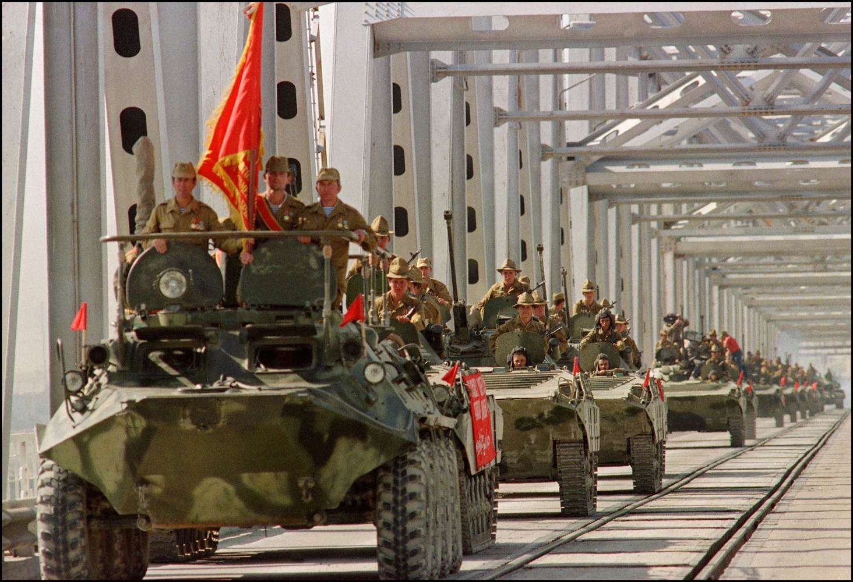
1979-1989: Soviet Invasion to Afghanistan

Slide 11
Bin Laden and Al-Qa‘ida
Americans asked: “Why do they hate us?”
Bin Laden’s grievances against US
US position on the Palestinian-Israeli conflict
Continued U.S. economic sanctions against Iraq and the hardships they imposed on the Iraqi people
Presence of US troops in Saudi Arabia
Al-Qa‘ida was a new phenomenon, a stateless international terrorist network that sought to establish an Islamic order along the lines of the Taliban government
Bin Laden’s ultimate objective was the overthrow of the US-friendly Saudi and Egyptian regimes

Slide 12
The Occupation of Iraq
Although no evidence connected Iraq to the 9/11 attacks, Bush and his advisers made a case for preemptive military action against Iraq, main rational behind the intervention:
Iraq’s alleged possession of weapons of mass destruction
Regime change was necessary for the benefit of the Iraqi people
Iraq’s possession of one of the world’s largest oil reserves
UNSC Resolution 1441: Iraq must disclose its holdings of weapons and allow UN inspection teams into Iraq
March 20, 2003: Operation Iraqi Freedom began
Postwar, US dismantled Iraq’s political and economic infrastructure, creating a turbulent climate that started the country on a descent into political, economic, social, and sectarian chaos

Slide 13
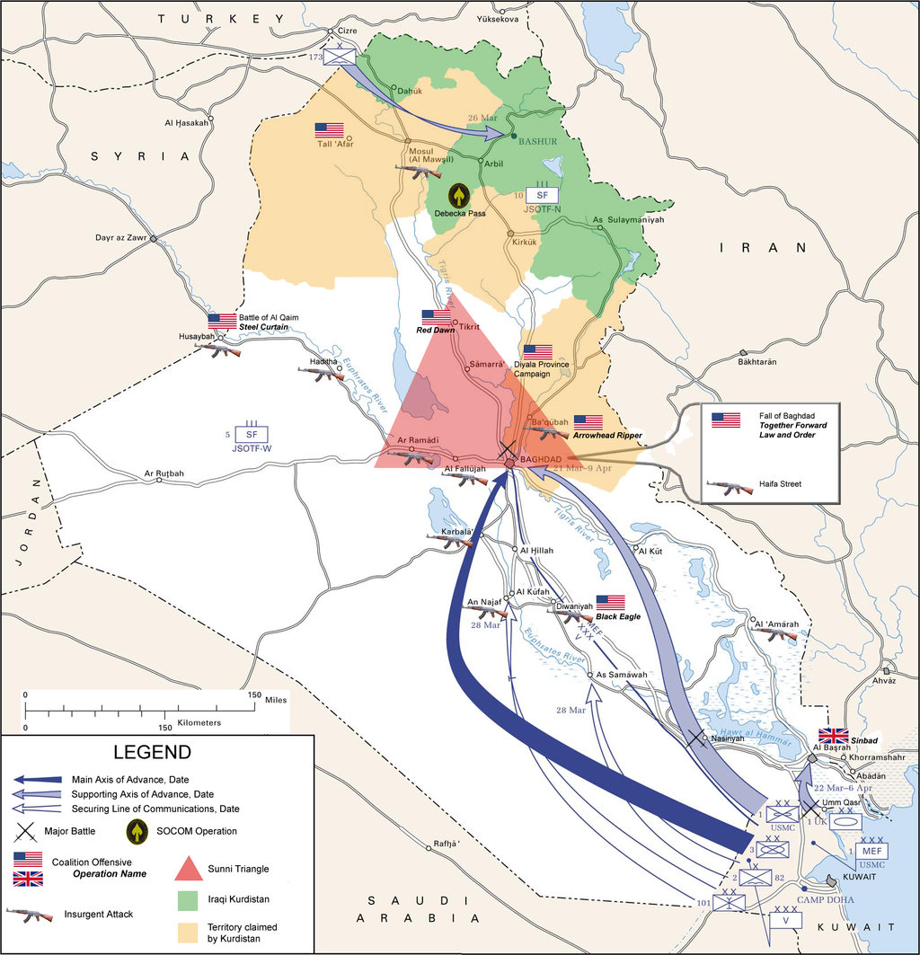

Slide 14
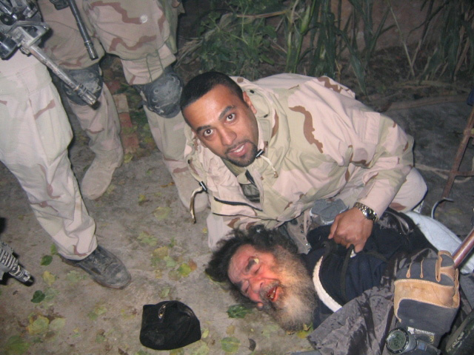

Slide 15
Sectarian Violence & Fragmentation
Anti-US insurgency first emerged among Iraqis angered at presence of foreign troops
Some attracted to a more extreme attack on US-led occupation → establishment of al-Qa‘ida in Iraq (AQI)
AQI killed American forces, int’l community members, and Iraqi Shi‘ites
In 2007, George W. Bush announced a “surge,” working with Sunni tribal leaders to fight AQI = the Awakening, or Sahwa
Steady collapse of state institutions—a new government did not emerge until May 2006, under Shi‘a prime minister, Nuri al-Maliki
New political system that emerged post-US-led invasion and occupation favored sectarian government over forging a national consensus

Slide 16
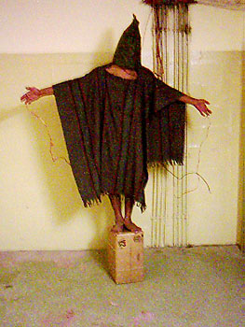
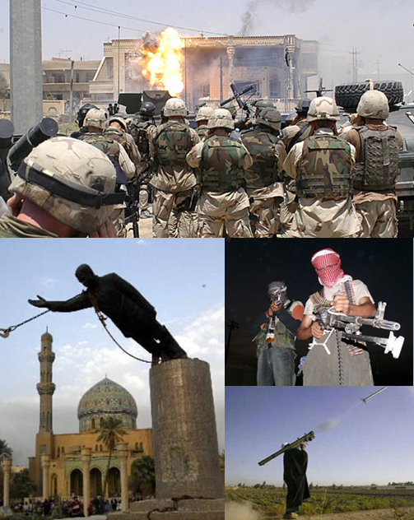
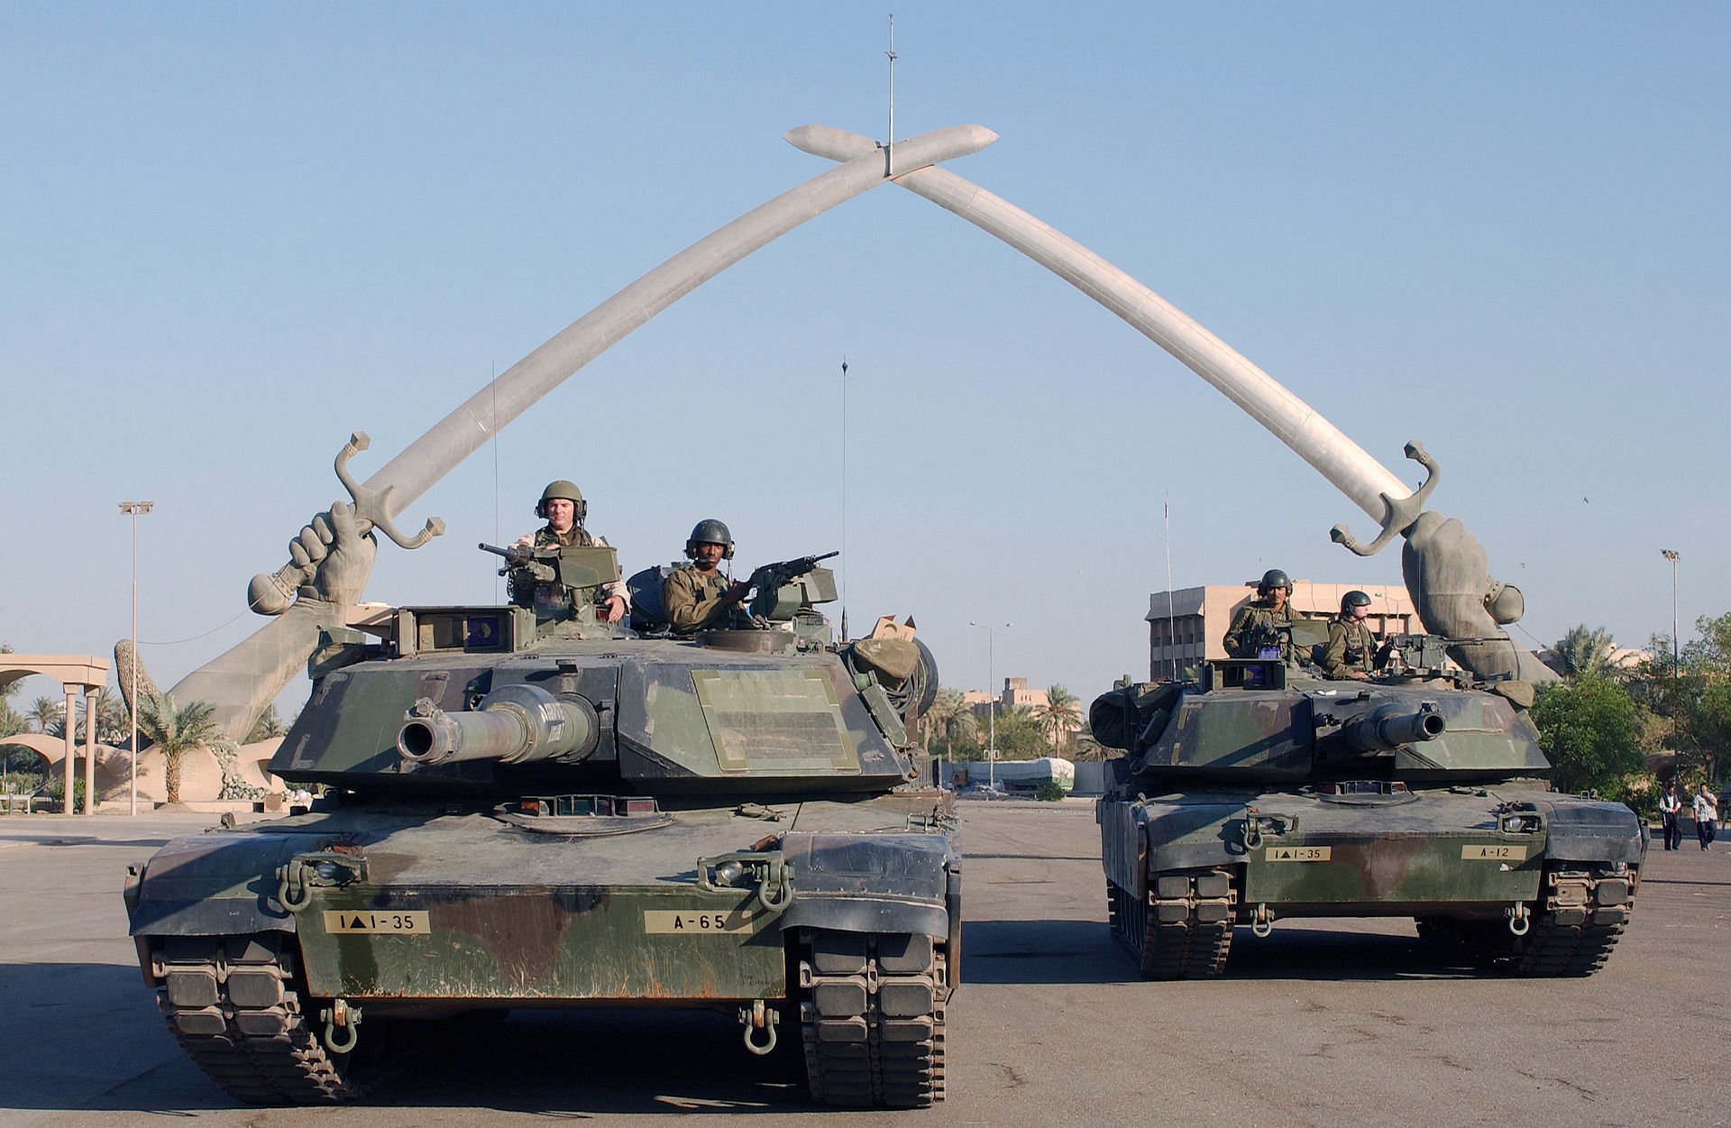

Slide 17
Sectarian Violence & Fragmentation
Shi‘a and Kurdish leaders consolidated power, while Sunnis felt marginalized
Iraq’s Kurdish population/government carved out a zone of prosperity and relative stability
Main source of tension with Shi‘a-led government in Baghdad was over oil
Al-Maliki:
His divisive policies gave Kurds’ demands for autonomy extra impetus
Became increasingly paranoid and authoritarian
Refusal to fund Sunni groups or integrate them deepened resentment
Hollowed out national institutions
Status of Forces Agreement: Iraqi government’s agreement with the US for US troops to redeploy by June 30, 2009

Slide 18
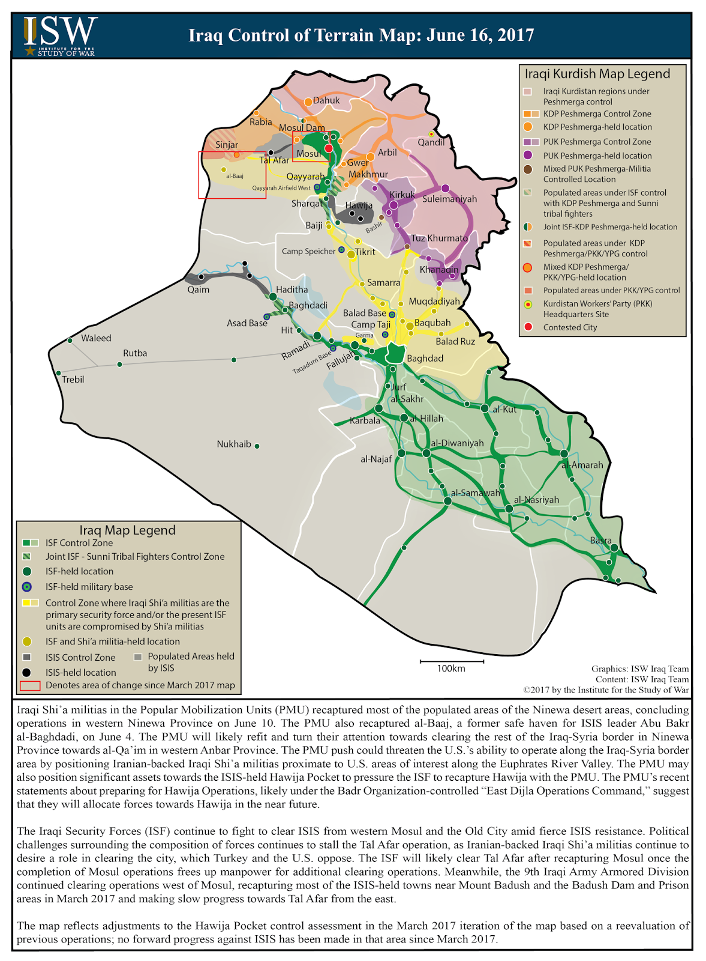

Slide 19
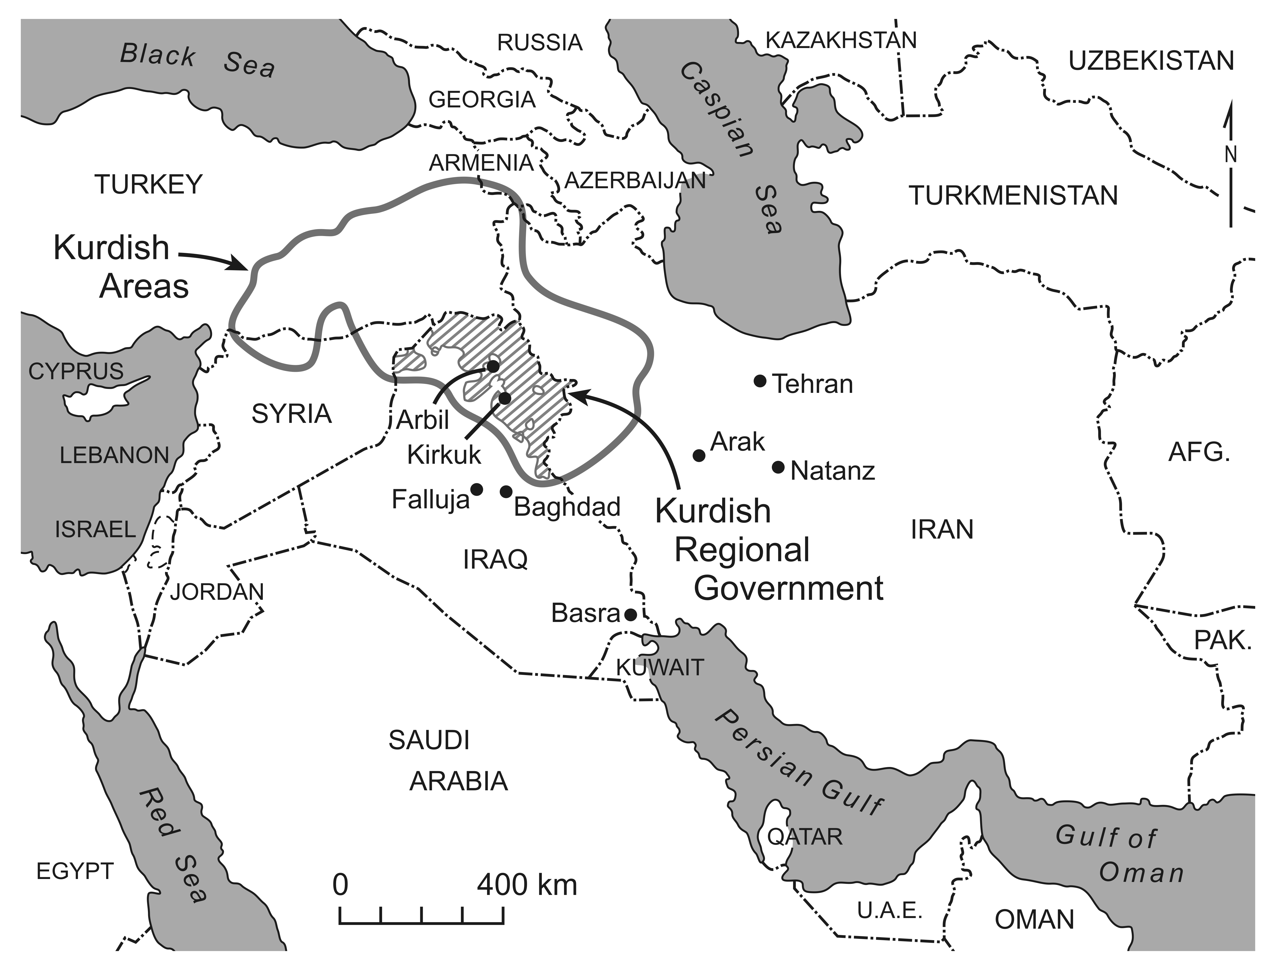
Kurdish Homelands

Slide 20
The Rise of ISIS
Marginalization of Sunnis → the Islamic State of Iraq and al-Sham (ISIS) to take control of large parts of Iraq in 2014
IS, or Da‘esh
Sunni jihadist organization
Offspring of AQI
AQ: Priority to fight the West / ISIS: Priority to topple local Muslim regimes / proclaim a territorial state (Islamic State)
2013: ISIS broke away from AQ
Leader: Abu Bakr al-Baghdadi
Leader is Abu Bakr al-Baghdadi
Syrian civil war gave AQI cover to regroup and new ways to raise funds and recruit
ISIS broke off as a reconstituted group with the aim of defeating the “near enemy” rather than the West
ISIS came back into Iraq in June 2014, and routed Iraqi army (number of fighters: 30,000-45,000 / area controlled: approximately the size of Jordan / population controlled: around 8 m. / militant groups in other countries pledge allegiance to ISIS – Egypt, Libya)
Kurdish peshmerga viewed their fight against ISIS as a step towards independence
Iraqi Sunnis saw ISIS as a necessary and expedient ally
ISIS attracted large numbers of foreign fighters and adopted highly organized and ruthless forms of warfare

Slide 21
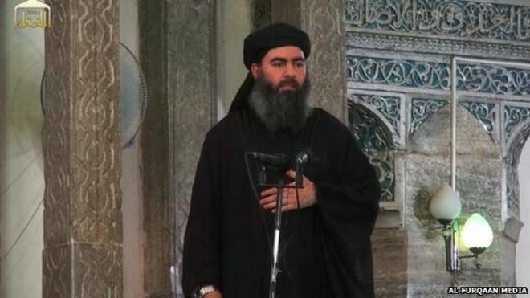
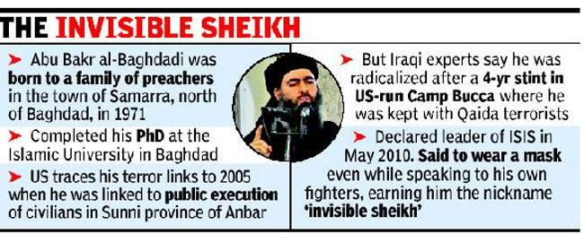

Slide 22
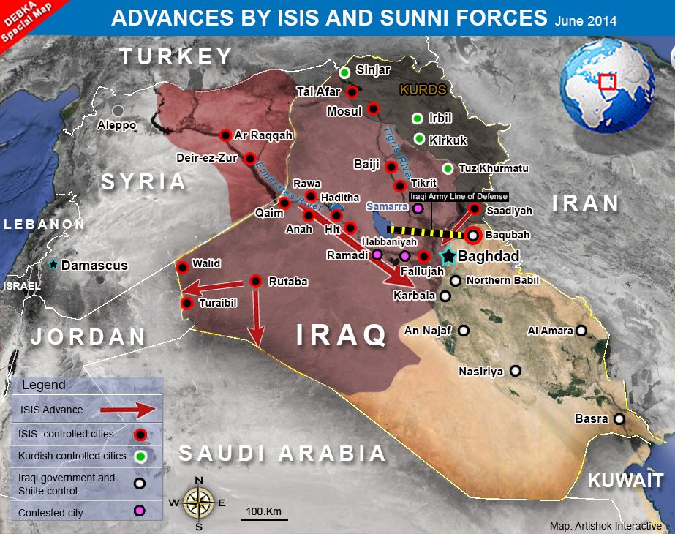

Slide 23
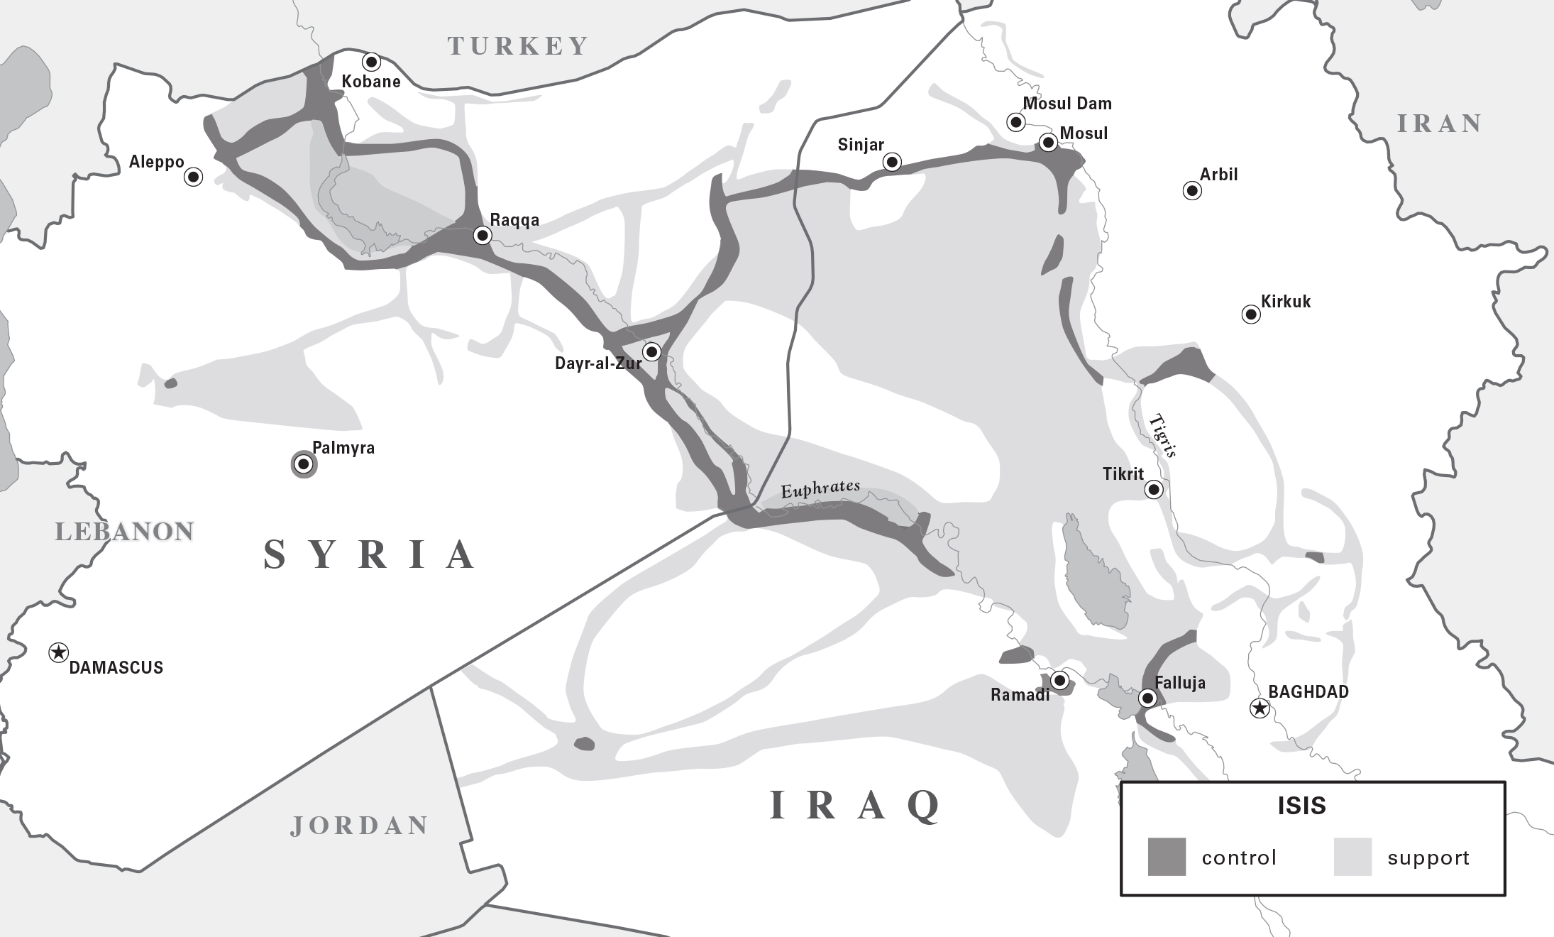
The Spread of ISIS, April 2015

Slide 24
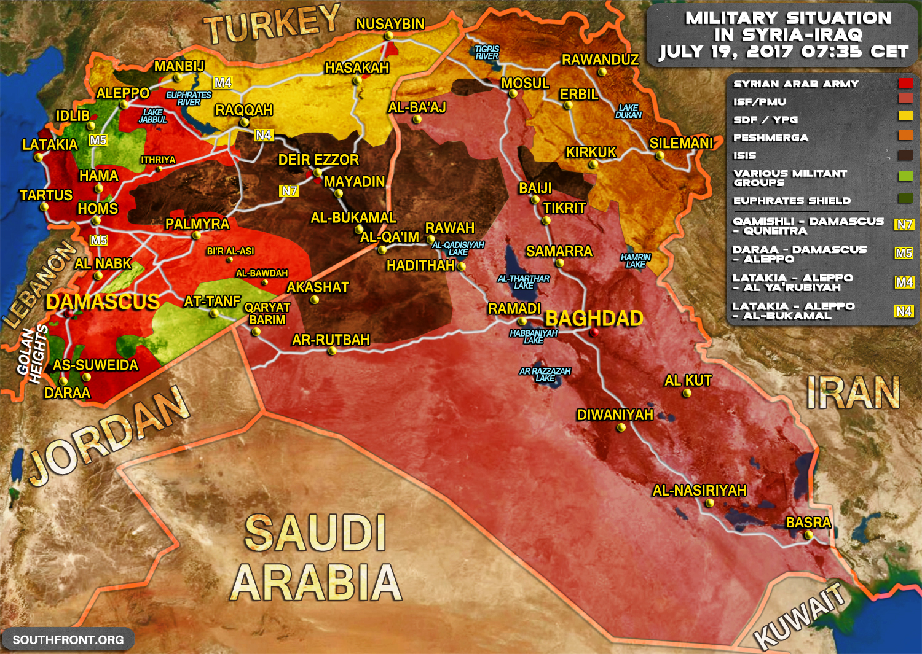

Slide 25
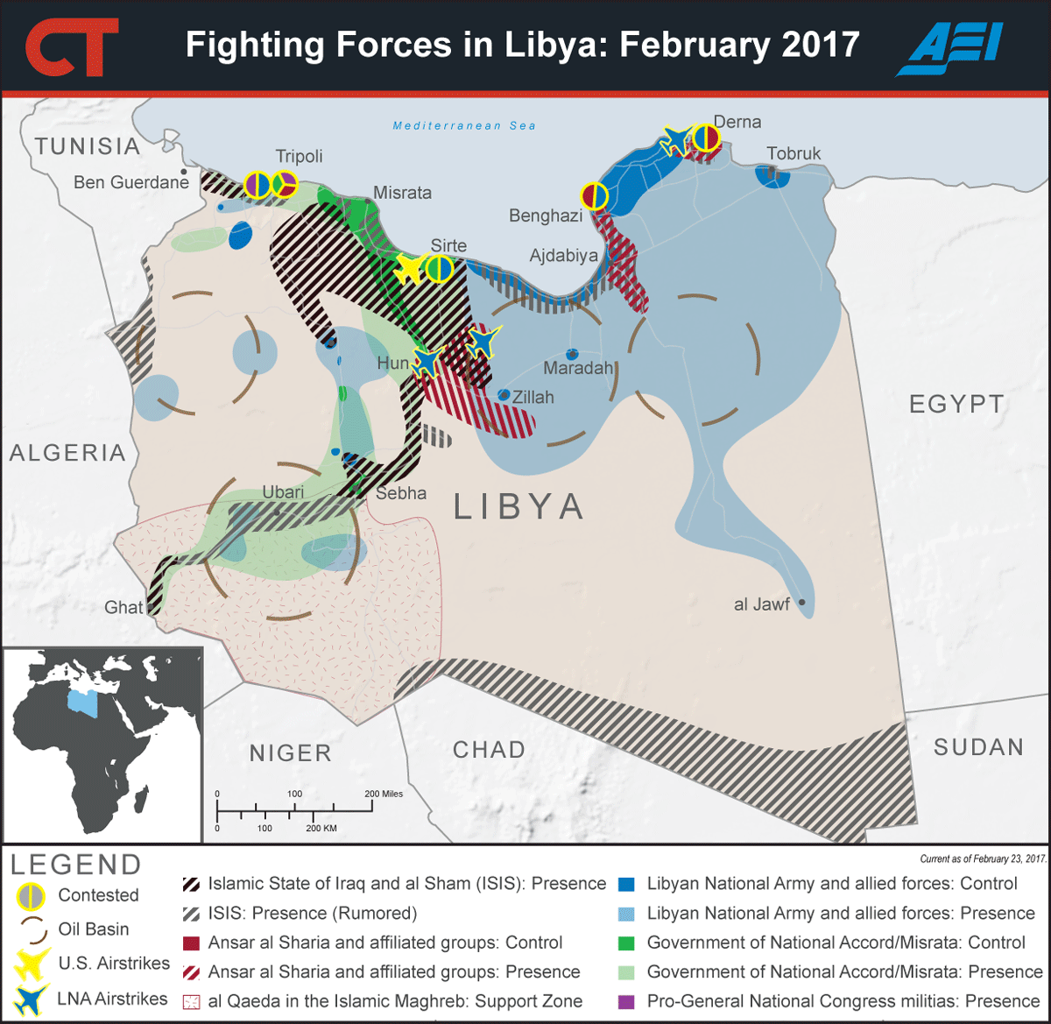

Slide 26
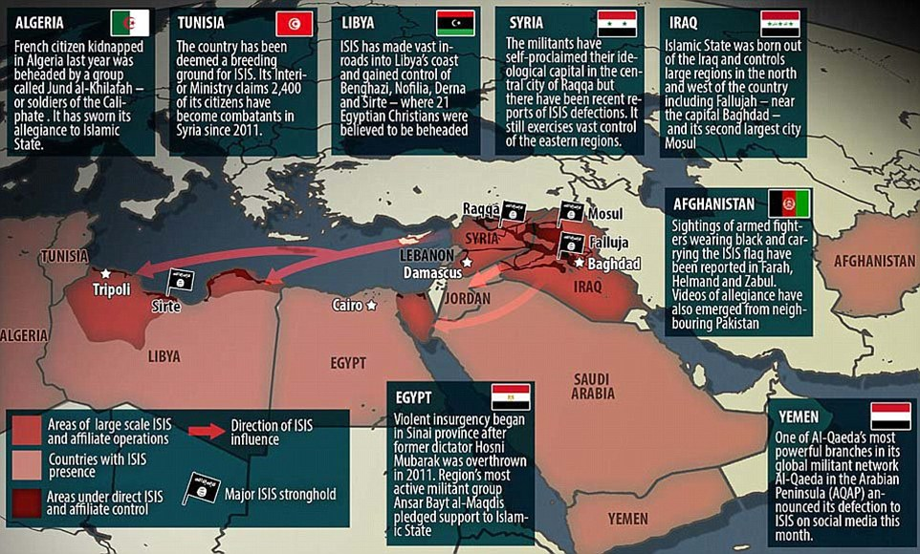

Slide 27
Iran’s Nuclear Program
Bush included Iran in his “axis of evil” list in 2002
But America’s faltering occupation of Iraq emboldened Iran
Shi‘a allies in Iraq were now in positions of leadership
Iran’s potential for development of a nuclear fuel cycle became a matter of national honor
Resentment grew at being held to double standard set by the international community
Chaos in Iraq dampened the Bush administration’s enthusiasm for taking on the Iranian regime
President Obama tried to engage Iran diplomatically
But revelation of another uranium-enrichment plant in September 2009 derailed Obama’s initial efforts at engagement

Slide 28
The Joint Comprehensive Plan of Action
By the time Hassan Rouhani, was elected in 2013, Iran had established 20,000 centrifuges
Rouhani had campaigned on reducing tensions with the West
2015: JCPOA (Joint Comprehensive Plan of Action) deal was announced
In this deal, Iran agreed to end controversial parts of its nuclear program in exchange for economic sanctions relief
The deal cuts off Iran’s two pathways to a nuclear weapon: uranium enrichment and its transformation into plutonium
Iran reduced by 98% its stockpile of low enriched uranium
Limit future enrichment capacity by reducing the number of operating centrifuges by 2/3 to 5,000
Pure concrete into its heavy-water reactor at Arak, destroying its capacity to produce weapon-grade plutonium
Allows for inspections by the International Atomic Energy Agency (IAEA) in Iran
Angry reaction: from Saudi Arabia and mainly Israel, retained his option to take action when deemed necessary / fears that Iran would utilize its accessible funds to finance its proxies in the region

Slide 29
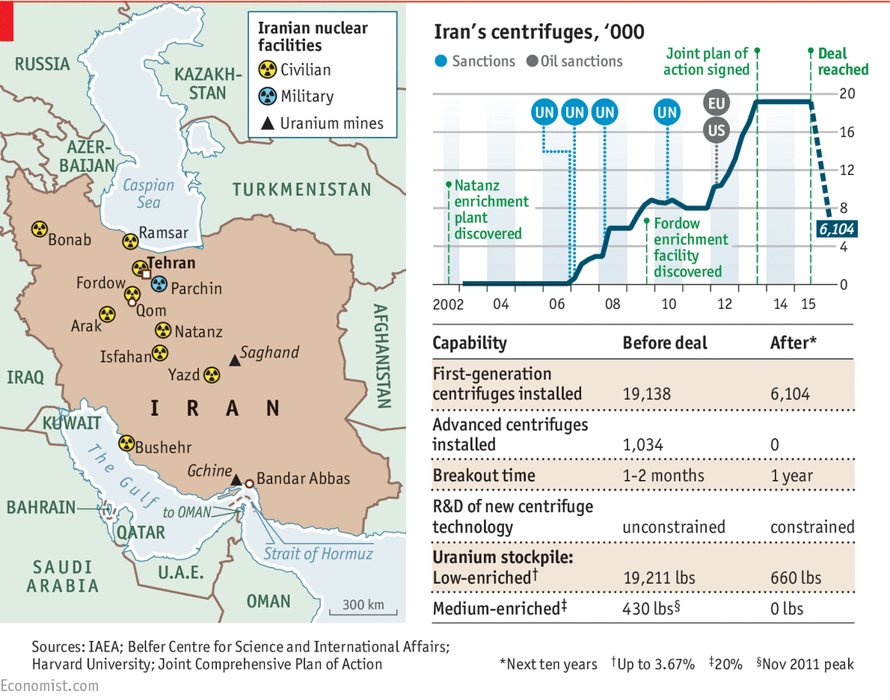

Slide 30
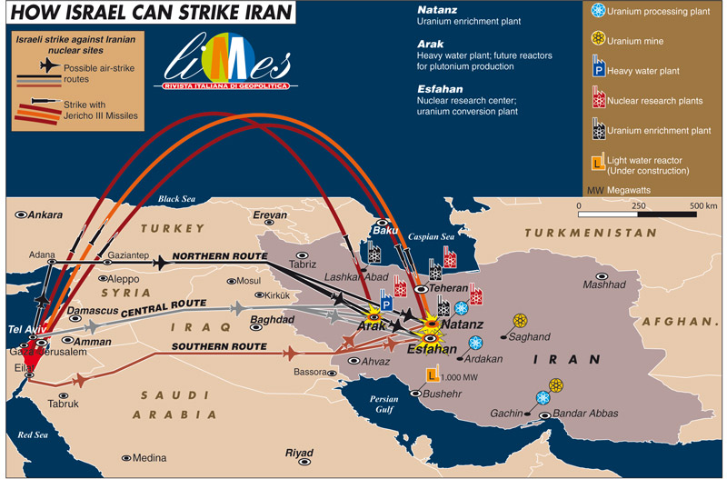

Slide 31
US-Middle East Policy under Obama
Growing indications that as regional powers assert themselves in an increasingly fractured environment, the US hegemony may be beginning to wane
President Obama’s promise of diplomatic engagement raised hopes as well as expectations throughout the Middle East
Defeating ISIS requires a political solution
But Obama’s response has continued to rely heavily on military action in the region
Fourth successive US president to bomb Iraq
Iranian nuclear deal is a notable deal for diplomacy

Slide 32
General Assessment: Geopolitical Constants
Cold War / Post-Cold War periods & the Broader Middle East & North Africa: Extension of the Eastern Question & the Great Game of the past
Eastern Question: Referring to the MENA
Great Game: Referring to the South Asia
Actors:
Then (Great Britain & Imperial Russia + France)
Cold War (US & USSR + Great Britain)
Post-Cold War (US & Russia + China)

Slide 33
General Assessment: To “the shores of Tripoli” (First Barbary War, 1801–1805)

Slide 34
General Assessment: US Six Main Objectives since 1940s
Containment of the USSR (today Russia… mainly)
Assurance to the access to oil (mainly for the European & Asiatic allies)
Peaceful conflict resolution & balance of power maintenance
Promotion of stable (even autocratic) pro-Western states
Preservation of the independence & territorial integrity of Israel
Protection of the sea lanes, lines of communications and the like, connecting the US and Europe with Asia

Slide 35
General Assessment: Policy Inconsistences in Implementing these Objectives
All administrations advocate these policies but the implement them in various ways
i.e. Peripheral or strong-point containment
Achieving one objective at the expense of others
i.e. Rising oil prices: Expensive access to oil vs enabling allied countries to buy with the extra revenues American weapons
“the law of unintended consequences”
i.e. Camp David Accords, unanticipated consequences (Egypt expelled from the Arab League, thus leaving Iraq the dominant Arab power, planning to dominate in the Gulf – vs Iran & Kuwait)
2003: Iraq invasion (dismantlement of two countries, rise of Islamic extremism, rise of Oil Russia revives)
Even a superpower has its limits to impose its will & failures prompted the reassessment of the policies
Syria policy regarding the deposition of the Asad regime, as the main priority

Slide 36
General Assessment: Was the US policy successful?
Cold War – 9/11 period:
500 American fatalities in the region (half of them in one incident, Beirut, 1983) vs 50,000 in Southeast Asia (1965-75)
5 out of 6 policies were accomplished (only not being able to confine regional conflicts)
Cost: $150 - $200 billion, less than half of the Vietnam war
These points ignore:
Disasters (i.e. Iranian revolution) / near disasters (i.e. close to nuclear confrontation in 1973) cases that these policies brought to the region
It doesn’t take into account the effects of these policies in the region, since it assess them in US terms [i.e. supporting appalling regimes, US weapons against civilians, “sacrifice” nations (Kurds 1975 or 1988), pressure for adoption specific economic policies]

Slide 37
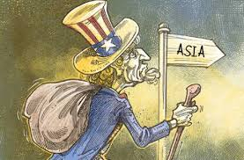
General Assessment: Following a New Paradigm (“Pivot to Asia”)

Slide 38
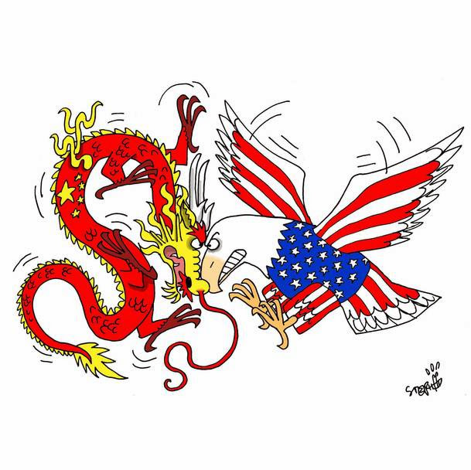
General Assessment: Following a New Paradigm (“Pivot to Asia”)

Slide 39
General Assessment: Following a New Paradigm (“Pivot to Asia”)

Slide 40
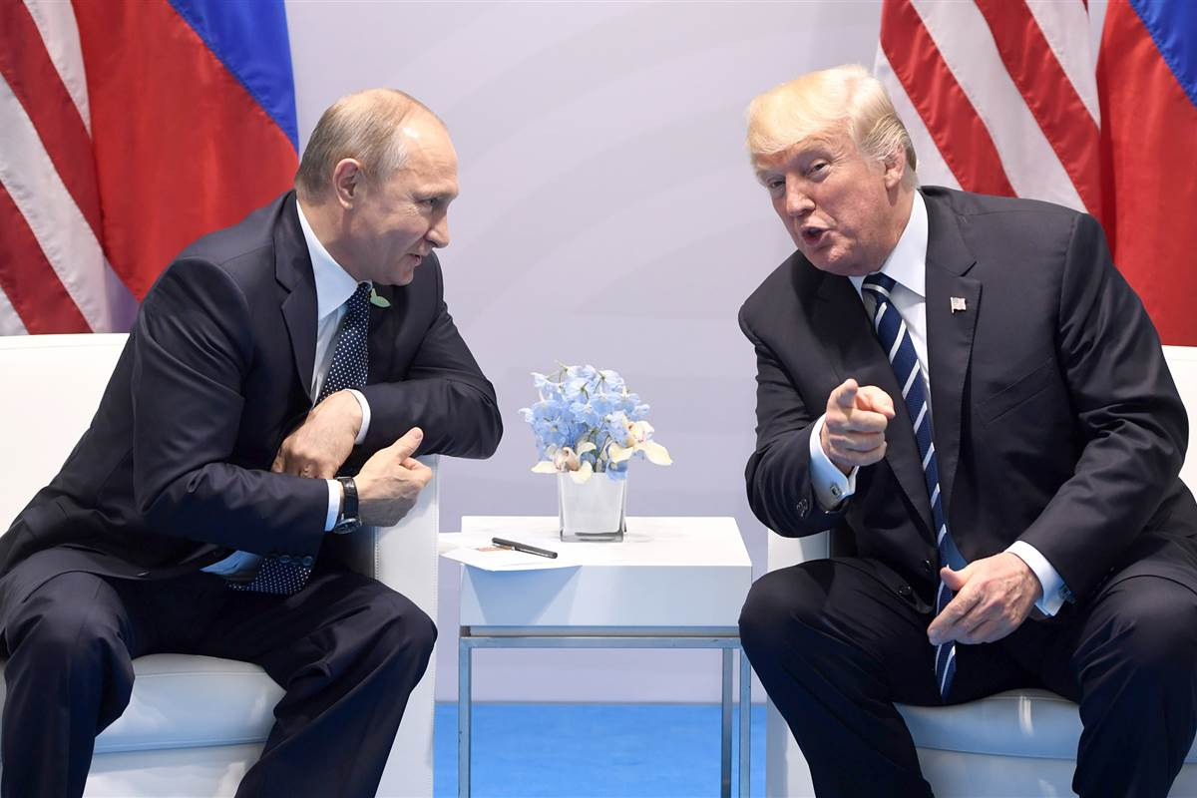
President Tramp: Compromise with Russia

Slide 41
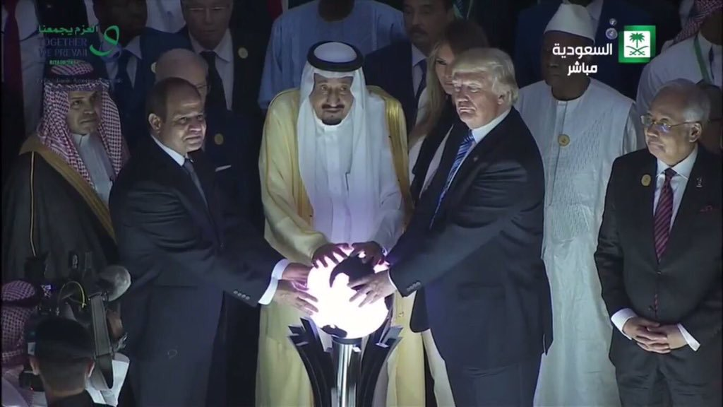
President Tramp: War against Islamic extremism

Slide 42
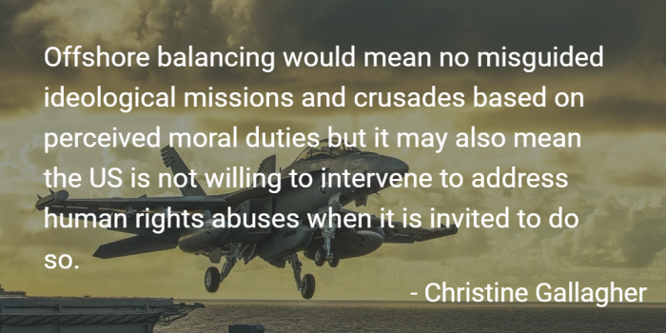
President Tramp: Strategy of “Offshore Balancing”

