Slide 1
GEOPOLITICS OF
THE MIDDLE EAST AND TURKEY
Dr. ILIAS ILIOPOULOS
Dr. phil, Ludwig-Maximilian University of Munich
Ass. Prof., National University of Athens
Former Professor, Hellenic Naval War College
and American College of Greece

Slide 2
The Development of Islamic Civilization to the Eighteenth Century
Chapter 3
The Ottoman and Safavid Empires: A New Imperial Synthesis

Slide 3
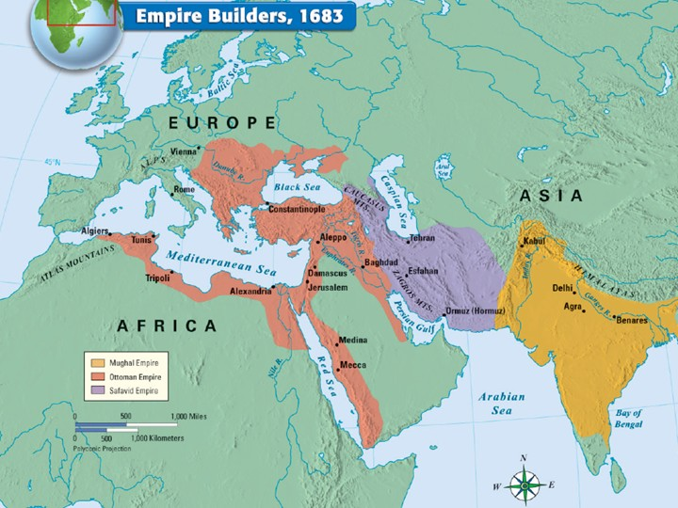
16th-Century Islamic Empires
Three expansive empires emerged
Mughal Empire of Delhi
Safavid Empire of Iran
Ottoman Empire

Slide 4
Mughal Empire [Delhi]; Safavid Empire [Iran]; Ottoman Empire

Slide 5
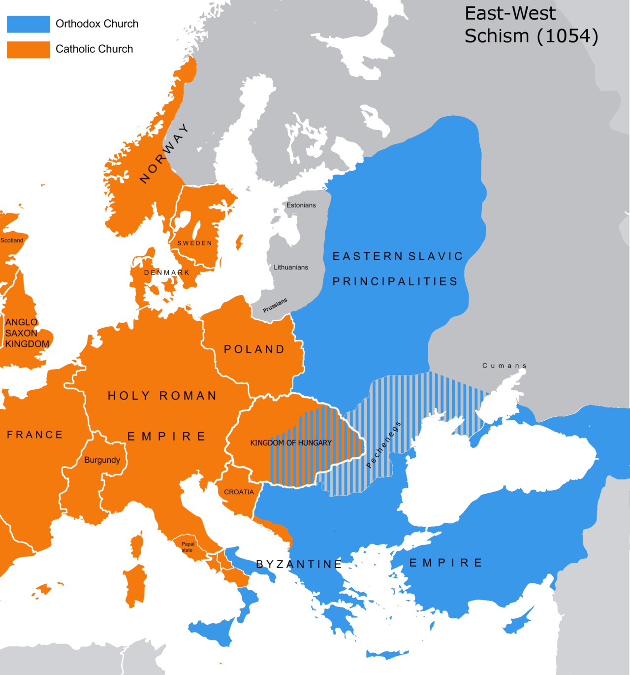
The Eastern Roman
(Byzantine) Empire 330 – 1453 AD

Slide 6
The Rise of the Ottoman[-Turkish] Empire
Originated as one of over a dozen Moslem
small principalities in Asia Minor.
The tradition of Ghazi (غازي, , ġāzī) warfare against non-Muslims shaped the Ottoman Empire.
Ottoman system based on conquest and exploitation of conquered lands and peoples.

Slide 7
The Rise of the Ottoman[-Turkish] Empire
Traced to the military achievements of chieftains Osman and his son Orhan (“ghazi son of ghazi”).
Subjects of Orhan’s ghazi became known as Osmanlis (Ottomans).

Slide 8
Ghazis – ghaza (the warfare)
“the instrument of the religion of God,
a servant of God who purifies the earth
from the filth of polytheism;
the ghazi is the sword of God,
the protector and the refuge of the believers.
If he becomes a martyr in the ways of God,
do not believe that he has died – he lives in beatitude with God, he has eternal life”
-Ghaza was performed for spoils & booty too.

Slide 9
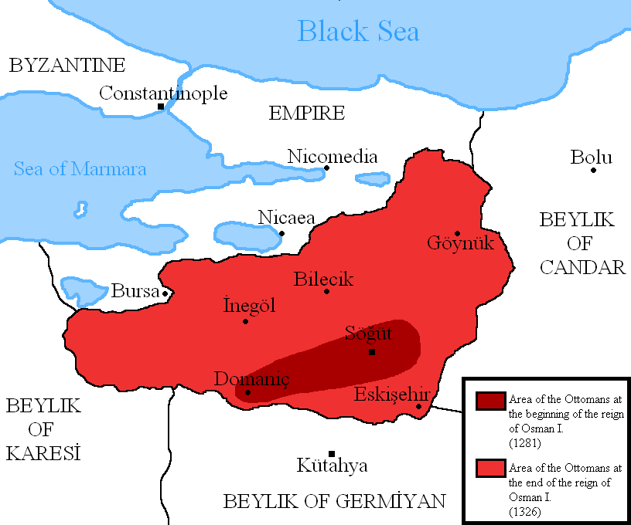
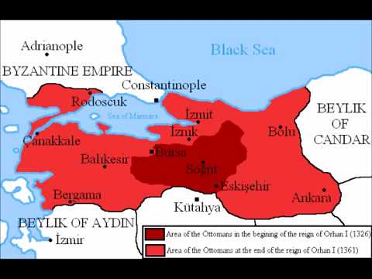
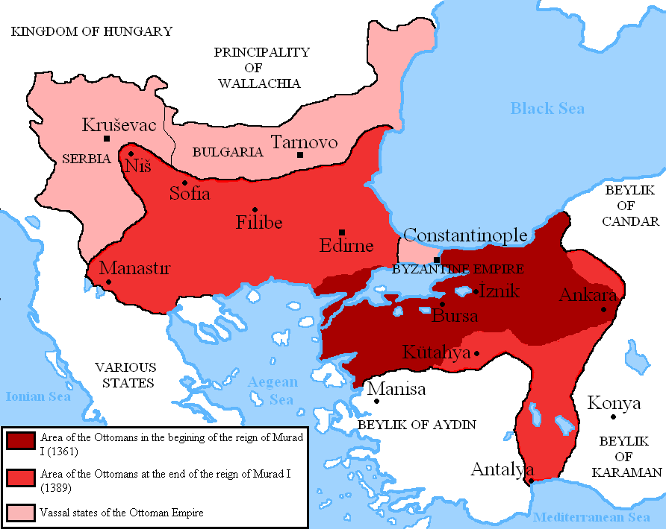
Initial Expansion (13th-14th c.)

Slide 10
Ottoman Initial Expansion over Greek-Christian (Byzantine) Asia Minor (13th – 14th c.)

Slide 11
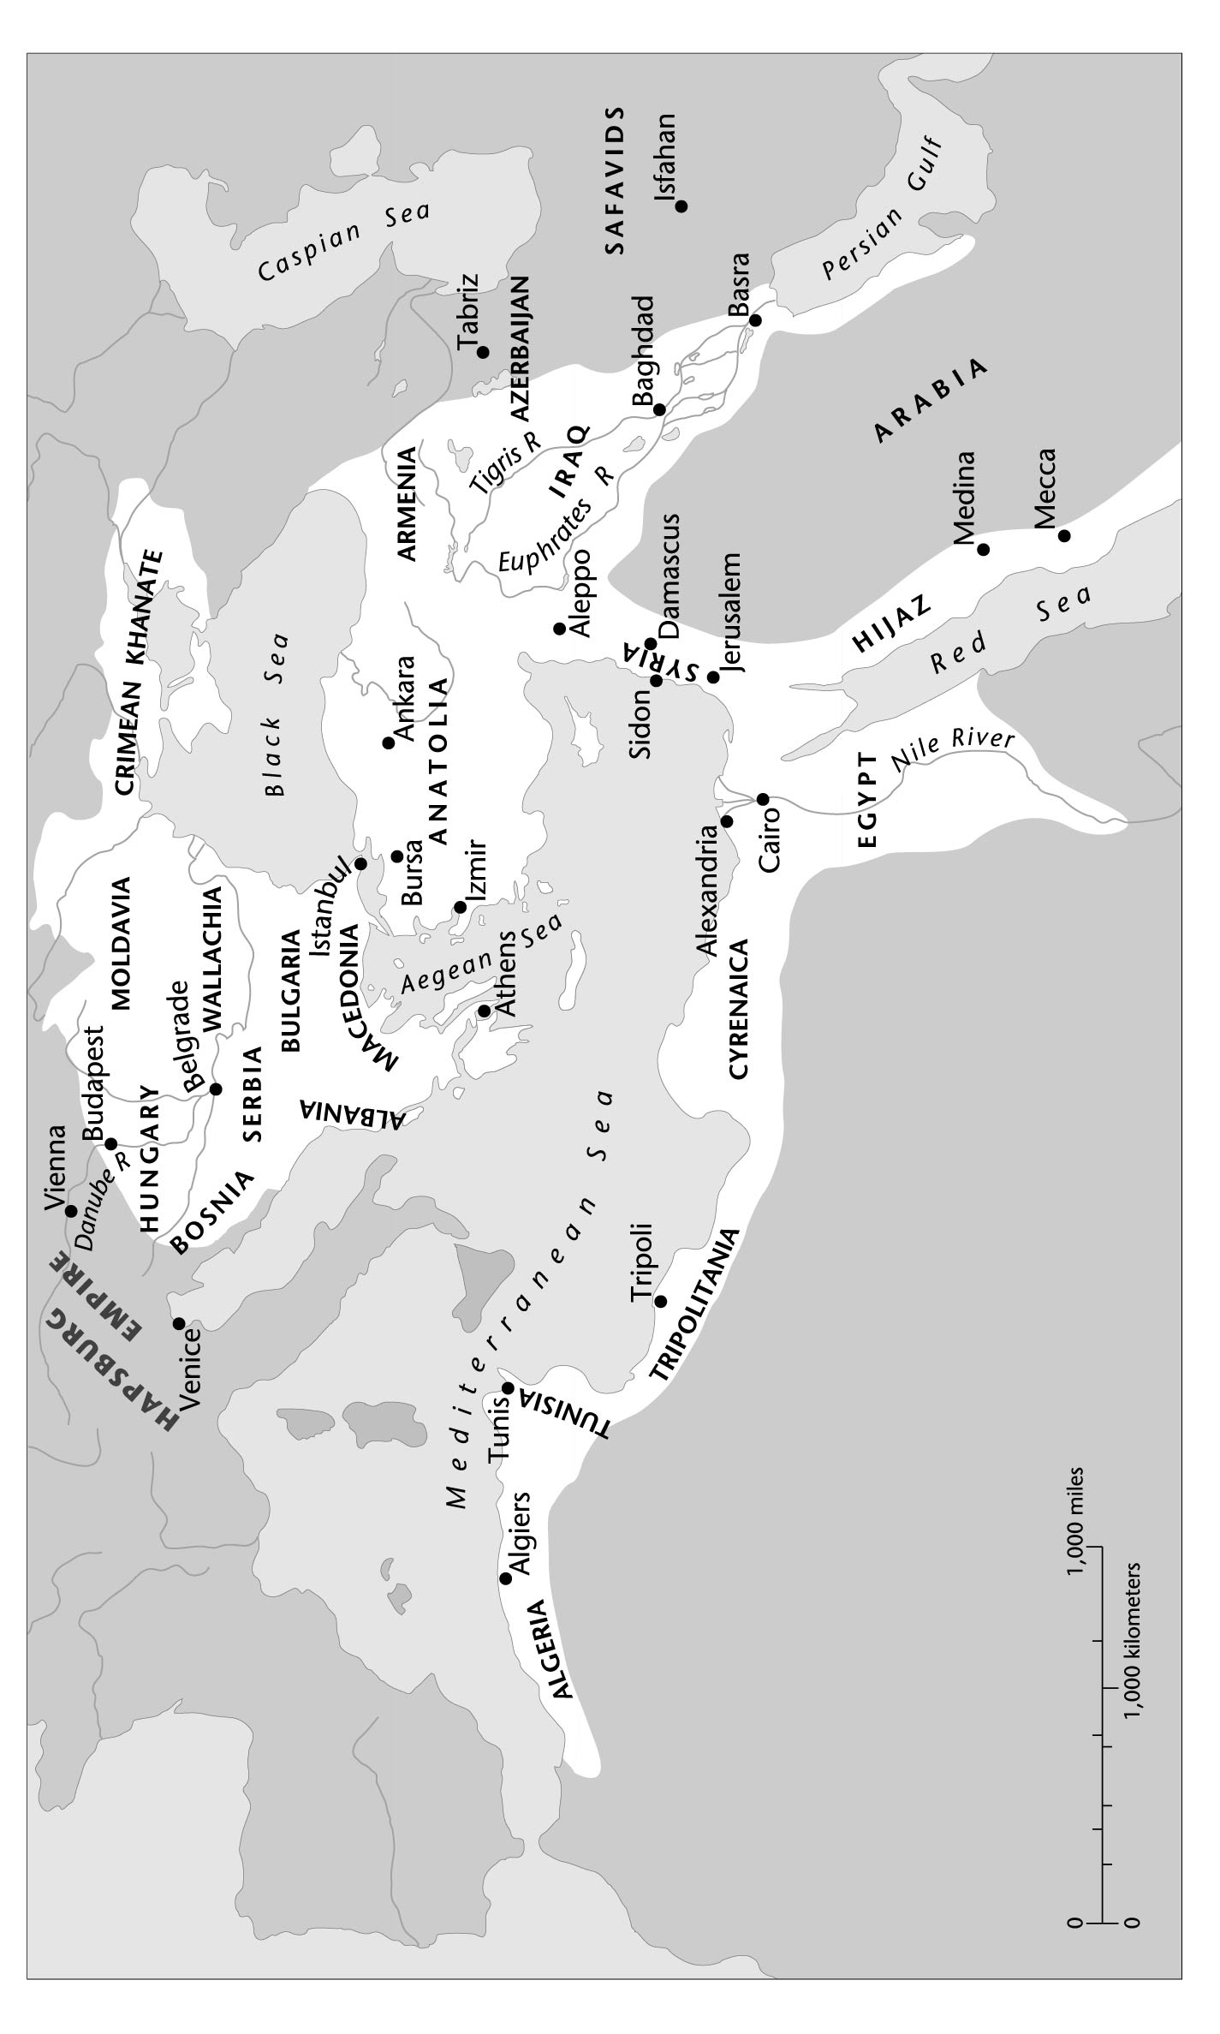
Ottoman Expansion over (Greek) Western Coast of Asia Minor, the European parts of the Byzantine Empire, and the other Christian lands of the Balkan Peninsula (14th-16th c.)
Three series of conquests turned the Ottoman Empire into a world power

Slide 12
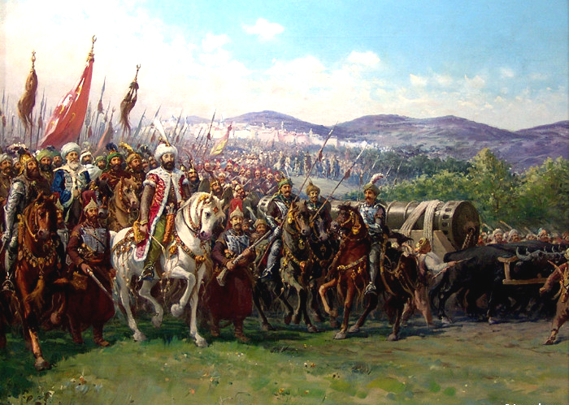
Siege of Constantinople by Ottoman Sultan Mehmed II, 1453

Slide 13
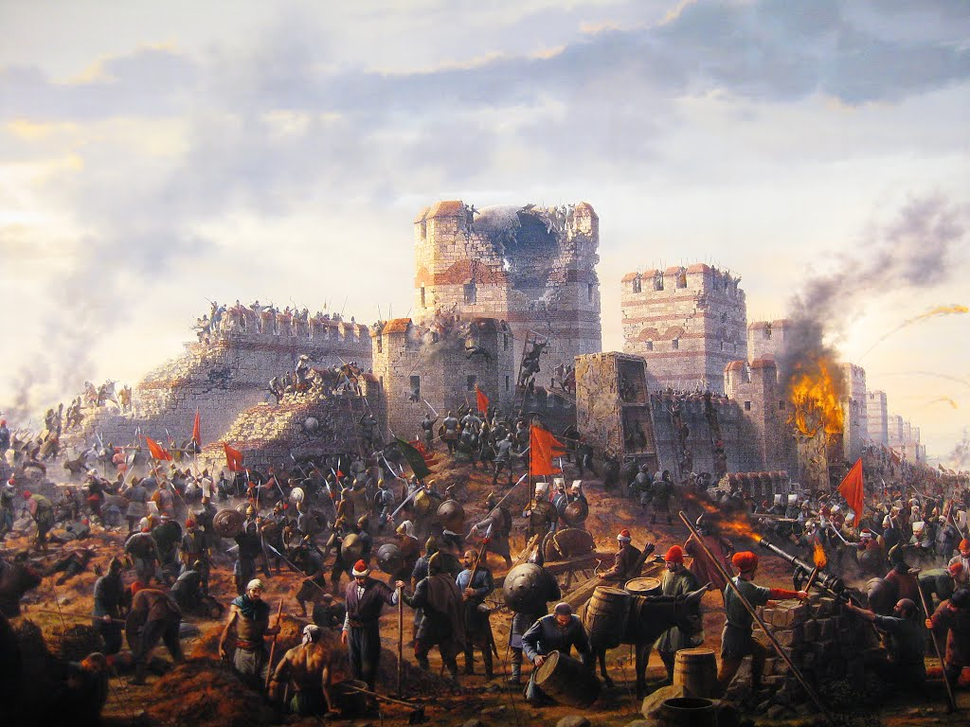
Fall of Constantinople in the hands of the Ottoman Turks, May 29, 1453

Slide 14
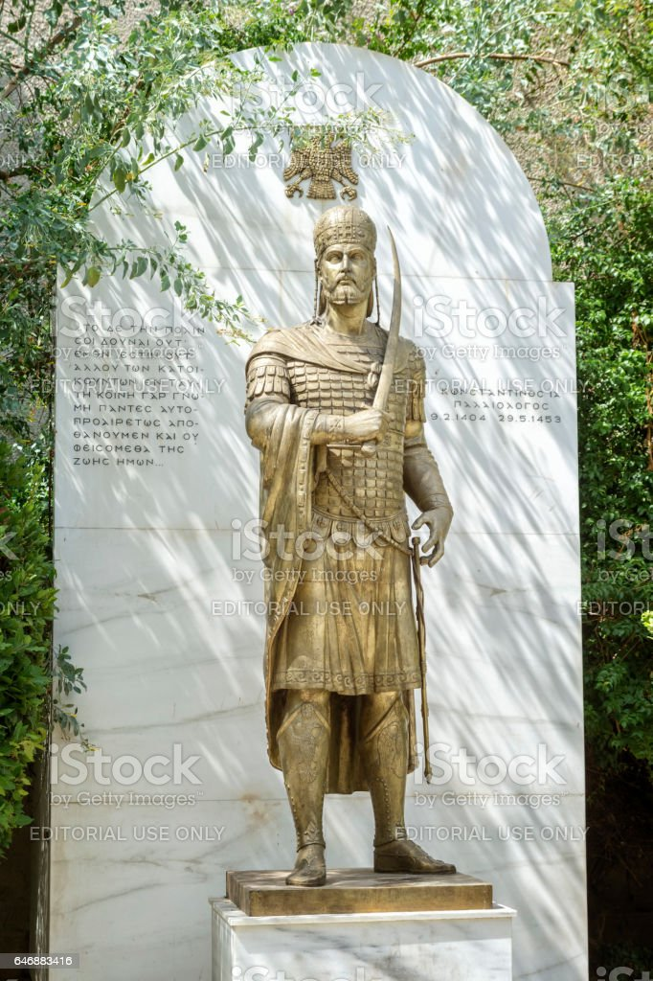
The last Greek-Orthodox Emperor Constantine XI Palaeologus
fell at the gates of Constantinople,
May 29, 1453

Slide 15
Eastern expansion against Safavids from Iran and Ottoman conquest of Arab lands

Slide 16
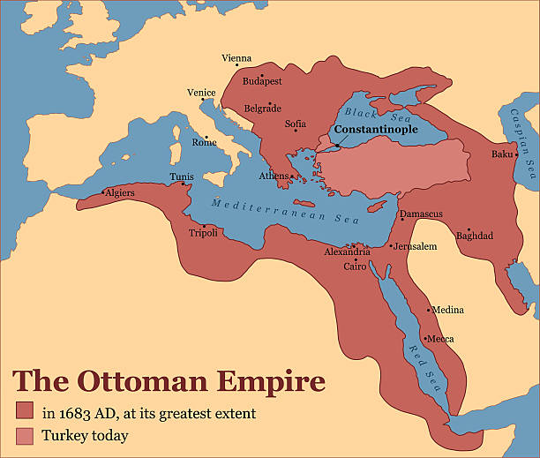

Slide 17
The “Turkish threat” to Europe European campaigns of Sultan Suleyman I, the Magnificent (1520-1566). 1st Siege of Vienna, 1529

Slide 18
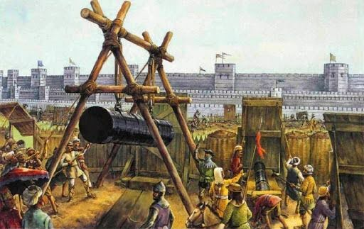
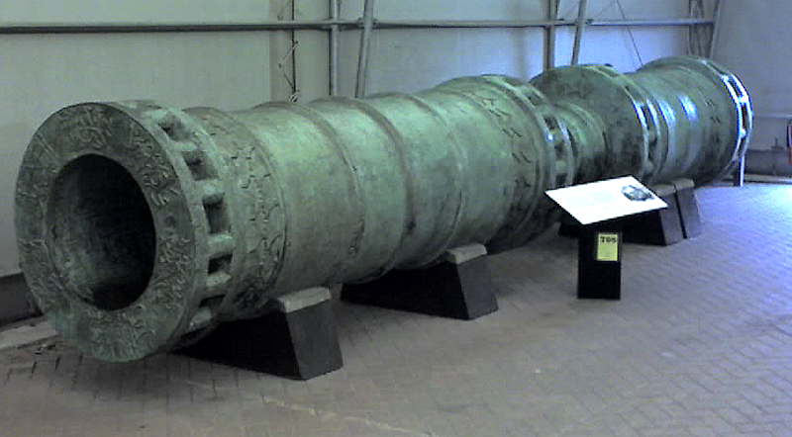
Ottoman Military Advancement
The creation of a navy and
improvements in the Ottoman land army
The development and use of
gunpowder weapons by the Janissaries.
Military professionalism and
superior treatment of troops relative to
adversaries

Slide 19
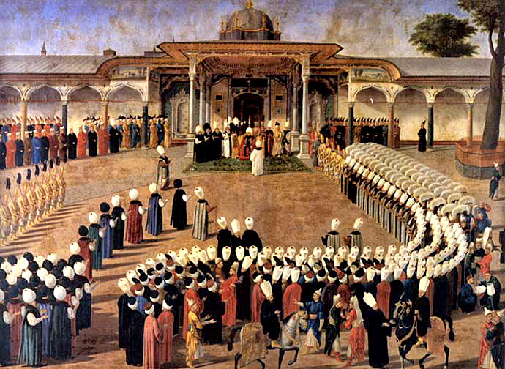
Ottoman Ruling Elite
The Sultan-Caliph: an absolute monarch whose right to rule derived from the House of Osman
All royal princes trained with equal claims to throne
Sultans instituted a divan (imperial council)
Grand Vizier presided over Divan; most powerful government official aside from Sultan

Slide 20
Principles of the Ottoman Ruling Elite
The tradition of ghaza (holy war & booty)
The legacy of urban Islamic civilization
Local custom: more interested in efficiency than uniformity
The division of society into rulers (askeris) and ruled (reaya)

Slide 21
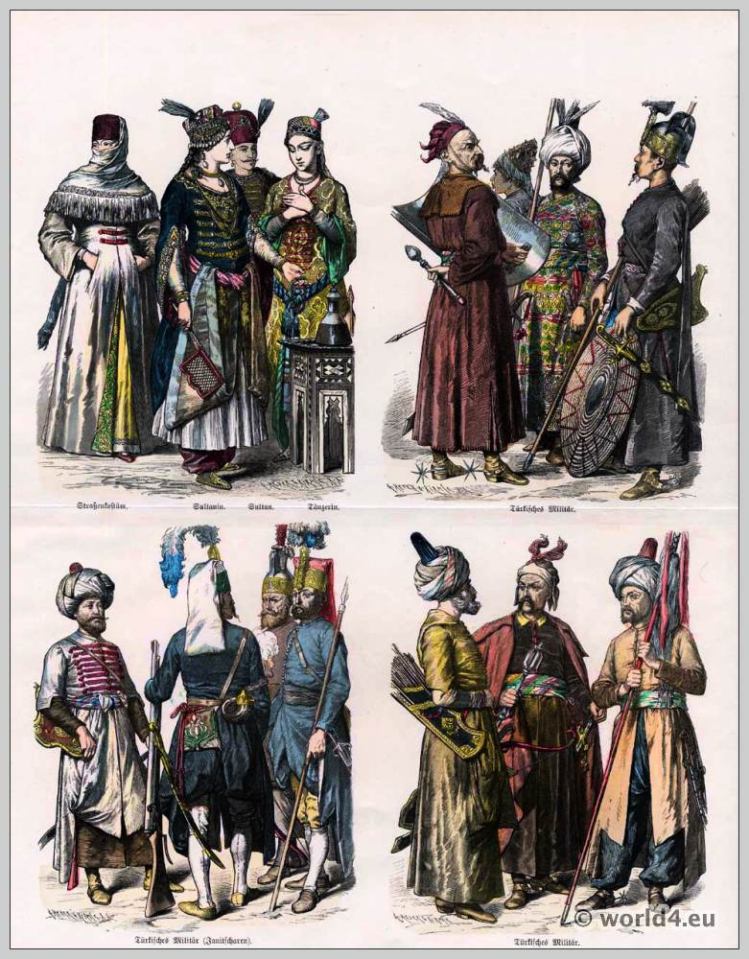
Note:
“Ottoman” means being a member of a highly trained elite; thus… “Ottoman” you were becoming –
not born
“Turk” was a pejorative term!

Slide 22
The Ottoman Slave Elite
Devshirme (collecting): Ottoman method of procuring slaves from among European Christian subjects
Boys (age 8 to 10 - but at times up to 20) taken way from their families, transported to Constantinople, forcefully converted to Islam and subject to hard training to become elite soldiers, military commanders,
and civilian administrators
Foreign-born status ensured their allegiance to sultan

Slide 23
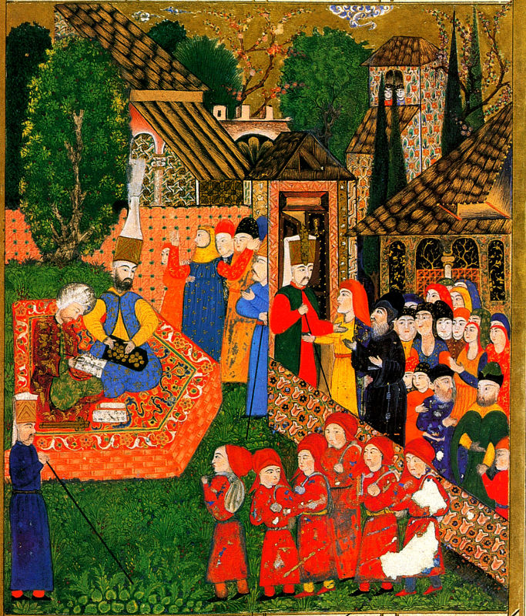
The Ottoman Slave Elite
Constant infusion to the
Ottoman ‘elite’ of European
Christian warrior-statesmen-slaves.
A tragedy for Christian families
and nations subject to
the hated BLOOD TAX:
Large number of Christian boys!

Slide 24
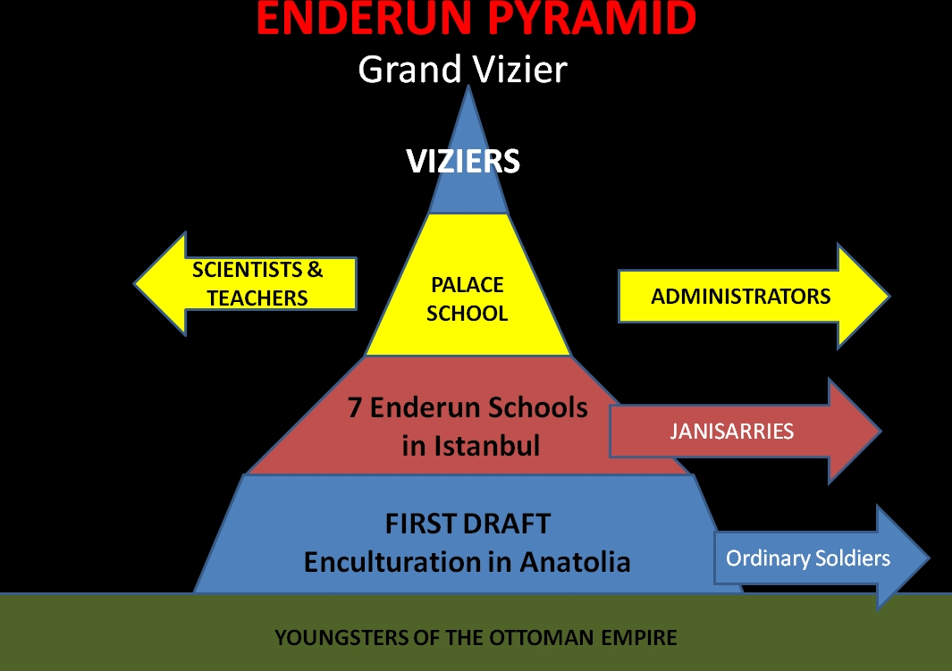

Slide 25
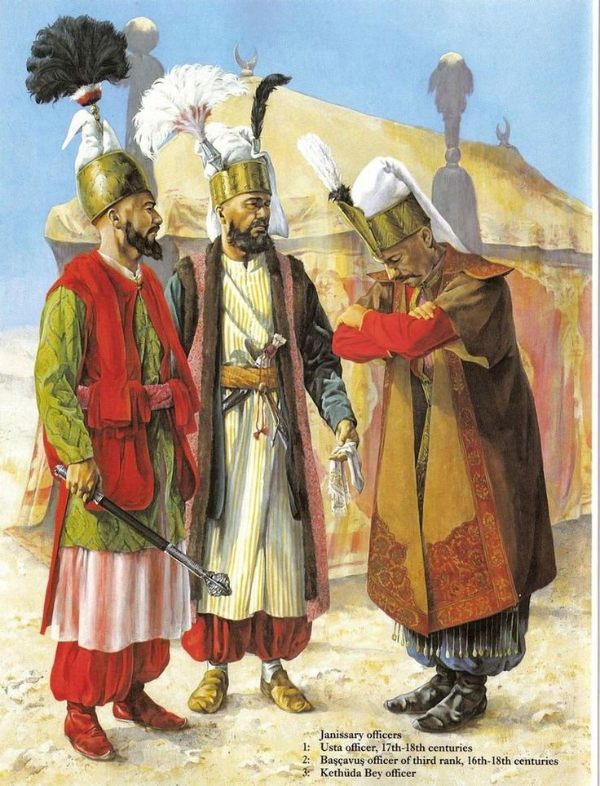
Three Branches of Ottoman Elites
Military:
Janissaries: max. 40,000, infantry & artillery
Sipahi: cavalry, timar holders
2. Civil service (high-ranking:
devshirme, middle-level:
free-born Muslims)

Slide 26
Religious establishment
The ulama and qadis (judges)
Shaykh al-Islam: chief religious dignitary of the empire
Sultan-caliph: religious and political leader of the empire.

Slide 27
The Millet System
Sultans organized their non-Muslim subjects into religious communities called millets.
Three [3] major non-Muslim religions/ confessions were granted millet status:
Greek-Orthodox Christianity
Judaism
Armenian Christianity

Slide 28
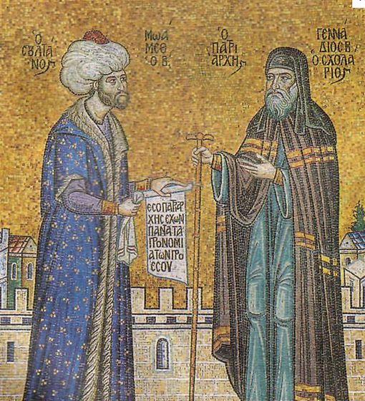
The Millet System
Permitted non-Muslims to retain their religious laws, educational systems, and communal leadership
Non-Muslims were still barred from military service; prevented from becoming members of the Ottoman ruling elite (unless converted)

Slide 30
Loss of Ottoman Superiority (economic & political; external & internal factors)
Ottoman system based on conquest & exploitation of conquered territories and peoples.
Once it stopped expanding, it entered the period of
decline. Turning point: 2nd Siege of Vienna 1683
Capitulations: Commercial treaties with European Powers meant to facilitate mutually beneficial ties but were largely exploited by European merchants (first France, 1536).

Slide 31
Loss of Ottoman Superiority (economic & political; external & internal factors)
Weakened Ottoman central government led to inability to fund and improve military
Losses to Austria and Russia after the 1690s:
Treaty of Karlowitz, 1699: Loss of Hungary to Austria; first main surrender of territory

Slide 32
- The Turks in the defensive – for the first time!
Treaty of Küchük Kaynarja (1774): Ended Russo-Turkish War (1768-1774)
Successive land and naval defeats of the Ottomans
Turks out of Crimea; out of Moldavia & Wallachia (Romania)
Orthodox Russia to “protect” Greek-Orthodox population of the Ottoman Empire

Slide 33
Greek ship-owners could rise Russian flag to their ships
and were allowed to build large ships:
Emergence of Greek merchant fleet used for economic
and later on for military purposes – during the Greek War of Independence (1821).
Economic benefits & acquired maritime experience.
Rise of a middle class with close connection to the
European political, economic and intellectual developments

Slide 35
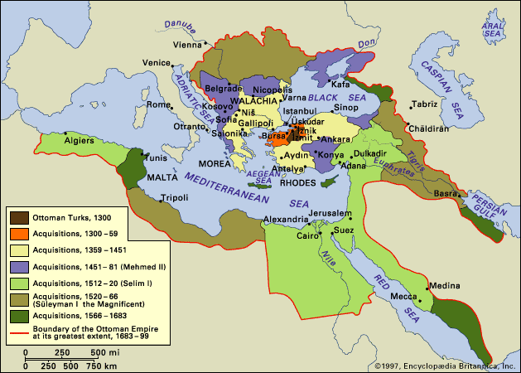
Loss of Ottoman Superiority (the changing nature of the Ottoman State)

Slide 36
Shah Isma‛il & the Rise of The Safavid Empire
Late 13th century: Safavid family member (Kurdish or Turkish origins) founds Sunni Sufi religious brotherhood in Azerbaijan.
Turkish followers (Qizilbash) known as Red-headed Ones.
Isma‛il (1494-1524) proclaims himself shah in 1501

Slide 37
Shah Isma‛il & the Rise of The Safavid Empire
Isma‛il declares Twelver Shi’ism official,
compulsory state religion
Dissolves Sunni brotherhoods;
executes those who refuse to accept Shi‛ism
Claims to be descended from the 7th Imam
Safavid empire in transition from tribal military regime to absolutist bureaucratic empire.

Slide 38
Shah Abbas I (1587-1629) & the End of the Safavid Empire
Shah Abbas reversed decline of Safavid Empire
Built up a standing royal army composed of ghulam (military slaves) [37,000 (Georgians & Circassians) cavalry & infantry with muskets, artillery]
Designated Isfahan as capital (400,000 population 1598)
Established centralized government, enabling the empire to survive another century after his death (1629)

Slide 39
Successive shahs failed to maintain the strength of the standing army
1722: Afghan rebels seized Isfahan
ending the Safavids
1794: Turkish chieftain, Fath Ali Shah, established the Qajar dynasty (until 1920s)

Slide 40
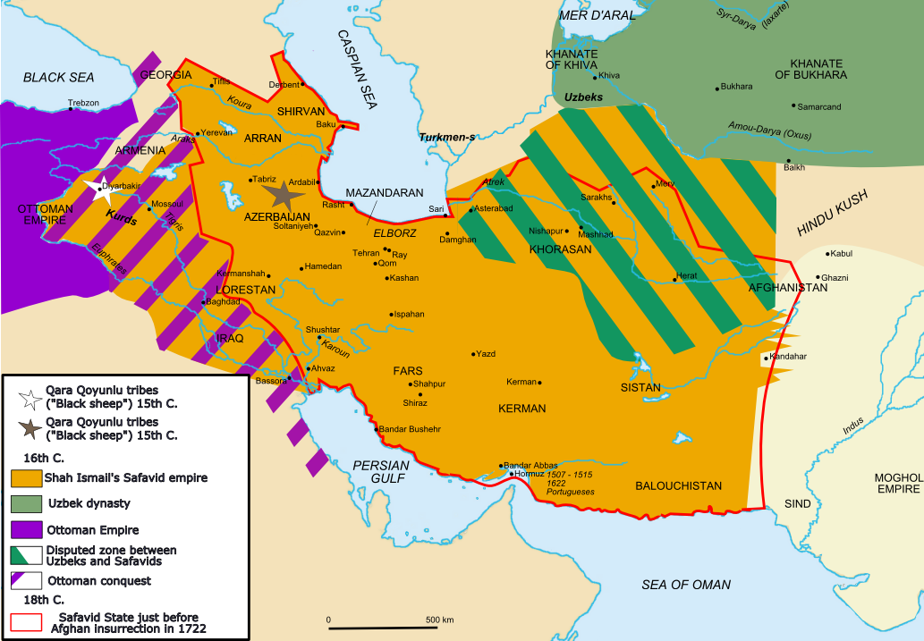
Concluding Remarks: Sunni- Shi‛a Struggle for Iraq
1508 to 1638: Ottoman-Safavid battle for Iraq
Both desired to control the Persian Gulf port of Basra & Baghdad
Iraq a symbolic contest between Sunni Ottomans and Shi‛a Safavids
For Ottomans, Baghdad was Abbasid capital & home of founders of universal Islam
For Safavids, Iraq home to sacred Shi‛a sites Najaf & Karbala
Current sectarian divisions were implanted that period of time

