Slide 1
GEOPOLITICS OF THE MIDDLE EAST AND TURKEY
Dr. ILIAS ILIOPOULOS
Dr. phil, Ludwig-Maximilian University of Munich
Ass. Prof., National University of Athens
Former Professor, Hellenic Naval War College
and American College of Greece

Slide 2
The Development of Islamic Civilization to the Eighteenth Century
Chapter 1-b:
The Rise and Expansion of Islam

Slide 3
Muhammad (570 AD –– 632 AD)
Muhammad ibn Abdullah (Abū al-Qāsim Muḥammad ibn ʿAbd Allāh ibn ʿAbd al-Muṭṭalib ibn Hāshim)
The founder of Islam and the proclaimer of the Qur’ān
Of the Quraysh tribe (Hashim clan), Mecca.
In his 20s, married wealthy businesswoman and widow, Khadijah (Islam’s first convert).
On a sojourn to Mount Hira, he was summoned to his prophetic mission (“the Night of Power”).
Notes:
Muhammad married for 3 main reasons: (1) Marrying the widow of a martyr to honor the family. (2) Marrying the daughter or other relative of a community leader to establish family ties with that community to avoid armed conflicts. (3) Marriage with a woman of a special status.

Slide 4
How do we know about him?
Quran (Recitation):
Core of Islamic faith
God’s commands & direct word
Language divine & unchangeable
Hadith compilations: records of traditions (sunnah) or sayings of Muhammad
Biographies: Ibn Ishaq − written 100 years after death of Muhammad

Slide 5
Muhammad’s Prophethood, 1st Phase: Mecca Period (610–622 AD)
Muhammad began receiving revelations at the age of 40.
Uncompromised Monotheism; Basic notions:
Islam: “Submission to the will of God (Allah)”
Muslim: “Those who have submitted to the will of God (Allah)”
Ummah: Community of the faithful to the laws prescribed by God

Slide 6
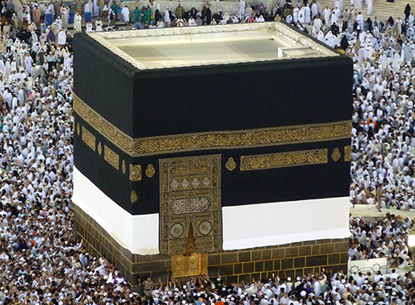
Muhammad’s Prophethood. 1st Phase: Mecca Period (610–622 AD)
Muhammad’s preaching threatened local tribal powers
Challenged Mecca culture of commercial wealth and tribal animist religious traditions
Ka‘ba was a focal point of Meccan religious & commercial life
Notes:
The Kaaba, pre-Islamic monument, rededicated by Muhammad in 631-32 AD, multiple renovations, granite masonry, covered with silk curtain and calligraphy in gold & silver-wrapped thread (Mecca, Saudi Arabia)

Slide 7
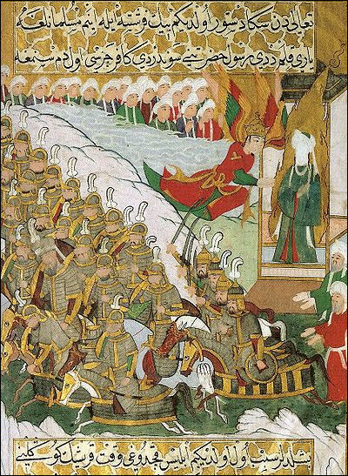
2nd Phase: Medina (Yathrib) Period (622-632 AD)
Tensions in Mecca push Muhammad & his followers to Medina — Hijrah (emigration) 1st year of Muslim calendar
Welcomed as a mediator among feuding tribes.
From a religious leader with few followers
to a statesman as well.
War against Mecca
(emerged victorious)

Slide 8
Muhammad’s Prophethood, 2nd Phase: Medina (Yathrib) Period (622-632 AD)
630: Muhammad led a force of 10,000 men to Mecca
and came to terms with Quraysh leadership.
Residents would retain their lives and property if they surrendered the city and accepted Islam.
Mecca remained a pilgrimage center – Ka ‘ba focal point of the new faith.
632: Death of Muhammad.

Slide 9
Issues with succession: The Rightly Guided Successors
Without clear doctrine on who will lead next, Muhammad’s death brings in-fighting
Four (4) Rightly Guided Successor (Rashidun Khalif)
Rashidun: Personal closeness to Muhammad
and adherence to the Quran
Khalif: Religious & Political Leadership
Abu Bakr Al-Siddiq (632-634 AD): Muhammad’s father-in-law / conquests: he unified the Arab tribes of the peninsula

Slide 10
Issues with succession: The Rightly Guided Successors
II. Umar Ibn Al-Khattab (634-644 AD):
Muhammad’s father-in-law / conquests:
Damascus (635),
Jerusalem (637),
Babylon (641),
Alexandria (642)
He introduced the Islamic calendar; state-building

Slide 11
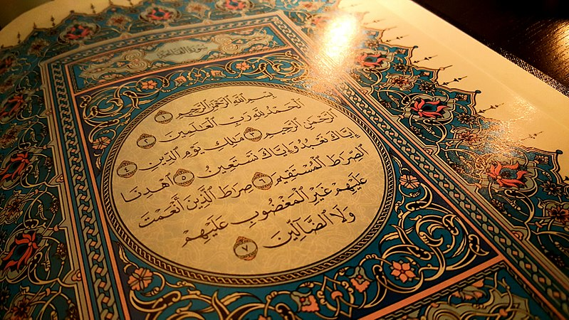
Issues with succession: The Rightly Guided Successors
III. Uthman Ibn Affan (644-656 AD):
Mohammad’s son-in-law / From the Umayyad family. Conquests:
Libya,
Cyprus,
Caucasus,
Iran,
Afghanistan
He established the Quranic text.
He was assassinated in a rebellion.
Surat al-Fatihah

Slide 12
Issues with succession: The Rightly Guided Successors
Ali Ibn Abi Talib (656-661 AD): Muhammad’s son-in-law (husband of Muhammad’s daughter Fatima) & cousin, early convert
Selected by the opponents of Uthman
Not recognized by the Umayyades
Mu’awiyah (Syria’s governor) claimed the Caliphate (657)
Ali’s capital: Kufa, Iraq; Assassinated by Kharijites; Hence: Dominance of the Umayyad Dynasty
Thus, a definite split in Islam between Sunni & Shia was created…

Slide 13
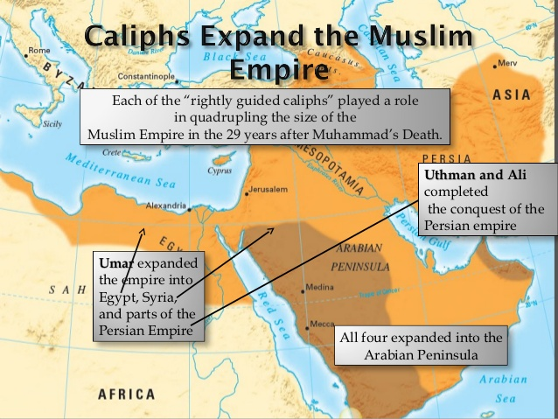

Slide 14
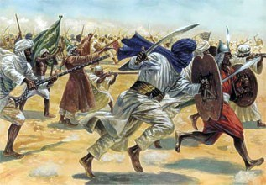
Issues with succession: The Rightly Guided Successors
636 a.D.: Battle of Yarmuk ended Greek-Christian [Byzantine] rule in Syria; 641 parts of Egypt
637: Battle of Qadisiyya led to collapse of the Sasanian [Persian] Empire
Notes:
BATTLE OF YARMOUK: Major Battle between the army of the Byzantine Empire and the Muslim Arab forces of the Rashidun Caliphate. The battle consisted of a series of engagements that lasted for six (6) days in August 636,
near the Yarmouk River, along what today are the borders of Syria–Jordan and Syria–Israel. The result was a complete Muslim victory which ended Byzantine rule in Syria. One of the most decisive battles in military history.
It marked the first great wave of Islamic conquests after the death of prophet Muhammad, heralding the rapid advance of Islam into the then Christian Levant.

Slide 15
Umayyad dynasty 661-750
Mu‛awiyah I (r. 661-680) founder
Transfers capital from Mecca to Damascus
Many Byzantine administrative practices adopted
Heroic age of conquests
Discontent between exclusively Arab elite and non-Arab converts culminates in revolution

Slide 16
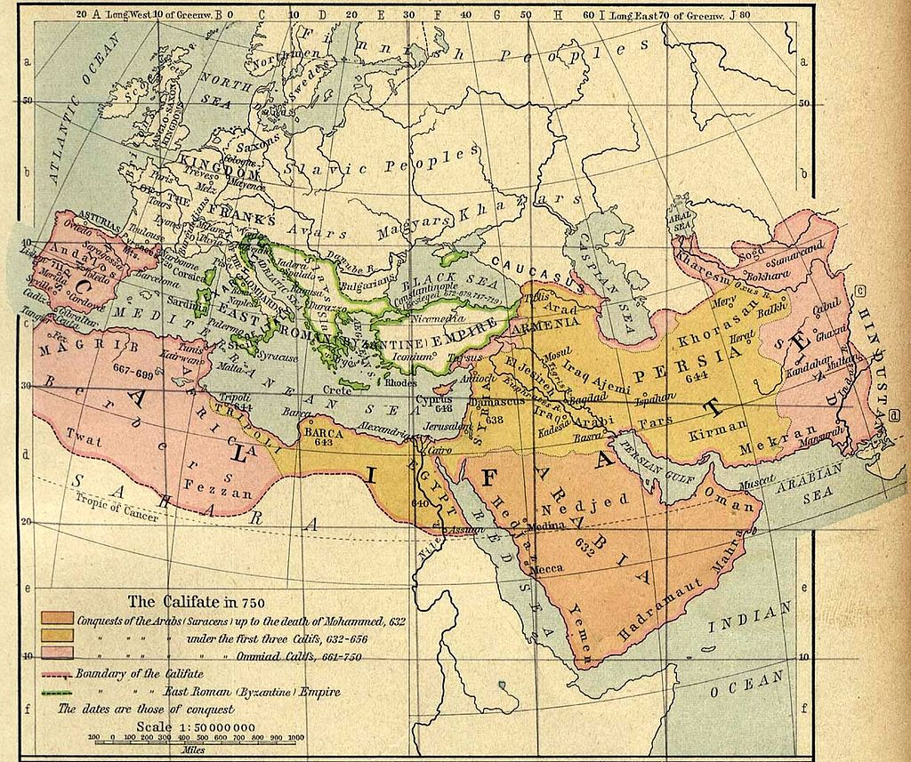
Umayyad dynasty 661-750

Slide 17
Durability of conquests: Heartlands of Christianity / Persia
Factors that facilitated it:
Monotheistic religions background
A degree of tolerance to non-Muslims [“People of the Book” - (dhimmis)]
Jews/Christians should be allowed to practice their religion
Manage their internal affairs
Not equal to the Muslims though: must pay special poll tax (jizyah) –
not serving to the army – wearing certain colors –
not so large places of worship]

Slide 18
But often: Less tax burden than those levied by
the Byzantines & the Sasanians
Mass conversions not encouraged, initially, since this would have led to
Loss of tax base
(exclusive Arab religion)

Slide 19
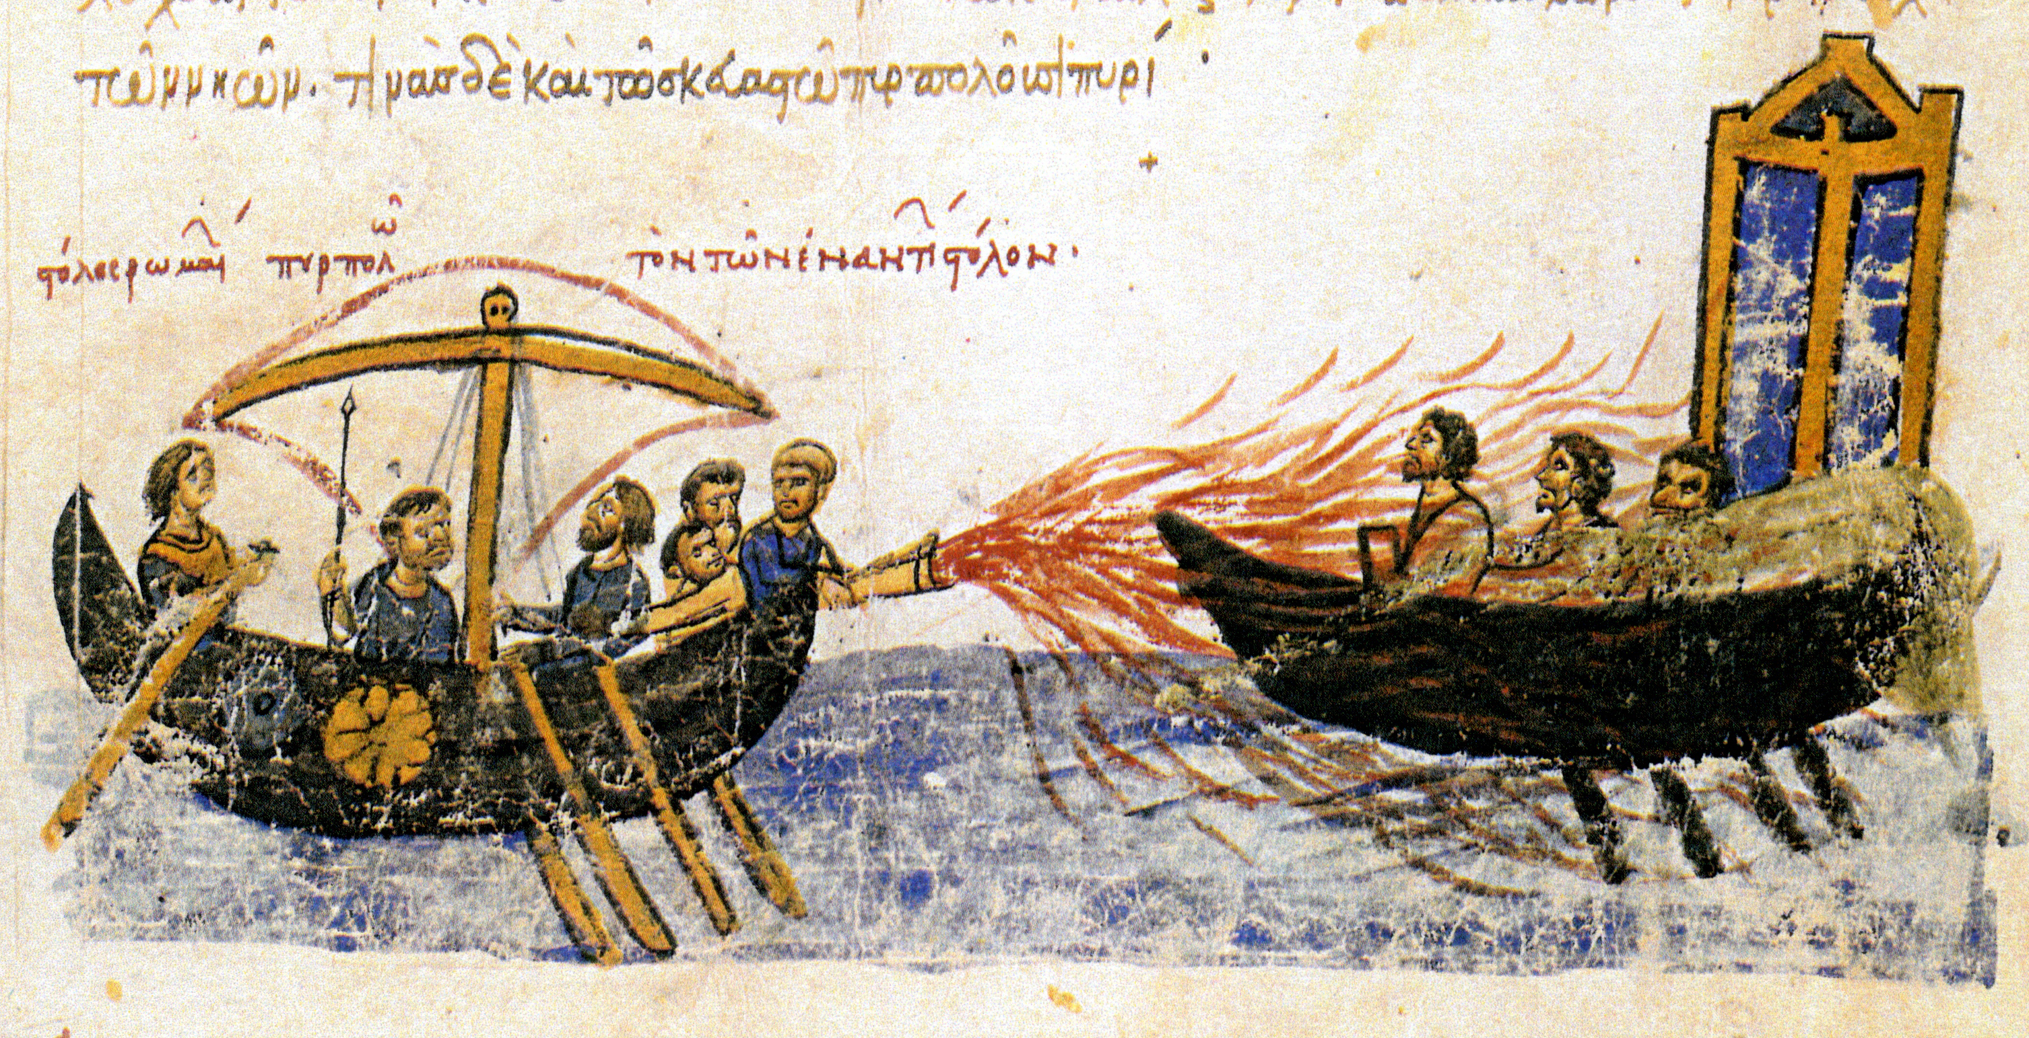
Umayyad dynasty 661-750 AD
674-678: 1st Arab Siege of Constantinople (Byzantine Emperor Constantine VI stops Arabs, consolidates a barrier)
717-718: 2nd Arab Siege of Constantinople (decisive victory of Emperor Leo III)
732: Battle of Poitiers (Charles Martel stops Arabs in France)

Slide 20
Abbasid Empire, 750–1258 AD
A marked contrast from Umayyads in its cosmopolitanism, openness / equality to non-Arabs
Moves capital to Baghdad (762, Caliph Al-Mansur)
Incorporates Sasanid practices
Employment of converted Iranians
Bureaucratic system
Absolutism; Caliph: “Shadow of God on Earth” (king and spiritual leader)

Slide 21
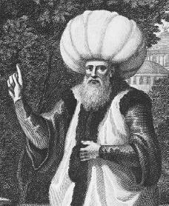
Abbasid Empire, 750–1258 AD
A time of political stability and flourishing culture, urban life, consolidation of heartland territories (period of the High Caliphate: 750-945)
Illustrious caliphs:
Al-Mansur (754-775)
Harun Al-Rashid [the Upright](786-809)
Al-Ma ‘mun (813-833)

Slide 22
Loss of North Africa in late 8th century.
Autonomous Islamic states

Slide 23
Concluding Remarks
Umayyads (Damascus): Heirs of Byzantium / exclusive identity / Arab superiority
Abbasids (Baghdad): Heirs of Persia / inclusive identity /
Equality of the members of the Ummah.

Slide 24
Concluding Remarks
Arabic language / Islam replaced – did not completely eliminate Greek/Christianity, Persian/Zoroastrianism, Aramaic/Judaism, in vast territories
A new civilization based on Muhammad’s mission as described in Quran emerged

