Slide 1
Operating Systems
-Concepts
-C++

Slide 3
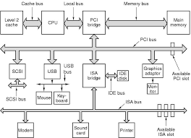
Peripheral Component Interconnect
Industry Standard Architecture
Intelligent Drive Electronics
Small Computer System Interface
Universal Serial Bus
Serial Advanced Technology Attachment
Redundant Array of Inexpensive Disks

Slide 5
Kernel Mode or Privileged Instructions
The instructions that can run only in Kernel Mode are called Privileged Instructions. They have the following characteristics: .
If any attempt is made to execute a Privileged Instruction in User Mode, then it will not be executed and treated as an illegal instruction. The Hardware traps it in the Operating System.
Before transferring the control to any User Program, it is the responsibility of the Operating System to ensure that the Timer is set to interrupt. Thus, if the timer interrupts then the Operating System regains the control. Thus, any instruction which can modify the contents of the Timer is a Privileged.
Privileged Instructions are used by the Operating System in order to achieve correct operation, such as:
I/O instructions and Halt instructions, Turn off the Interrupts,
Set the timer, Context Switching,
Clear the Memory or Remove a process from the Memory,
Modify entries in Device-status table

Slide 6
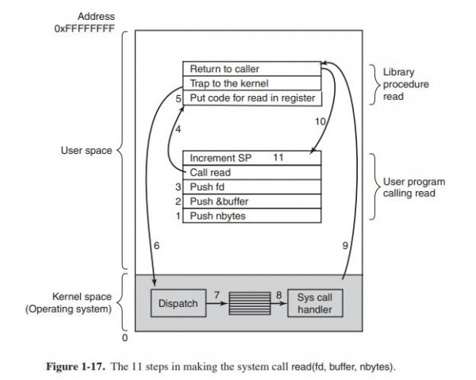

Slide 7
Types of Operating Systems
Mainframe
Server
Multiprocessor
Personal
Sensor-Node
Real-Time

