Slide 1
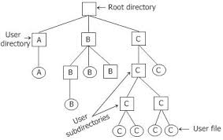
File(s) & Directories
Files are logical units of information created by processes
To keep track of files, file systems normally have directories or folders, which are themselves files. Hierarchical tree-based structures.

Slide 2
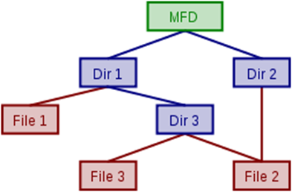
File names
Unique file name in each directory.
Pathname: the name of the file along with the path from the working directory, e.g. the file list1.c in the directory reisis/year3/computing2 has the unique pathname reisis/year3/computing2/list1.c in the entire reisis/ directory system (tree property).
Unique absolute (root/…/usr/reisis/…/list1) and consequently, relative from the working directory e.g. year3 (year3/…/list1) pathname for each file.
Shared files: use the link command to let a file have 2 path names. In this case we create a Directed Acyclic Graph (DAG).

Slide 3
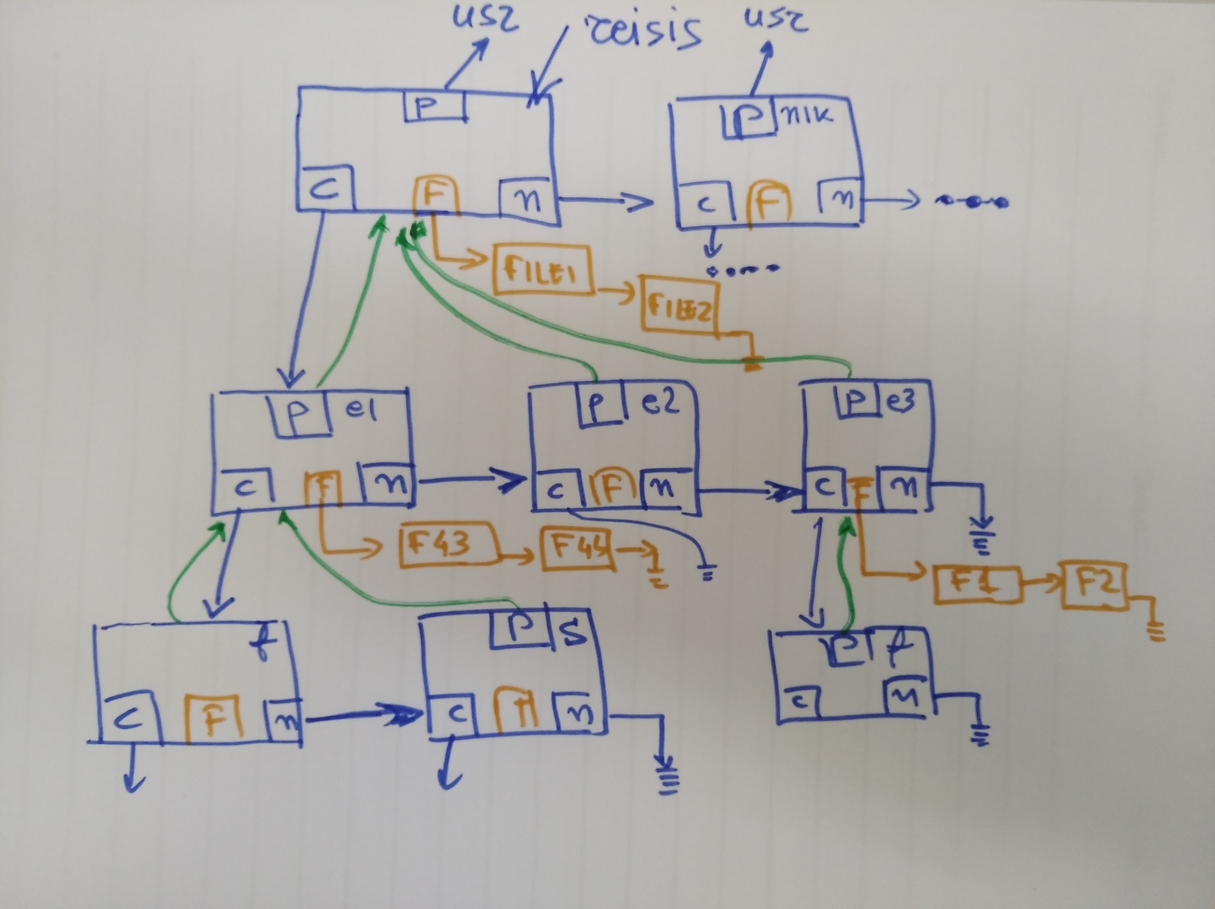

Slide 4
Reading & Writing into a file
There are two semaphores:
W protecting the file
S protecting the user_counter
Open file Close file
If read If read
begin begin
wait(S) wait(S)
increment(user_counter) decrement(user_counter)
if user_counter==1 wait(W) if user_counter==0 signal(W)
signal(S) signal(S)
end end
else wait(W) else signal(W)

