Slide 1
Athens University 16 May 2017 Private International Law Some reflections from the perspective of an English barrister
Alexander Layton QC

Slide 2
I. The United Kingdom
II. English law – Background
III. Trusts
IV. Jurisdiction – A jigsaw
V. Rome II
VI. Brexit

Slide 3
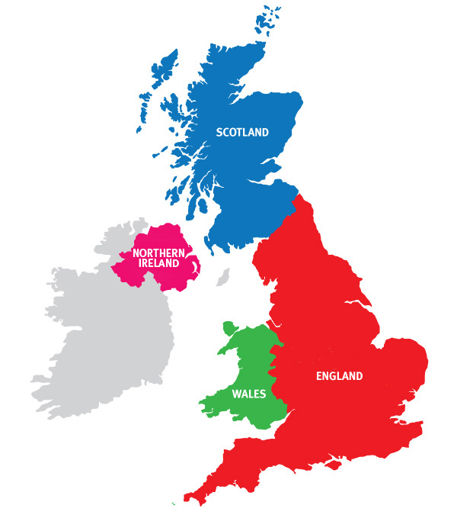
I. The United Kingdom
4 nations; 3 systems
England (& Wales)
Scotland
Northern Ireland
No (written) constitution

Slide 4
UK Parliament & Government make laws for whole country
But subject to devolved powers for other nations – Regional Assemblies
Scotland has separate (Roman-law influenced) legal system
Northern Ireland has separate legal system based on English law
English law applies in Wales

Slide 5
II. English law
European law
[ECHR]
Statute law
= Acts of Parliament; Statutory Instruments
Common law
Principles of Equity
Duallist sytsem: Treaties only part of domestic law if incorporated

Slide 6
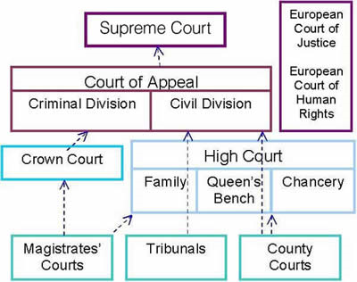
English Court system
Supreme Court for whole UK
Specialist sub-divisions of High Court
Commercial Court
Administrative Court
Patents Court

Slide 7
English Court system
13th Century – Three “Royal” courts / courts of common law
Common Pleas
King’s Bench
Exchequer
But possible to petition King in Council to review.
Developed into Court of Chancery, permanently established by end of 16th century
Courts of common law and equity merged in 1875

Slide 8
Equity mitigated harshness / rigidity of common law
Principles of Equity
'Equity regards as done what should have been done'
'Equity will not suffer a wrong to be without a remedy'
'Equity acts on the person'

Slide 9
III. Trusts
Developed from medieval land law.
If A wished to transfer land to B, he had first to surrender it to his feudal lord
Feudal lord legally owned the land
But Equity said that the feudal lord then held the land “to the use of” B.
B had an “equitable interest” in the land.

Slide 10
Settlor gives property to Trustee to hold on trust for the Beneficiary
Trustee has duty to account to beneficiary
Trust may be created
by statute
in writing
even orally
by operation of law: remedial and constructive trusts
Settlor
Trustee(s)
Beneficiary

Slide 11
Hague Convention on the Law Applicable to Trusts and to their Recognition – 1 July 1985
12 countries:
Australia
Canada
Cyprus
Italy
Leichtenstein
Luxembourg
Malta
Monaco
Netherlands
San Marino
Switzerland
United Kingdom

Slide 12
Hague Convention - Art 2:
For the purposes of this Convention, the term "trust" refers to the legal relationships created - inter vivos or on death - by a person, the settlor, when assets have been placed under the control of a trustee for the benefit of a beneficiary or for a specified purpose.
A trust has the following characteristics -
a) the assets constitute a separate fund and are not a part of the trustee's own estate; b) title to the trust assets stands in the name of the trustee or in the name of another person on behalf of the trustee; c) the trustee has the power and the duty, in respect of which he is accountable, to manage, employ or dispose of the assets in accordance with the terms of the trust and the special duties imposed upon him by law.
The reservation by the settlor of certain rights and powers, and the fact that the trustee may himself have rights as a beneficiary, are not necessarily inconsistent with the existence of a trust.

Slide 13
Contemporary uses of trusts:
To hold property for persons who cannot hold it themselves
To make financial provision for dependants
Wills and succession
Tax avoidance
To enable joint ownership of land
Facilitating investments (eg. unit trusts)
Charities

Slide 14
IV. Jurisdiction [Civil & commercial] – A Jigsaw Brussels I Recast [Brussels I bis]
Renvoi to national law:
1. Art 4. Actor sequitur forum rei
Art 62- domicile of individuals
2. Art 6.2 – Jurisdiction vs non-EU domiciliaries
3. Art 7.1 – Place of performance
4. Art 7.6 – Trusts
Art 63.3 – domicile of trusts
5. Art 25 – Jurisdiction agreements
6. Art 26 – Entry of an appearance
7. Art 35 – Provisional and protective measures

Slide 15
1. Art 4. Actor sequitur forum rei
Art 62 – Domicile of Individuals National law
English law very liberal
Civil Jurisdiction & Judgments Order 2001, Sch. 1, para. 9:
(2) An individual is domiciled in the United Kingdom if and only if—
(a) he is resident in the United Kingdom; and
(b) the nature and circumstances of his residence indicate that he has a substantial connection with the United Kingdom.
(6) In the case of an individual who—
(a) is resident in the United Kingdom, or in a particular part of the United Kingdom; and
(b) has been so resident for the last three months or more,
the requirements of sub-paragraph (2)(b) …shall be presumed to be fulfilled unless the contrary is proved

Slide 16
2. Art 6.2 – Jurisdiction vs non-EU domiciliaries
Service within the (territorial) jurisdiction (US: ‘tag’ jurisdiction).
Personal, post, etc
May be set aside if D can show that there is another country, to whose jurisdiction he is amenable, which is more appropriate (forum non conveniens)
(includes transitory presence = exorbitant – see Arts 5.2 & 6.2)
Service out of the jurisdiction
Gateways [CPR PD 6B para. 3]
paradigm
England is ‘the proper place to bring the claim’ (forum conveniens).’

Slide 17
3. Art 7.1(a) – Place of performance of the obligation in question
Tessili v Dunlop AG National law
1. Agreement, express or implied
2. Debtor seeks out creditor
3. Exceptions (eg, bank accounts)

Slide 18
4. Art 7.6 – Trusts
A person domiciled in a Member State may be sued in another Member State: …
(6) as regards a dispute brought against a settlor, trustee or beneficiary of a trust created by the operation of a statute, or by a written instrument, or created orally and evidenced in writing, in the courts of the Member State in which the trust is domiciled;

Slide 19
4. Art 7.6 – Trusts
Art 63.3 – domicile of trusts national PIL
CJJO 2001, Sch. 1, para 12
12.— Domicile of trusts (section 45)
…
(3) A trust is domiciled in a part of the United Kingdom if and only if the system of law of that part is the system of law with which the trust has its closest and most real connection.

Slide 20
5. Art 25 – Jurisdiction agreements
25.1 - If the parties, regardless of their domicile, have agreed that a court or the courts of a Member State are to have jurisdiction to settle any disputes which have arisen or which may arise in connection with a particular legal relationship, that court or those courts shall have jurisdiction, unless the agreement is null and void as to its substantive validity under the law of that Member State.
Includes PIL rules (!) – Recital 20
Where a question arises as to whether a choice-of-court agreement in favour of a court or the courts of a Member State is null and void as to its substantive validity, that question should be decided in accordance with the law of the Member State of the court or courts designated in the agreement, including the conflict-of- laws rules of that Member State.

Slide 21
Null and void
Conflict of law rules – NOT Rome I [Art 1.2(e)]
1. Express choice
2. Implies choice
3. Closest and most real connection
Substantive law
Eg: void for mistake as to identity
ultra vires
voidable for lack of capacity
etc.

Slide 22
6. Art 26 – Entry of an appearance
Apart from jurisdiction derived from other provisions of this Regulation, a court of a Member State before which a defendant enters an appearance shall have jurisdiction. This rule shall not apply where appearance was entered to contest the jurisdiction, or where another court has exclusive jurisdiction by virtue of Article 24.
Elefanten Schuh GmbH v Jacqmain
Challenge not preliminary to any defence

Slide 23
Entry of appearance and challenge to jurisdiction
Defendant has time within which to file an Acknowledgment of Service
May indicate challenge to jurisdiction
Issue an application
If unsuccesful, Acknowledgment of Service ceases to have effect, BUT
Filing a further Acknowledgment of Service is deemed submission to the jurisdiction

Slide 24
7. Art 35 – Provisional and protective measures
Application may be made to the courts of a Member State for such provisional, including protective, measures as may be available under the law of that Member State, even if the courts of another Member State have jurisdiction as to the substance of the matter.
National rules of jurisdiction, including exorbitant rules
National measures

Slide 25
7. Art 35 – Provisional and protective measures
Application may be made to the courts of a Member State for such provisional, including protective, measures as may be available under the law of that Member State, even if the courts of another Member State have jurisdiction as to the substance of the matter.
National rules of jurisdiction, including exorbitant rules
National measures
‘Freezing’ orders
‘Search’ orders
Interim payments
Provisional damages

Slide 26
V. Rome II – Non-contractual obligations
Art 4:
4.1 – Lex loci damni
4.2 – Displacement - Common habitual residence
4.3 – Escape clause: “… manifestly more closely connected with a country other than that indicated in paragraphs 1 or 2…”
Can 4.3 lead back to lex loci damni if parties share habitual residence?

Slide 27
Art 15(c). Applicable law governs “the existence, the nature and the assessment of damage or the remedy claimed”
Contrast English law, where assessment of damage is categorised as procedural and hance governed by the lex fori.

Slide 28
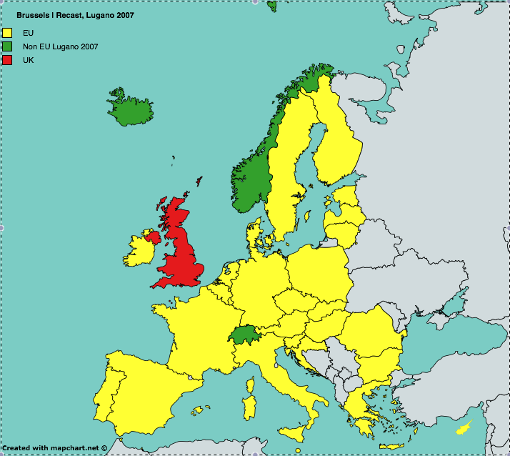
VI. BREXIT Brussels I Recast, Lugano 2007

Slide 29
1. Replacement of Brussels I Recast?
Revival of Brussels Convention of 1968 (with Accession Conventions up to 1996)?
Revival of Lugano Convention 1988?
Continuation of Lugano Convention 2007?
Special agreement on Danish model?

Slide 30
(a) Revival of Brussels Convention (and accession conventions)?
Article 68(1) Brussels I and Brussels Ibis Regulations
This Regulation shall, as between the Member States, supersede the 1968 Brussels Convention, except as regards the territories of the Member States which fall within the territorial scope of that Convention and which are excluded from this Regulation pursuant to Article 355 of the TFEU.
Termination or suspension?
If “revival” possible: withdrawal because of fundamental change of circumstances? Vienna Convention on the Law of Treaties, Art 62

Slide 31
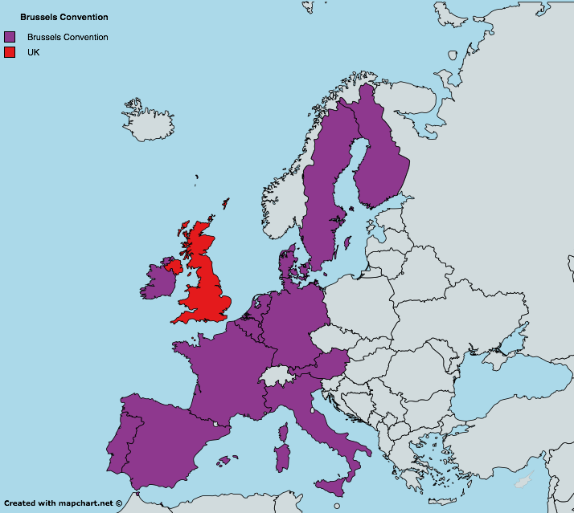
Would this be a good thing?
– Not really, but better than nothing
Limited territorial scope & return to outdated rules
Original 6: Belgium, France, Italy
Germany, Luxembourg,
Netherlands
1978: Denmark, Ireland
UK
1982: Greece
1988: Portugal, Spain
1996: Austria, Finland, Sweden

Slide 32
(b) Revival of Lugano Convention 1988?
Will this happen? – Probably not
Article 69(6) Lugano Convention 2007
Without prejudice to Article 3(3) of Protocol 2, this Convention shall replace the Convention on jurisdiction and the enforcement of judgments in civil and commercial matters done at Lugano on 16 September 1988 as of the date of its entry into force in accordance with paragraphs 4 and 5 above.
Would this be a good thing?
– Not really, but better than (a) nothing and (b) revival of Brussels Convention

Slide 33
(c) Continuation of Lugano Convention 2007?
Will this happen? – A realistic possibility
No automatic status of UK as contracting party after Brexit
Article 70 Lugano Convention 2007
After entering into force this Convention shall be open for accession by:
(a) the States which, after the opening of this Convention for signature, become Members of the European Free Trade Association, under the conditions laid down in Article 71;
[…]
(c) any other State, under the conditions laid down in Article 72.
Possibility of accession under (c): requires unanimous agreement of other Contracting Parties (EU, Denmark, Iceland, Norway, Switzerland)
But non-membership of Internal Market?

Slide 34
(c) Continuation of Lugano Convention 2007?
Would this be a good thing?
– Hmmm. Better than
(a) nothing,
(b) revival of Brussels Convention, or
(c) revival of Lugano 1988
Same territorial scope as at present
but
Differences from Brussels I Recast:
no qualification of priority rule
no recital 12 re arbitration

Slide 35
(d) Special agreement on Danish model?
Best option
Applies Brussels I (Reg 44/2001)
Confers jurisdiction on CJEU for interpretative rulings
Adapt to Lugano 2007, Protocol II model
- “pay due account to the principles laid down by any relevant decision concerning the provisions concerned …”
- Entitlement to submit “statements of case or written observations”
Preferred option by Bar Council Brexit Working Group
Will it happen? – Who knows?
Non-membership of Internal Market?

Slide 36
2. What if there is no agreement?
Jurisdiction
Extension of CPR 6.36 & PD6B para. 3.1
Service out
Discretion (“England & Wales if the proper place…”)CPR 6.37(3)
Forum non conveniens
Anti-suit injunctions

Slide 37
(b) Recognition & Enforcement of European judgments
Revival of UK’s old bilateral conventions?
Foreign Judgments (Reciprocal Enforcement) Act 1933
Gives effect to bilateral conventions
Process of registration on application; may be set aside if grounds for non-recognition apply
CPR Part 74
Common law action on a judgment

Slide 38
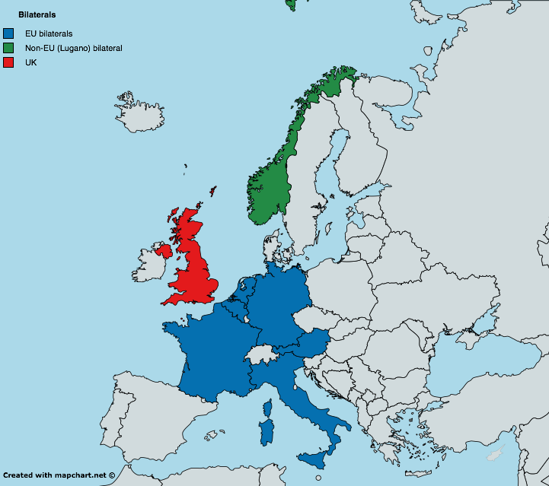
Revival of UK’s old bilateral conventions?
Pre-Brussels conventions “for the reciprocal [recognition and]enforcement of judgments in civil and commercial matters”:
France, Paris, 18 January 1934
Belgium, Brussels, 2 May 1934
Germany, Bonn, 14 July 1960
Norway, London, 12 June 1961
Austria, Vienna, 14 July 1961
(amended, London, 6 March 1970)
Italy, Rome 7 February 1964,
(amended, Rome, 14 July 1970)
Netherlands, The Hague, 17 November 1967

Slide 39
Will this happen? – Probably
Article 69, Brussels Ibis Regulation
Subject to Articles 70 and 71, this Regulation shall, as between the Member States, supersede the conventions that cover the same matters as those to which this Regulation applies. In particular, the conventions included in the list established by the Commission pursuant to point (c) of Article 76(1) and Article 76(2) shall be superseded.
Article 70, Brussels Ibis Regulation
1. The conventions referred to in Article 69 shall continue to have effect in relation to matters to which this Regulation does not apply.
2. They shall continue to have effect in respect of judgments given, authentic instruments formally drawn up or registered and court settlements approved or concluded before the date of entry into force of Regulation (EC) No 44/2001.

Slide 40
Is this a good thing? – Not really
Only judgments of superior courts
Only civil and commercial matters
Indirect rules of jurisdiction (presence and submission)
Refusal of recognition of default judgments without sufficient actual notice to D
Refusal on grounds of public policy (including conflicting judgments), fraud or immunity
No refusal on choice of law grounds

Slide 41
Common law action “on the judgment”
Doctrine of ‘obligation’
Review of jurisdiction of court of origin: presence or submission
Bases of refusal – fraud, public policy, immunity

Slide 42
(c) Recognition & Enforcement of UK judgments in other European states
Under old bilateral conventions
Variety of approaches
Review of jurisdiction on basis of national law
Other requirements/grounds for refusal
Often cumbersome (or no) procedures
Difficulty to obtain information, legal uncertainty

Slide 43
3. Other options
(a) Hague Choice of Court Convention
Double convention
Arts 1 & 2 - Scope
Civil & commercial
Business to business
Excludes “arbitration and related proceedings”; and
Carriage
Competition
Rights in rem in immovable property
Torts for damage to tangible property not arising from contractual relatiuonship
Validity nullity or dissolution of legal persons, or validity of decisions of their organs
Validity of IP rights (other than copyright and related rights) – except for breach of contract
Etc.

Slide 44
Art 5 – Jurisdiction of chosen court
Exception for agreement which is null and void under the law of the (purportedly) chosen state
No forum non conveniens
Art 6 – Obligation of other courts to suspend or dismiss proceedings, unless they are within a list of exceptions
Art 8 – Recognition and enforcement
except as permitted by this Convention
Short list of exceptions, roughly equivalent to Brussels I Recast

Slide 45
(b) Arbitration
Good idea!
New York Convention 1958 – 150+ parties
But
only partial solution – unlikely in tort cases, multi-party cases, etc.
confidentiality and legal development concerns

Slide 46
Thank You.

