Slide 1
GEOPOLITICS OF
THE MIDDLE EAST AND TURKEY
Dr. ILIAS ILIOPOULOS
Dr. phil, Ludwig-Maximilian University of Munich
Ass. Prof., National University of Athens
Former Prof., Hellenic Naval War College & American College of Greece

Slide 2
The First World War and
the End of the Ottoman Empire

Slide 3
WWI and the Ottoman Empire
The Ottoman Empire joined the Central Powers against the Entente Cordiale
1914: German General Liman von Sanders arrives

Slide 4
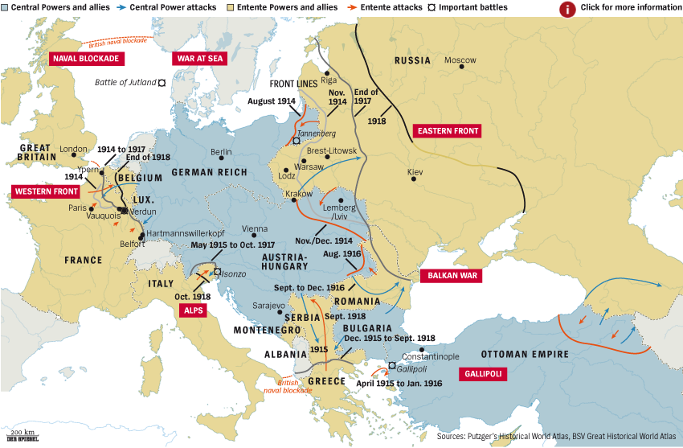

Slide 5
The German Battleships that became… Ottoman

Slide 6
Ottoman Campaigns in WWI
1914-1917: Ottoman and Russian armies engaged in warfare in eastern Anatolia and the Caucasus region
1915, Armenian Genocide: On the grounds that Armenians were collaborating with the Russians, Young Turks (CUP) ordered collective reprisals against the entire Armenian population
1915-1916, The Gallipoli campaign: Ottomans successful against British-led Allied offensive, bringing Mustafa Kemal to military fame

Slide 7
The Armenian Genocide, 1915: ca. 1,5 million civilians

Slide 8
The Armenian Genocide, 1915: Over 1,5 million civilians

Slide 9
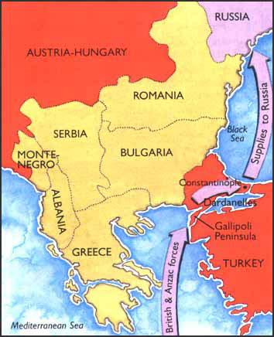
1915-1916, The Gallipoli campaign:

Slide 10
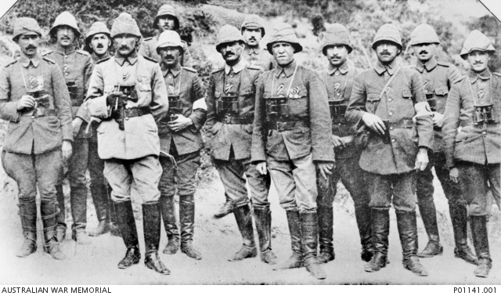
1915-1916, The Gallipoli campaign:

Slide 11
1914–1917: British and Ottoman forces battle back and forth on Mesopotamian front. Britain captures Baghdad and takes over Southern Iraq
1915: Jamal Pasha strike against Suez Canal
1917–1918: British build up troops in Egypt and attack Turks in Palestine; Arab Revolt captures Damascus and the French take over Beirut
Oct. 31, 1918: Ottomans sign Armistice of Mudros

Slide 12
The War in the Middle East

Slide 13
WWI resulted in partial division of
the Ottoman Empire and
the occupation of its Arab provinces
by Britain and France.

Slide 14
Wartime Administration in Greater Syria
The Sultan-Caliph issued a call of jihad, urging all Muslims to unite behind the Ottoman Empire
in its confrontation against Britain, France, and Russia
Young Turkish [CUP] government suspicious about loyalties of Arab population of Greater Syria
To ensure stability & loyalty of Arabs, CUP placed Greater Syria under direct supervision of Jamal Pasha

Slide 15
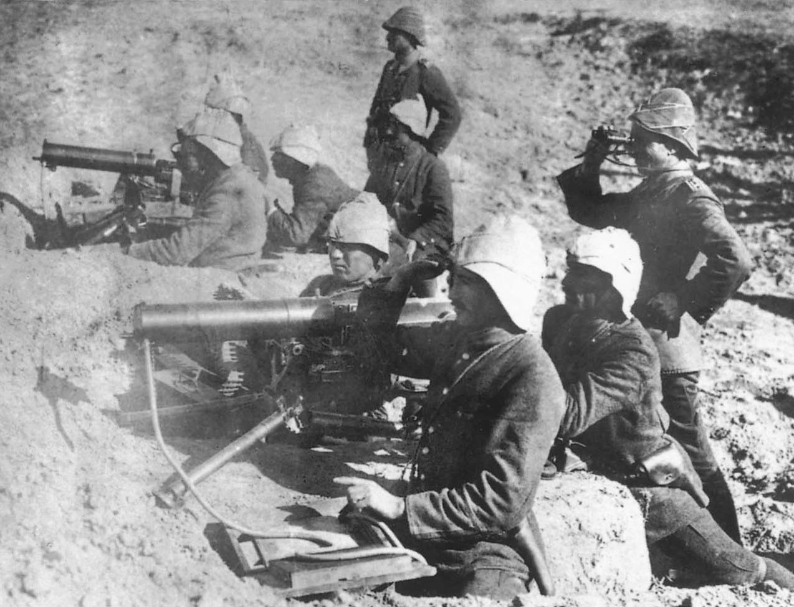
The Ottoman Army in 1917
The product of a century of reform efforts, the sultan’s military enjoyed significant successes at Gallipoli, Kut, and the eastern front during World War I. (Trustees of the Imperial War Museum, London)

Slide 16
Jamal Pasha’s Greater Syria
Jamal Pasha was committed to Islamic solidarity
Known as the Blood Shedder among locals, he became increasingly repressive towards those he believed were in contact with Britain or France
Jamal imprisoned Arab notables, charged them with treason, and publicly hanged over 30 people
His policies aroused intense anti-CUP sentiment, but he was still able to quell any uprising in Greater Syria

Slide 17
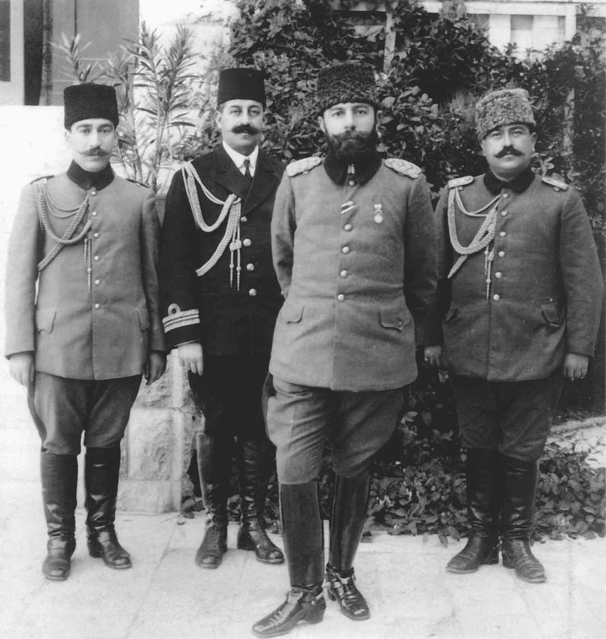
Jamal Pasha, one of the CUP ruling triumvirs, and members of his staff.
As the Ottoman governor of Syria during World War I, Jamal became known in some circles as the Blood Shedder for his acts of repression against the Arab population. (Trustees of the Imperial War Museum, London)

Slide 18
The “Husayn-McMahon Correspondence” (10 Letters, July 1915 – March 1916)
Amir Sharif Husayn ibn Ali: Guardian of Mecca & Medina, the most prestigious Arab-Islamic position
Ottoman (Young Turkish) government pressed him to declare his support to the caliph’s jihad and gather the Arab tribes around the Ottoman army

Slide 19
July 1915: Husayn sent a letter to Henry McMahon (British High Commissioner to Egypt) to discuss conditions for an alliance with Britain and to launch a revolt against the Turks
-Husayn requested recognition of an independent Arab state in exchange for leading rebellion against the Turks with its frontiers including the Arab lands east of Egypt: Arabian Peninsula & Greater Syria (Syria, Lebanon, Palestine, parts of Iraq)

Slide 20
McMahon eventually accepted Husayn’s territorial demands, subject to further negotiations
But he informed Husayn that the area lying west of
a line from Damascus-Homs-Hama-Aleppo
could NOT be included since “it is not inhabited by
Arabs only”
Husayn made clear that he would not abandon
the claim for the Syrian coast line after the war

Slide 21
Mc Mahon tried to secure a special British position to the provinces of Baghdad & Basra: Husayn gave his consent to a temporary British occupation until a stable administration would be stablished
McMahon: “Great Britain is prepared to recognize and uphold the independence of the Arabs in all the regions lying within the frontiers by the Sharif of Mecca”
Supply the Arabs for the revolution / recognize an Arab Caliphate once proclaimed

Slide 22
British language was “ambiguous” & vogue regarding Palestine (NOT specifically mentioned)
Husayn’s proclamation attacked the Young Turkish CUP (“atheists ignoring the Quran”)
and NOT the Caliph who was a “hostage” of
the CUP government

Slide 23
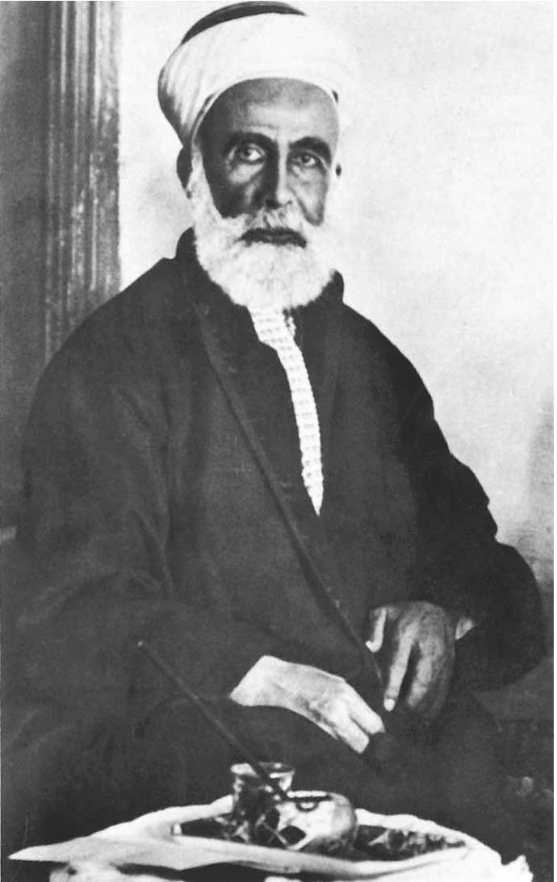
Sharif Husayn ibn Ali, the Amir of Mecca.
He proclaimed the Arab Revolt in 1916, and in return, Sharif Husayn expected the Allies to recognize him as the king of an Arab independent state once the war ended.
(Trustees of the Imperial War Museum)

Slide 24
The Arab Revolt (1916-1918)
June 10, 1916: the Arab Revolt began when Husayn’s tribal forces attacked the Turkish garrison at Mecca
Husayn justified revolt through Islamic solidarity
Many Arab public figures accused Husayn of being a traitor, and Husayn failed to generate broad support
The revolt relied upon tribal support and was dominated by the Hashimite family

Slide 25
The Arab Revolt (1916-1918)
Husayn’s tribal forces were commanded by his son, Amir Faysal, assisted by a contingent of British military advisors
The revolt did manage the capture of Damascus in 1918, which laid the foundations for the Arabs’ claim to an independent state

Slide 26
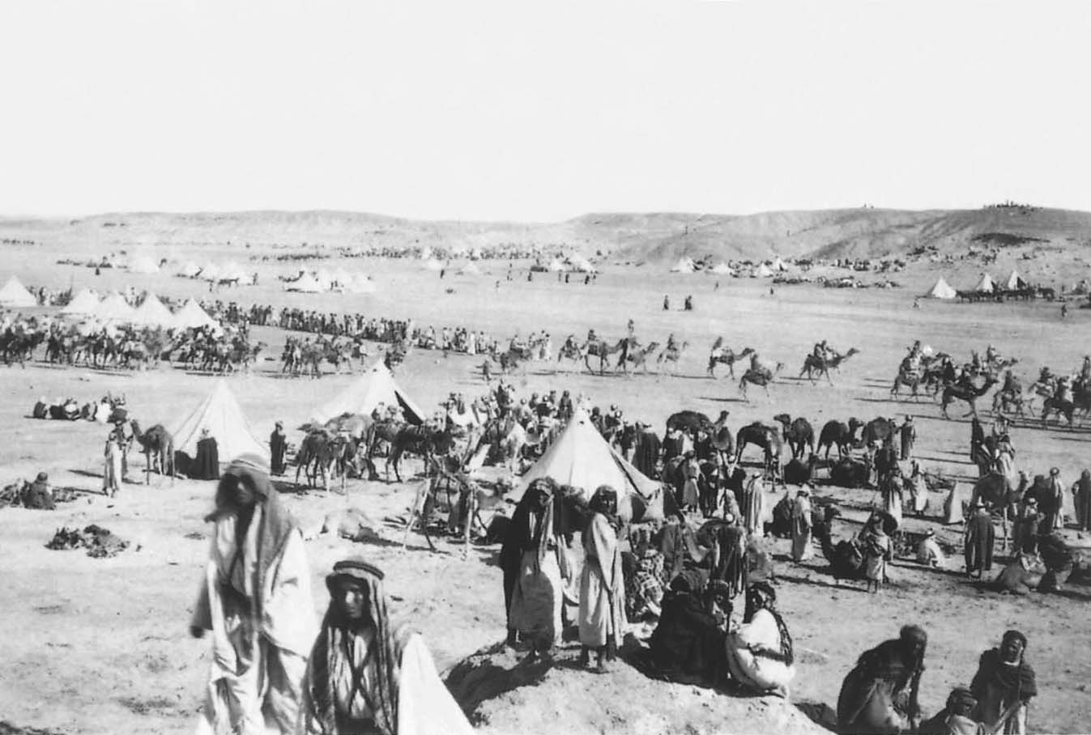
The “army” of the Arab Revolt at Wejh, Arabia, 1917
It was composed mainly of irregular tribal forces. (Trustees of the Imperial War Museum)

Slide 27
Amyr Faysal & T.E. Lawrence (1888-1935)

Slide 28
Allied Plans for the Ottoman Empire
Constantinople Agreement (1915):
In order to keep Russia in the war
(failures in the front with Germans & Ottomans)
Tsar Nicholas II was promised Constantinople
and the Straits of Bosphorus and the Dardanelles

Slide 29
Sykes-Picot Agreement (1916): A secret treaty that divided up most of the Arab Middle East between France and Britain, contradicting promises made to Sharif Husayn
It awarded France a large zone of “direct control” along the Syrian coast
It guaranteed Britain’s own “direct control” over portions of Mesopotamia (Iraq)

Slide 30
The Balfour Declaration (1917):
Britain agreed to favor the establishment of a
Jewish homeland in Palestine
Done to appeal to the Jewish community and to
secure control over territory adjacent to Suez Canal
When WWI ended, most Ottoman territory had been pledged to one or another of the Allies

Slide 31
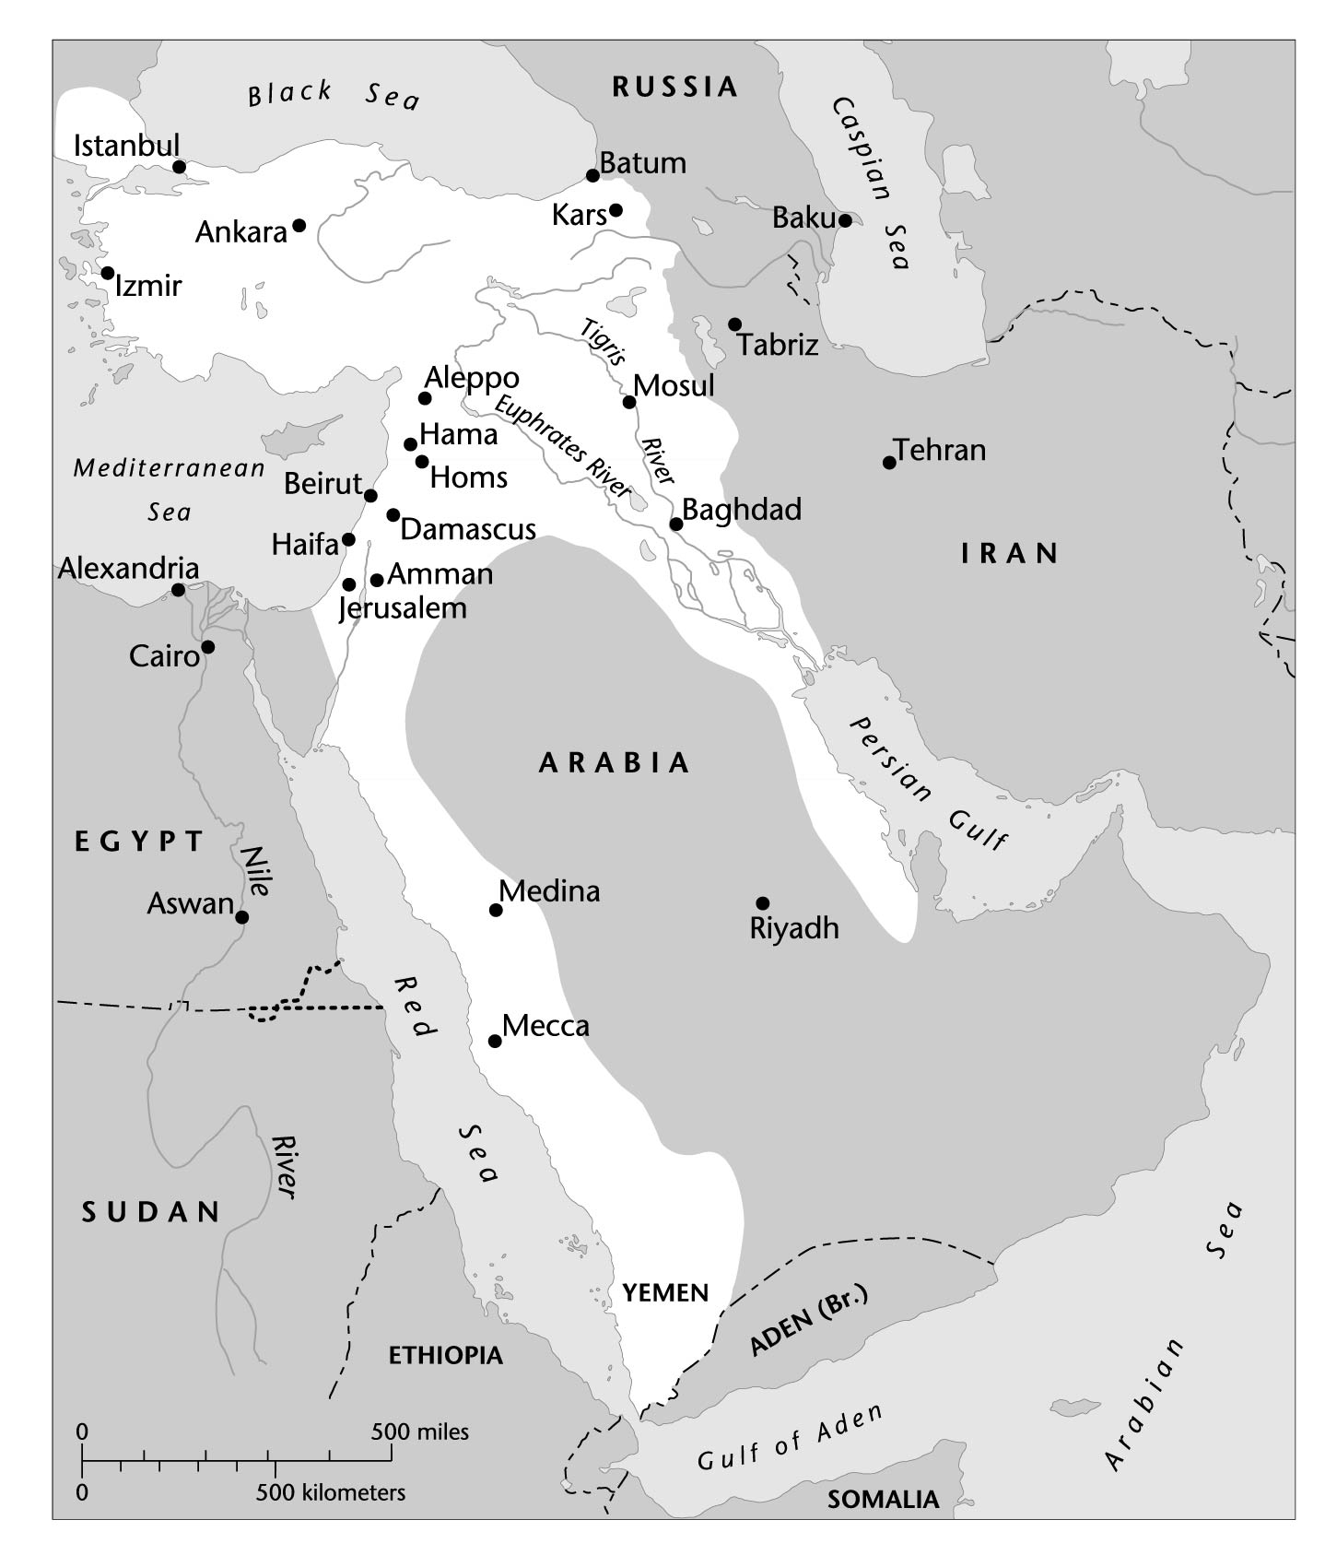
The Ottoman Empire in 1914

Slide 32
Allied Plans for the Ottoman Empire: T.E. Lawrence proposal (Nov. 1918)

Slide 33
Allied Plans for the Ottoman Empire: Sykes-Picot Agreement, 9 May 1916

Slide 34
The Peace Settlement
San Remo Conference (April 1920):
Terms of an Ottoman settlement were finally agreed upon and incorporated into the Treaty of Sèvres (August 10, 1920)

Slide 35
The Peace Settlement
Decisions made at San Remo detached the Arab provinces from Ottoman authority and apportioned them between Britain and France
The former Arab provinces were divided into entities called mandates
Britain got mandates for Iraq, Palestine and Transjordan
France got mandate for Syria and the Lebanon

Slide 36
From the Arab perspective,
the British pledges to Husayn
had been sacrificed
for Allied harmony and imperial interest

Slide 37
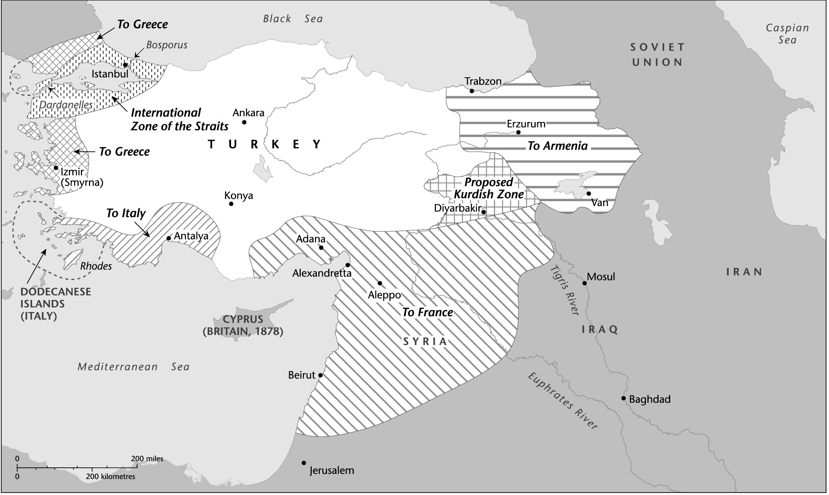
Division of former Ottoman territories under the Treaty of Sèvres, 1920

Slide 38
Faysal’s Syrian Kingdom (1918-1920)
1920: Syria proclaimed an independent state with Faysal as the King.
France saw declaration of Syrian independence as an usurpation of French claims to the region

Slide 39
July 24, 1920, the French defeated Faysal’s army, occupied Damascus, and forced Faysal into exile in Europe.
Sharif Husayn’s brother, Amir Abdallah, was integrated into Britain’s informal imperial network
Transjordan was created in 1921, with Abdallah as King

Slide 40
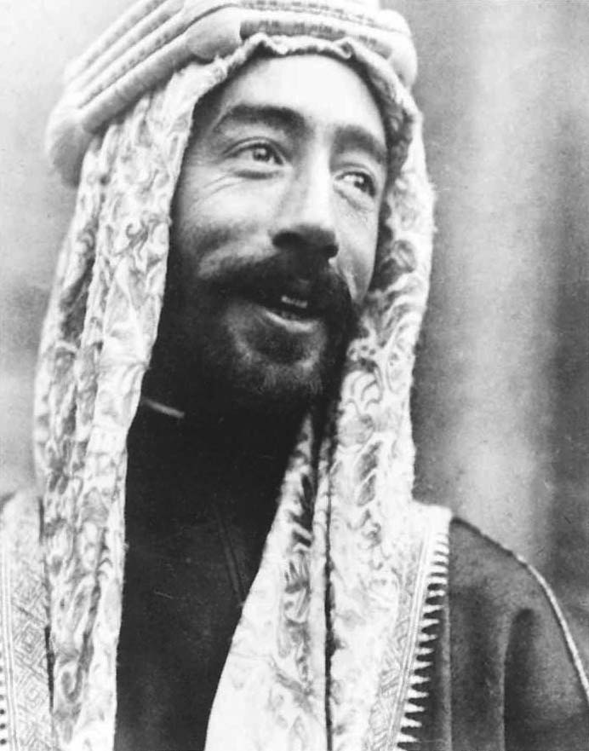
Amir Faysal
Amir Faysal, field commander of the Arab Revolt and later king of Syria. He was exiled after the defeat of his Syrian forces by the French in 1920. He was then selected by the British to become the first king of Iraq. (The Trustees of the Imperial War Museum, London)

Slide 41
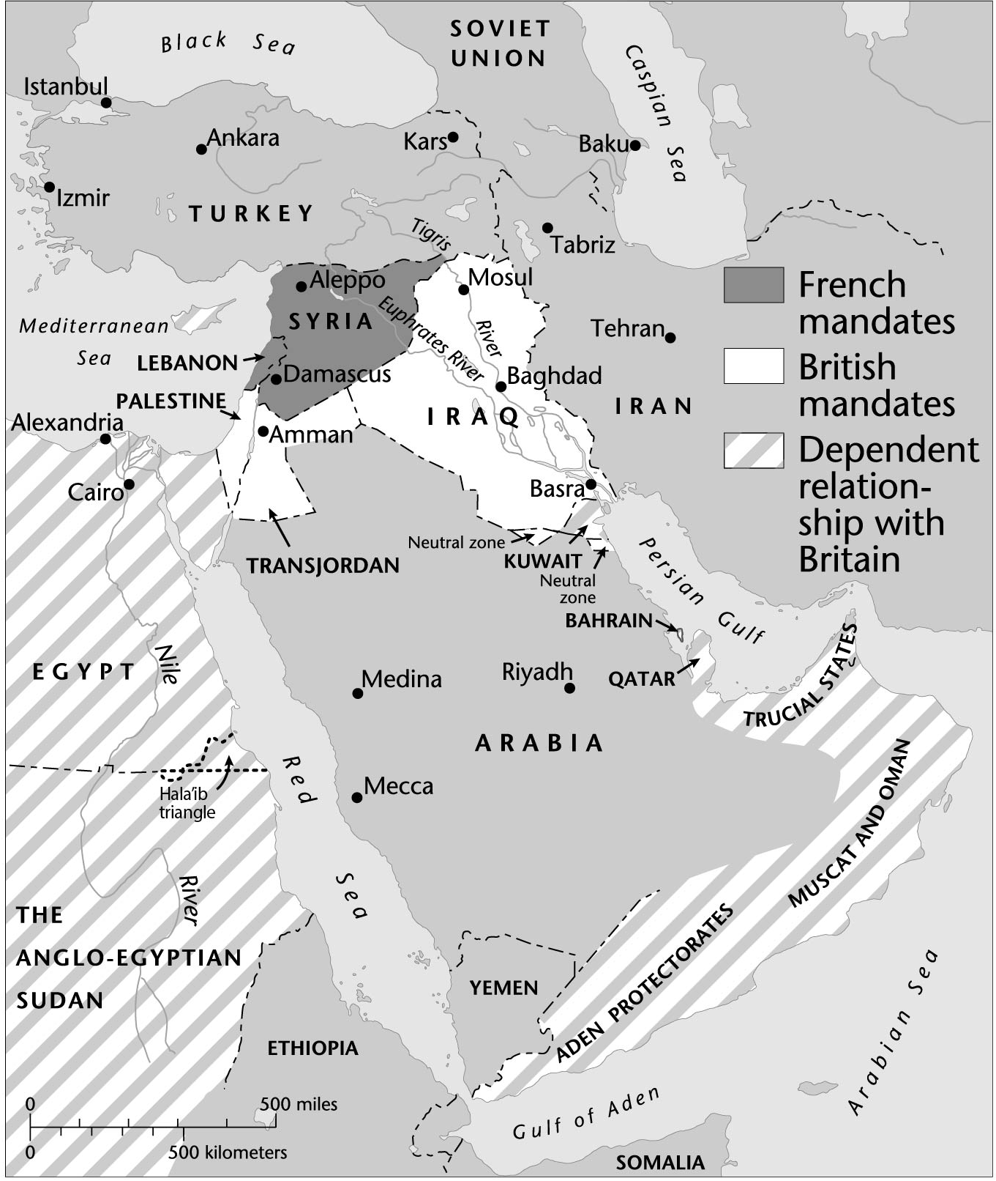
The Middle East in the Interwar Period

Slide 42
The End of Ottoman Order in the Middle East
For Arabs in the Ottoman territories, the dismemberment of the empire marked the end of a political, social, and religious order
Governments of post-war successor states sought to establish strict central control and to instill cultural uniformity

Slide 43
The End of Ottoman Order in the Middle East
By the end of 1918, the forces of political loyalty and cultural identity encapsulated in Ottomanism were irrelevant
Arabs focused on forging their new identities—Iraqis, Syrians, and later on “Palestinians”

