Slide 1
GEOPOLITICS OF THE MIDDLE EAST AND TURKEY
Dr. ILIAS ILIOPOULOS
Dr. phil, Ludwig-Maximilian University of Munich
Ass. Prof., National University of Athens
Former Professor, Hellenic Naval War College
and American College of Greece

Slide 2
Chapter 2-b:
The Development of Islamic Civilization
to the Fifteenth Century

Slide 3
Islam founded in 622 AD by Muhammad Muhammad ibn Abdullah (570 AD––632 AD)
(Abū al-Qāsim Muḥammad ibn ʿAbd Allāh ibn ʿAbd al-Muṭṭalib
ibn Hāshim)
The founder of Islam and
the proclaimer of the Qur’ān
Of the Quraysh tribe (Hashim clan), Mecca.

Slide 4
Islam = Uncompromised Monotheism;
Basic notions:
Islam: “Submission to the will of God (Allah)”
Muslim: “Those who have submitted to the will of God (Allah)”
Ummah: Community of the faithful to the laws prescribed by God

Slide 5
How do we know about him?
Quran (Recitation):
Core of Islamic faith
God’s commands & direct word
Language divine & unchangeable
Hadith compilations: records of traditions (sunnah) or sayings of Muhammad
Biographies: Ibn Ishaq − written 100 years after death of Muhammad

Slide 6
636 AD: Battle of Yarmuk ended Greek-Christian [Byzantine] rule in Syria; 641 parts of Egypt
637 AD: Battle of Qadisiyya led to collapse of the Sasanian [Persian] Empire

Slide 7
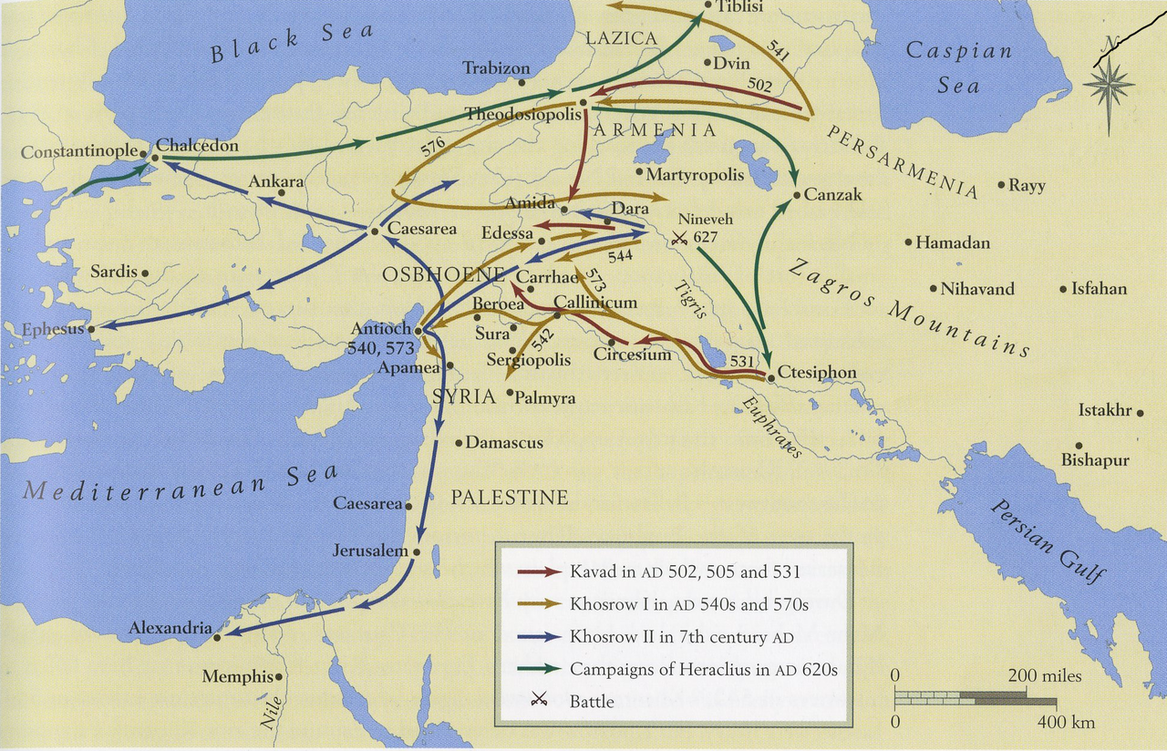
Pre-Islamic Arabia: Byzantine Empire vs Persian (Sasanian) Empire 540–629 AD

Slide 8
Major Battle between the army of the Byzantine Empire and the Muslim Arab forces of the Rashidun Caliphate.
Consisted of a series of engagements that lasted for six (6) days in August 636, near the Yarmouk River, along what today are the borders of Syria–Jordan and Syria–Israel.
Complete Muslim victory which ended Byzantine rule in Syria. One of the most decisive battles in military history.

Slide 9
It marked the first great wave of
Islamic conquests after the death of
prophet Muhammad,
heralding the rapid advance of Islam
into the then Christian Levant.

Slide 10
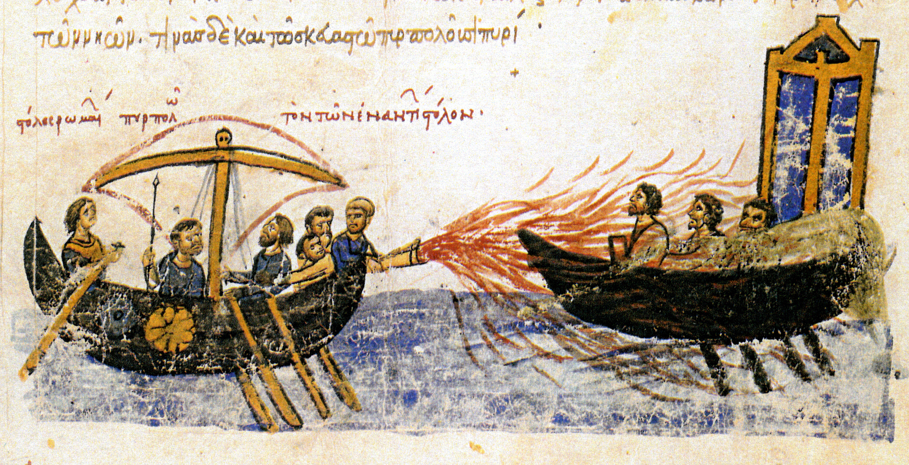
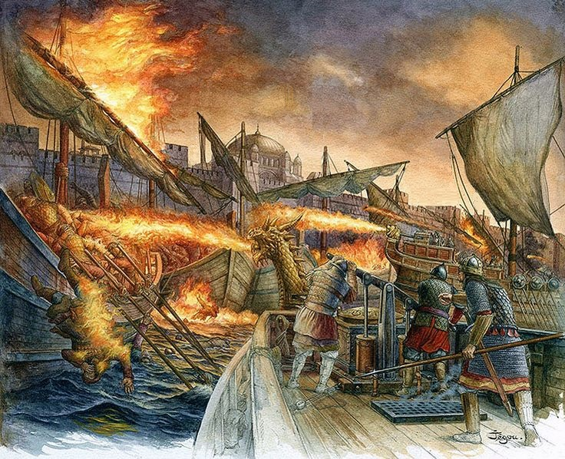
Umayyad dynasty 661-750 AD
674-678: 1st Arab Siege of Constantinople (Byzantine Emperor Constantine VI stops Arabs, consolidates a barrier)
717-718: 2nd Arab Siege of Constantinople (decisive victory of Emperor Leo III)
732: Battle of Poitiers (Charles Martel stops Arabs in France)

Slide 11
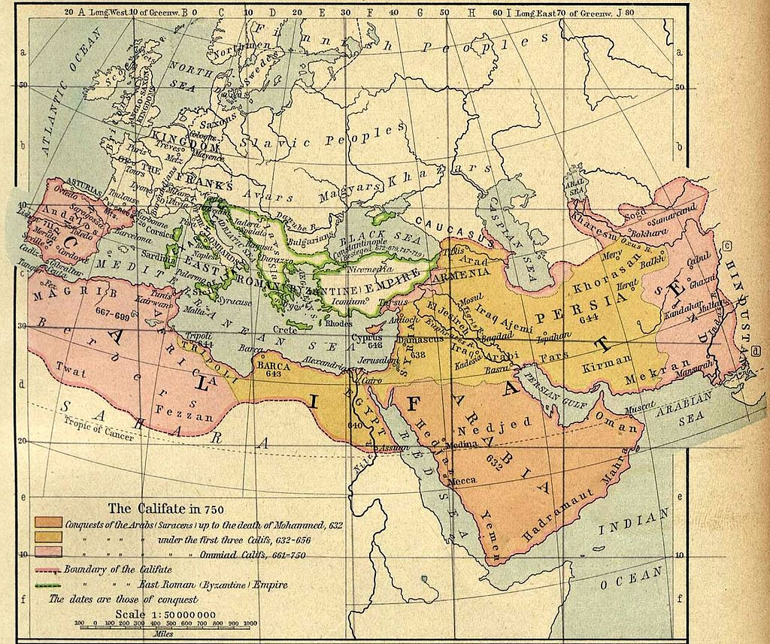
The Islamic Chalifate in 750 AD

Slide 12
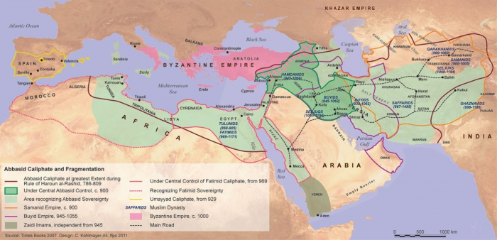
Loss of North Africa in late 8th century.

Slide 13
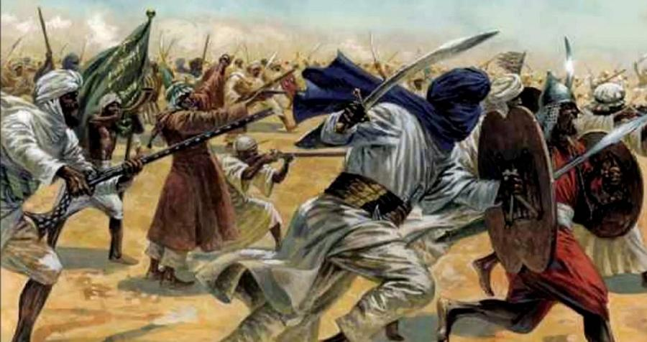
Jihad

Slide 14
Not a formal part of ritual;
But still integral component of Islamic doctrine
“striving in the path of God” in a threefold manner:
Individual’s inner struggle against sinful inclinations & the evil
A collective effort of the Ummah to promote “good” against the “evil”

Slide 15
Armed struggle against non-Muslims
for the purpose of expanding or defending Muslim lands,
both of the individual and of the Ummah.

Slide 16
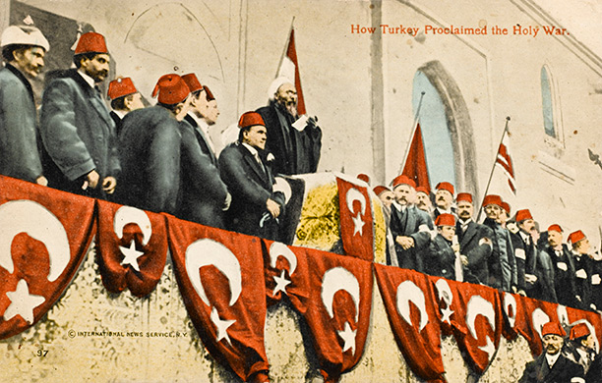
Jihad (Holy War) against Britain and France
is pronounced by the Ottoman Empire at the
Fatih Mosque, Constantinople, Nov. 14, 1914.

Slide 17
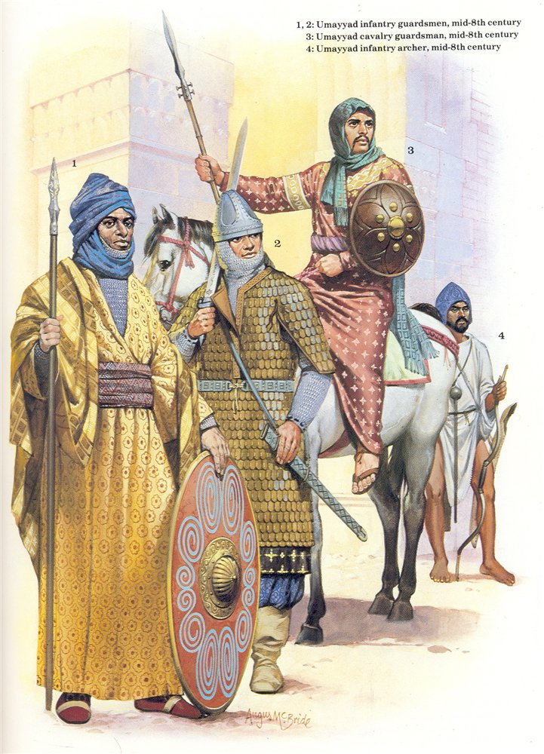

Slide 18
Durability of conquests: Heartlands of Christianity / Persia
Factors that facilitated it:
Monotheistic religions background
A degree of tolerance to non-Muslims [“People of the Book” - (dhimmis)]
Jews/Christians should be allowed to practice their religion
Manage their internal affairs
NOT equal to the Muslims though: must pay special poll tax (jizyah) –
not serving to the army – wearing certain colors –
not so large places of worship]

Slide 19
Mass conversions not encouraged, initially, since this would have led to
Loss of tax base
(exclusive Arab religion)

Slide 20
Islamic Sects: Sunni
“Sunni” is derived from “sunnah,” meaning tradition or custom.
Sunnis constitute the vast majority of Muslims in the world.
Sunni Muslims acknowledge the caliphs as those who are responsible for upholding the shar‛iah, and as those who are mortal beings with no divine powers.

Slide 21
Islamic Sects: Shi‛a

Slide 22
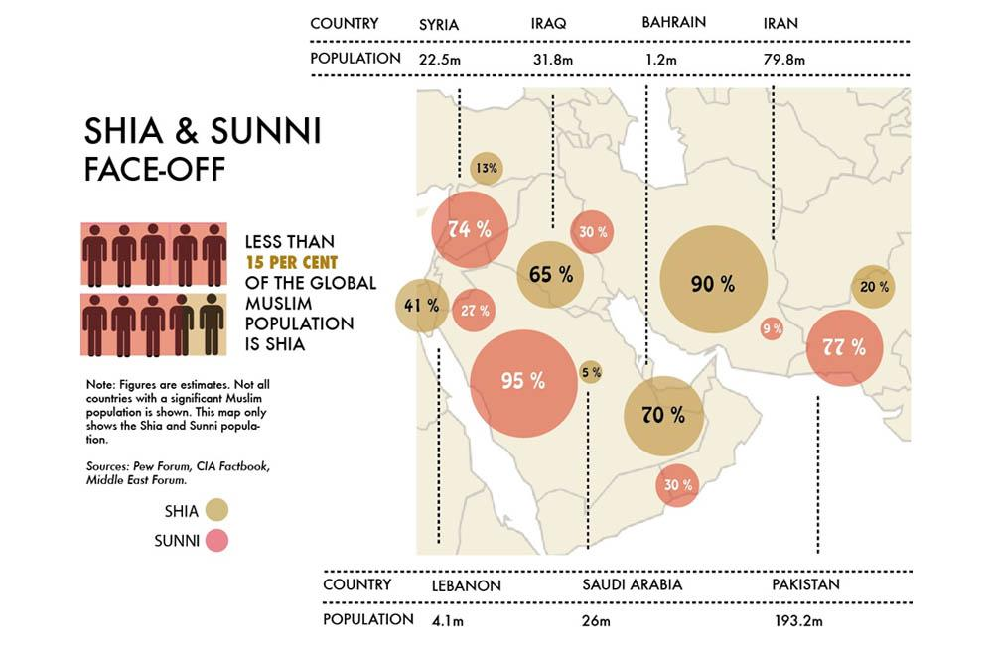

Slide 23
The Geopolitics of Islam
The world is divided into three “houses” (zones/territories)
Dar al Islam (Abode of Islam):
Dar al Harb (Abode of War):
Dar al Sulh / Ahd /Hunda (Territory/Abode of Treaty/Truce/Calm):

Slide 24
GEOPOLITICS OF ISLAM
Dar al Islam (Abode of Islam):
It is the Region of Muslim sovereignty, i.e.,
the part of the earth where Islamic law prevails

Slide 25
II Dar al Harb (Abode of War): Territories, whose leaders are called upon to convert to Islam.
Refers to territory that does not have treaty of non-aggression or peace with Muslims.
Jurists trace the concept to Muhammad, whose messages to the Persian, Abyssinian, and Byzantine emperors demanded that they choose between conversion and war.

Slide 26
When the leaders of Dar al-harb
accept Islam, the territory becomes
part of Dar al-Islam
where Islamic law prevails;
conversely, an Islamic territory taken by
non-Muslims becomes Dar al-harb when Islamic law is replaced.

Slide 27
III. Dar al Sulh / Ahd /Hunda
(Territory/Abode of Treaty/Truce/Calm):
Non-Muslim territory that has concluded
an armistice with a Muslim government,
agreeing to protect Muslims & their clients in that territory and often including
an agreement to pay tribute.

Slide 28
Note: The “division” is not definite,
Jihad /“Holy War”
might be the case between Dar al Islam &
Dar al Harb.

Slide 29
The Hanafi school of law holds that territory conquered by non-believers can remain Dar al-Islam as long as a Qadi administers Islamic laws & Muslims are protected. So, in theory all countries –where Muslims can practice their religion freely, are dar Al Islam; thus, no need for declaring Jihad.
However, the Islamic extremist movement
as it has emerged does NOT adhere to the above- mentioned approach.

Slide 30
Middle East: 11th to 15th c. AD: Seljuk Turks
11th & 12th c.: Seljuk expansion invigorated existing Islamic institutions and revitalized Sunni Islam (Nizam al-Mulk: founded the mandrasah system)
1055: Dominated Iran – controlled Baghdad
1071: Battle of the Manzikert (permanent Turkish presence in Asia Minor – gradual transformation of the region to a Muslim, Turkish speaking one)

Slide 31
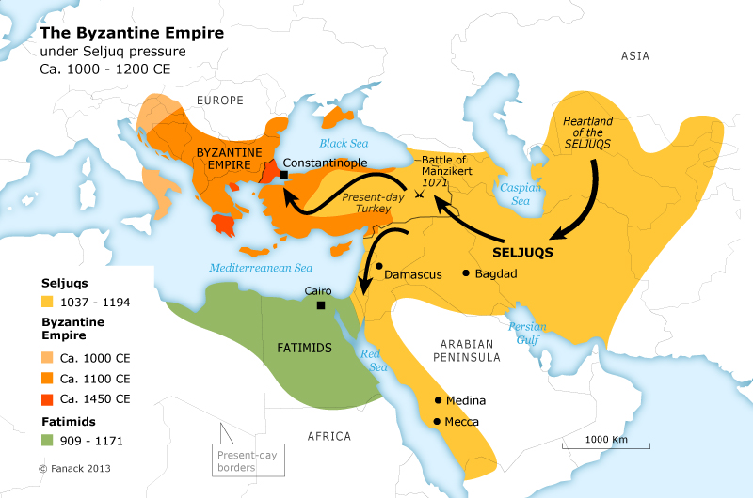

Slide 32
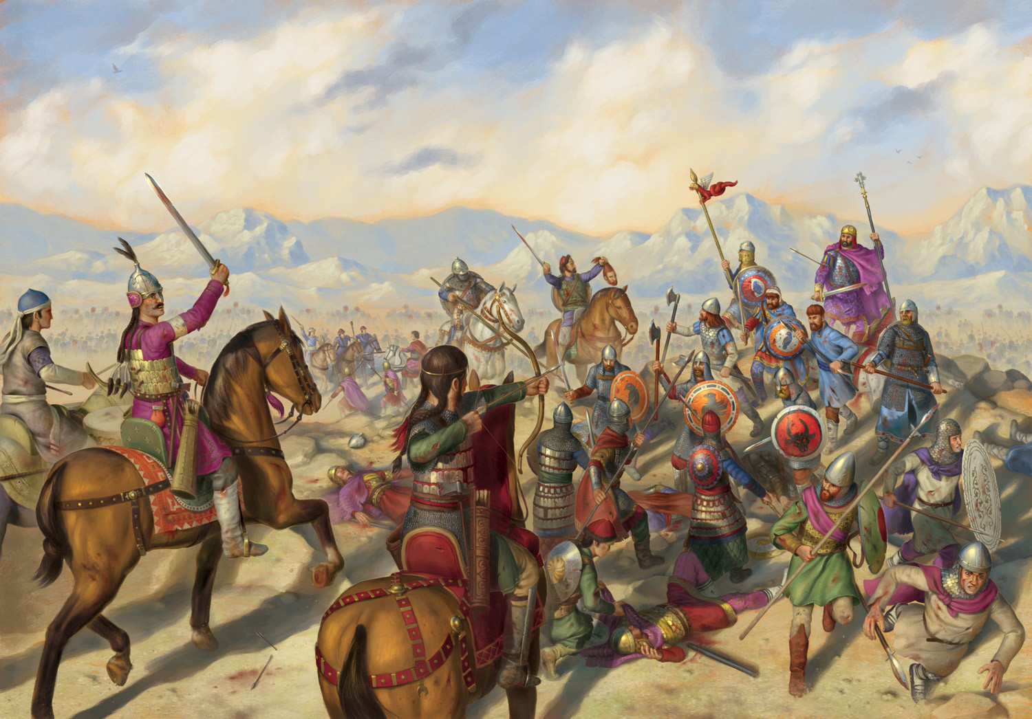
1071 AD: Decisive Battle of the Manzikert (Armenia): Greek Emperor Rhomanos IV Diogenes defeated by Seljuk-Turkish Sultan Alp-Arslan. The beginning of the end of the Greek-Christian presence and civilization in Asia Minor (today’s Turkish Anatolia)

Slide 33
Middle East: 11th to 15th Centuries: The Crusades

Slide 34
Middle East: 11th to 15th Centuries: The Crusades
Most devastating calamity for
Byzantine Empire
& Eastern Christendom;
(First) Fall of Constantinople, April 1204

Slide 35
Salah ad-Din Yusuf (1137–1193 AD)
Arabic in full Ṣalāḥ al-Dīn Yūsuf ibn Ayyūb (Righteousness of the Faith, Joseph, Son of Job), a.k.a. al-Malik al-Nāṣir Ṣalāḥ al-Dīn Yūsuf I
Greatest Muslim warrior king: born into a prominent Kurdish family 1137/38 Tikrit, Mesopotamia; died 1193 in Damascus. Sultan of Egypt, Syria, Yemen, and Palestine, founder of the Ayyubid dynasty. Wars against the Crusaders; his capture of Jerusalem (1187) ended its nearly 9 decades occupation by Franks

Slide 36
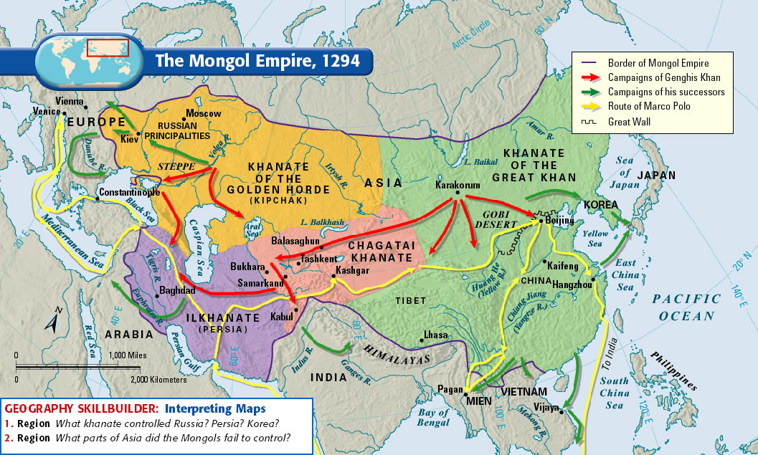
Middle East: 11th to 15th Centuries: The Mongols
13th c.: Mongol invasions brought nothing but destruction, but did not succeed in destroying Islamic order in the Middle East
1258: Hulagu Khan (son of Genghis Khan) sacked Baghdad and killed the Abbasid caliph – Ending the Abbasid Caliphate

Slide 37
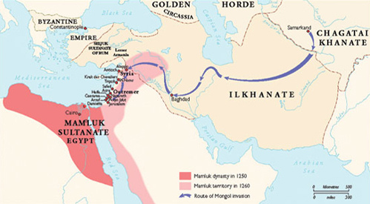
The Mamluks & Tatars’ invasions (Tamerlane)
1381–1402: Tamerlane’s hordes devastates Iran – Asia Minor
14th-15th c.: Mamluks (Turkish tribe, Cairo-based sultanate) defeated the Mongols (1260);
Masters of Syria – Rulers of Egypt until 1517
Battle of Ankara 1402

Slide 38
Ottoman Turkish Sultan Bayezid I Yildirim [=Thunderbold] (1360-1403), after the battle of Ankara (1402), defeated and captured by Tamerlane

Slide 39
Concluding Remarks
Consolidation process of the Arab empires partly allowed local customs to continue; however, total predominance of Islam in state and society
Moral imperatives of Quran were elaborated and formed core of the Shari ‘ah, sacred legal system of everyday activities
The ulama were overseeing enforcement of the Shari ‘ah transmitting the norms of the Islamic society

Slide 40
The Mongol invasions were a shock to Islamic order reinvigorated by the Seljuk Turks
but did not achieve to destroy it
Out of the chaos of the 14th –15th c. emergence of three substantial Islamic empires (Ottoman-Turkish, Safavid, Mughal) in the region from Asia Minor to India, that re-invigorated Islam and launched it to a new era of expansion.

